Slide 1



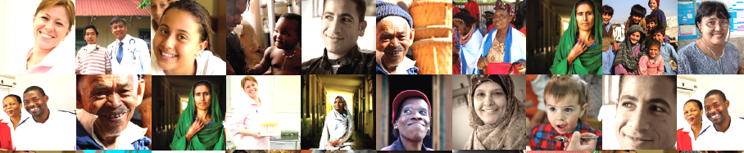

The End TB Strategy
Strengthening, Expanding and Innovating the Global TB Response
Muhammad Akhtar
October 2017

Slide 2
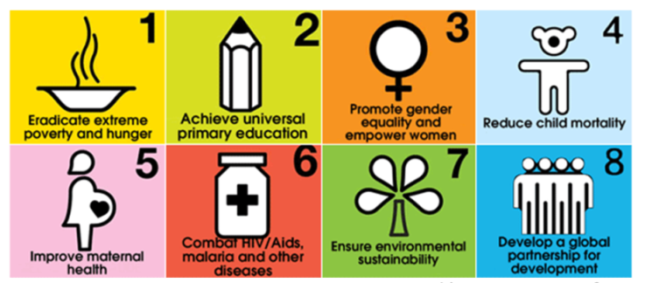
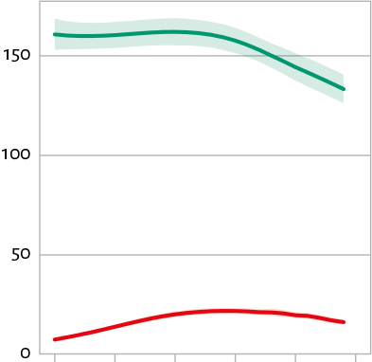
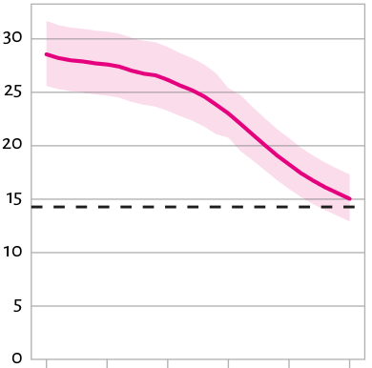
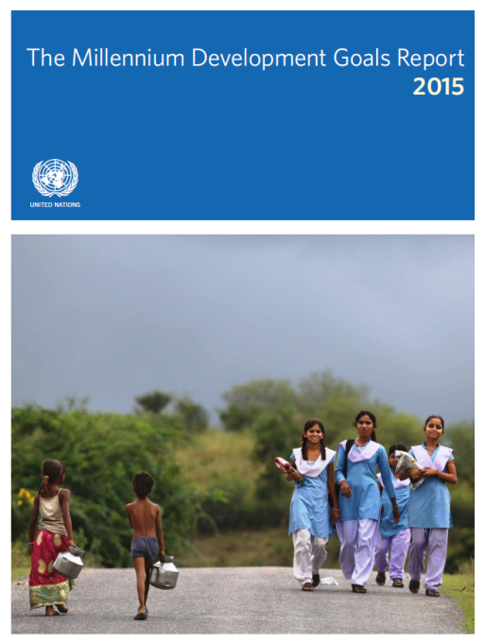
The MDG era is over
MDG6 TB target achieved
REVERSED
47% DROP IN TB MORTALITY
TB EPIDEMIC
Incidence
Mortality
Rate per 100,000 population
Falling 1.5% per year (2000-2014).
18% drop since 2000
Target
47% decline since 1990
1990 2000 2014
1990 2000 2014
43 million lives saved between 2000 and 2014

Slide 3
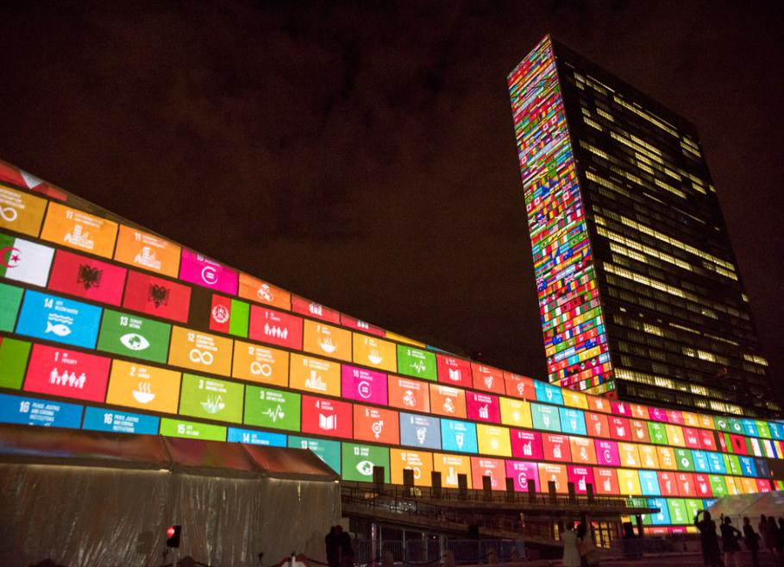
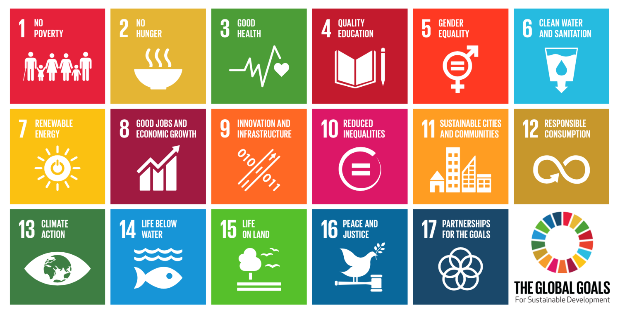
A new era with new ambitions
and a paradigm shift
UN Sustainable Development Goals: 2016 – 2030
17 goals and 169 targets

Slide 4










13 targets by 2030
3.1 Reduce
Maternal
mortality
3.2 Reduce
child and
neonatal mortality
3.3 End the epidemics of AIDS, tuberculosis, malaria
& neglected tropical
diseases and combat
hepatitis, water-borne
and other communicable diseases
3.4 Reduce
mortality due to NCD and improve mental health
3.5 Strengthen
Prevention and treatment of substance abuse (narcotics, alcohol)
3.6 Reduce
Mortality
due to road
traffic
injuries
3.7 Universal
access to sexual and
reproductive health-care services
3.8 Achieve
universal
health coverage
3.9 Reduce
deaths and
illness
due to pollution
and contamination
3.a Strengthen implementation FCTC (tobacco)
3.b Access to affordable essential medicines and technologies
3.c Increased health financing and health workforce in developing countries
3.d Enhance capacity for early warning, risk reduction and management of national and global health risks

Slide 5






Moving from halting TB to ending TB by 2030
Global commitment to End TB
SDG Target 3.3 – BY 2030
end the TB epidemic

Slide 6
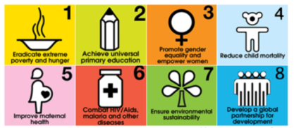

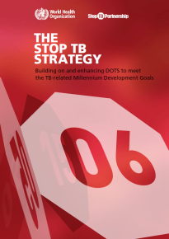
Changing the paradigm
MDG era
SDG era
From “stopping TB” to “ending TB” and ultimately eliminating it;
Translating quest for equity and social justice, UHC and social protection into access to high quality services without incurring catastrophic costs;
Placing at the centre all people vulnerable to, or affected by, TB;
Rapid introduction of innovations such as new tools, policies and systems;
“All of society” approach not just “all of government”

Slide 7
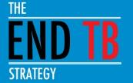
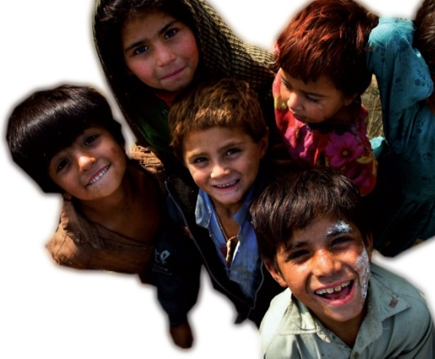
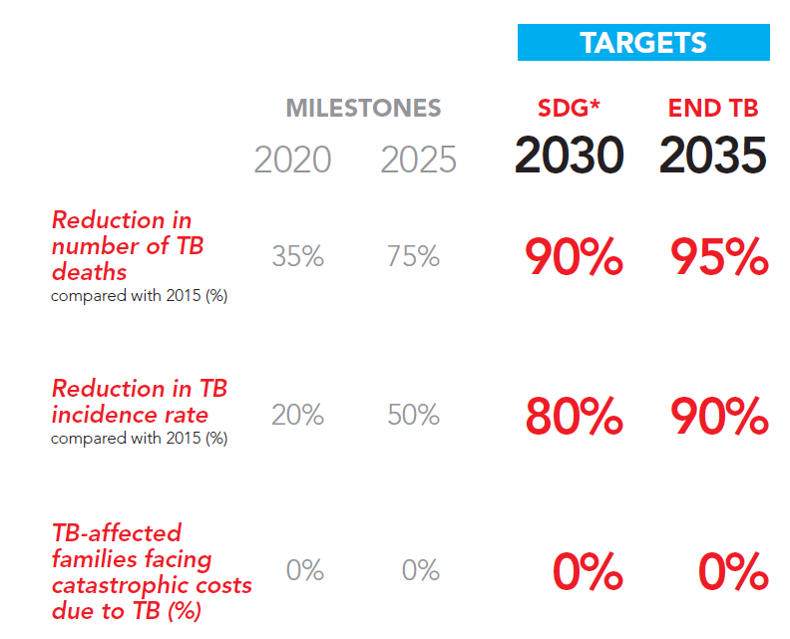
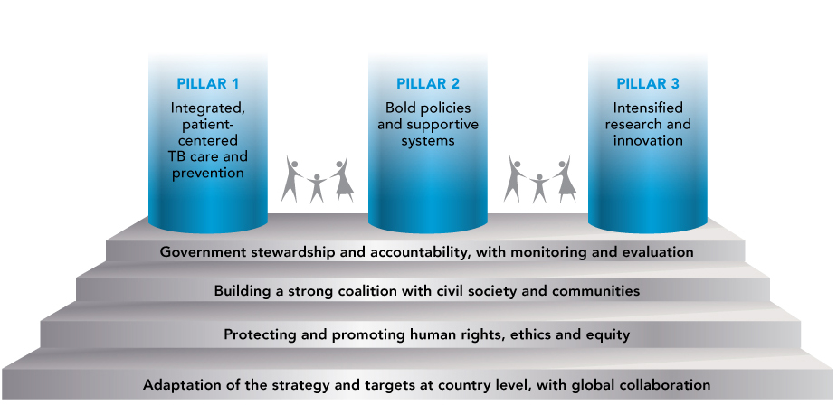
The End TB Strategy:
Vision, Targets and Pillars
Vision:
A world free of TB
Zero TB deaths, Zero TB disease, and Zero TB suffering
Goal:
End the Global TB epidemic

Slide 8
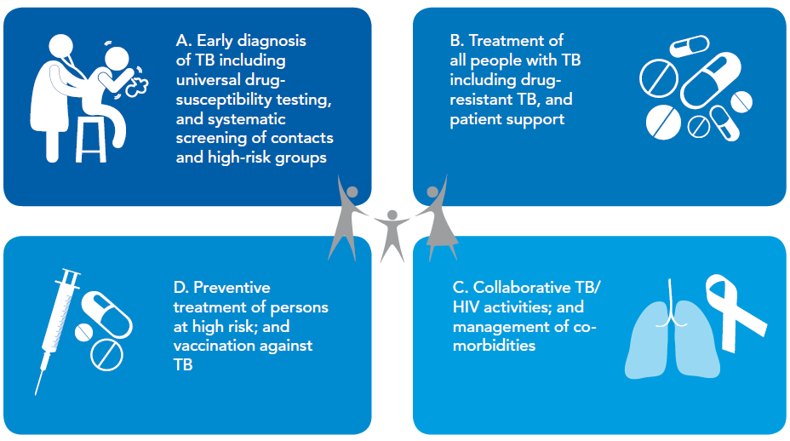
PILLAR 1: INTEGRATED, PATIENT-CENTRED CARE AND PREVENTION

Slide 9
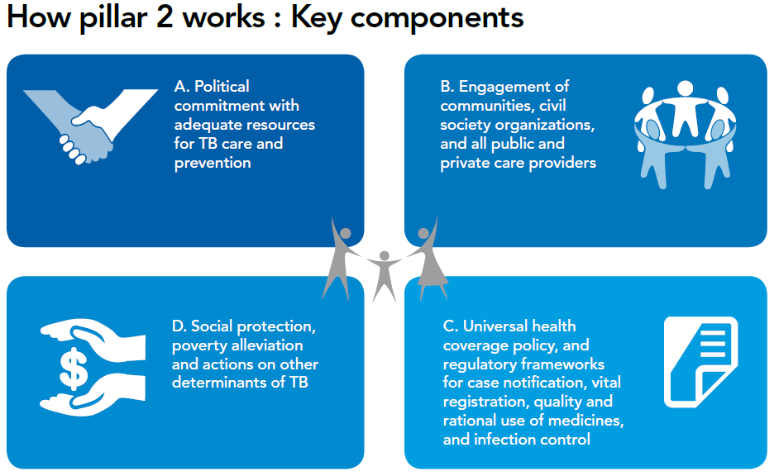
PILLAR 2: BOLD POLICIES AND SUPPORTIVE SYSTEMS

Slide 10
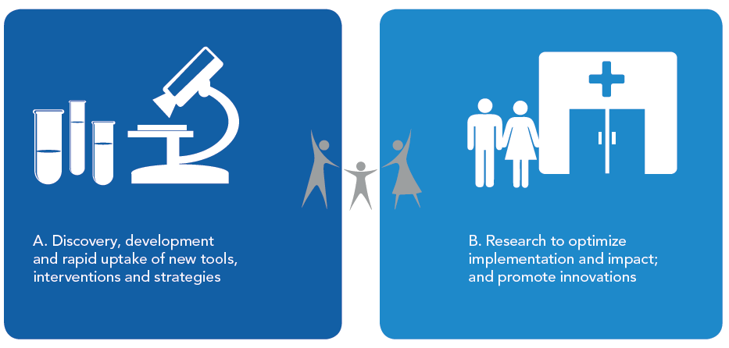
PILLAR 3: INTENSIFIED RESEARCH AND INNOVATION

Slide 11
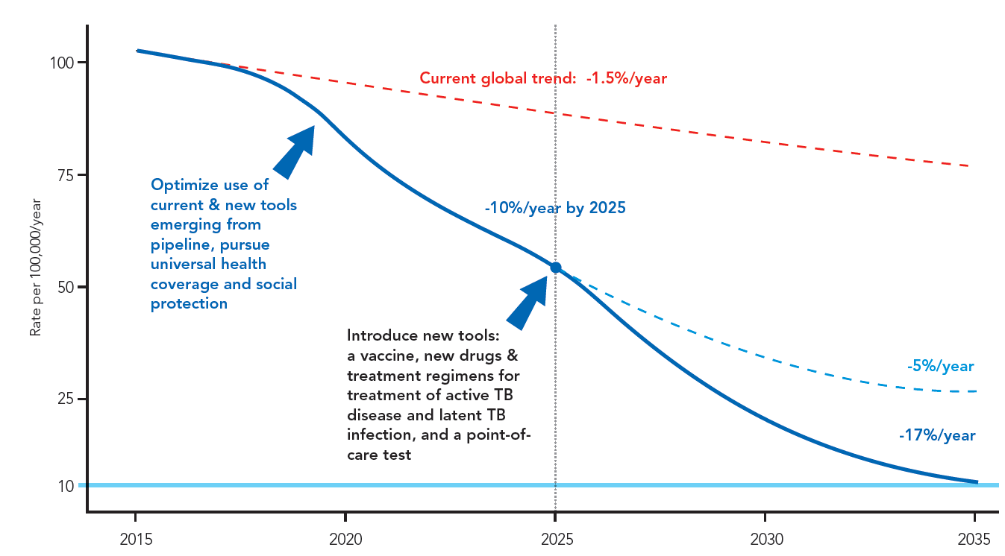



Innovations and Research are critical to break the trajectory of the TB epidemic
Better diagnostics, including new point-of care tests;
Safer, easier and shorter treatment regimens;
Safer and more effective treatment for latent TB infection;
Effective pre- and post-exposure vaccines.

Slide 12
Strengthen, Expand and Innovate to End TB
PRIORITY ACTIONS TO END TB
REACH THE 3.6 MILLION MISSED CASES
ADDRESS THE MDR-TB CRISIS
ACCELERATE RESPONSE TO THE TB/HIV CO-EPIDEMIC
ELIMINATE CATASTROPHIC COSTS
INTENSIFY TB RESEARCH AND UPTAKE
CLOSE FINANCING GAPS
COMMITMENT AND FINANCING
CHANGE IN MINDSET AT ALL LEVELS
MULTI-STAKEHOLDER ENGAGEMENT
Multi-disciplinary approaches
ATTENTION TO INNOVATION

Slide 13


Implementing the End TB Strategy
THE ESSENTIALS aims to guide actions at national level to adapt, launch and implement the World Health Organization’s End TB Strategy.
It calls for major transformations in the way we all work to better support those affected and to end the epidemic.
Global Action Framework
on TB research

Slide 14


Monitoring Progress – The Top Ten Indicators (1)
 | Indicator | Recommended target | Main rationale for inclusion in top-ten
1 | TB treatment coverage Number of new and relapse cases that were notified and treated, divided by the estimated number of incident TB cases in the same year, expressed as a percentage | ≥90% | High-quality TB care is essential to prevent suffering and death from TB and to cut transmission. High coverage of appropriate treatment is a fundamental requirement for achieving the milestones and targets of the End TB Strategy. In combination, it is likely that these two indicators will be used for monitoring progress towards universal health coverage (UHC) within the post-2015 Sustainable Development Goals (SDGs).
2 | TB treatment success rate Percentage of notified TB patients who were successfully treated. The target is for drug-susceptible and drug-resistant TB combined, although outcomes should also be reported separately. | ≥90%
3 | Percentage of TB-affected households that experience catastrophic costs due to TB Number of people treated for TB (and their households) who incur catastrophic costs (direct and indirect combined), divided by the total number of people treated for TB. | 0% | One of the End TB Strategy’s three high-level indicators; key marker of financial risk protection and progress towards UHC and social protection for TB-affected households.
4 | Percentage of newly notified TB patients diagnosed using WHO-recommended rapid tests Number of newly notified TB patients diagnosed with WHO-recommended rapid tests, divided by the total number of newly notified TB patient. | ≥90% | Accurate diagnosis is a fundamental component of TB care. Rapid tests help to ensure early detection and prompt treatment.
5 | LTBI treatment coverage Sum of the number of people living with HIV newly enrolled in HIV care and the number of children who are contacts of cases started on LTBI treatment, divided by the number eligible for treatment, expressed as a percentage | ≥90% | Treatment for latent TB infection (LTBI) is the main treatment intervention available to prevent development of active TB disease in those already infected with M. tuberculosis.
Notes:
The 10% per year fall in incidence that is needed by 2025 has been previously achieved only within the wider context of UHC and broader social and economic development. UHC means providing all people with access to needed services of sufficient quality to be effective, without their use imposing financial hardship. Progress in the countries with the highest burden today, such as China, India, Indonesia, Nigeria and South Africa will strongly influence whether targets can be achieved or not. To lower cases to 10 per 100,0000 population by 2035 ("end the global TB epidemic") and achieve a 95% reduction in TB deaths by 2035 will need a technological breakthrough by 2025 that will allow an unprecedented acceleration in the rate at which TB incidence falls between 2025 and 2035. This will only happen with substantial investment in R&D in the years up to 2025, so that new tools such as a post-exposure vaccine or a short, efficacious and safe treatment for latent infection that could substantially lower the risk of developing TB among the approximately 2 billion people that are already infected, are developed.

Slide 15
Monitoring Progress – The Top Ten Indicators (2)
 | Indicator | Recommended target | Main rationale for inclusion in top-ten
6 | Contact investigation coverage Number of contacts of people with bacteriologically-confirmed TB who were investigated for TB divided by the number eligible, expressed as a percentage | ≥90% | Contact investigation is a key component of early TB detection and TB prevention, especially in children.
7 | DST coverage for TB patients Number of TB patients with DST results divided by the number of bacteriologically confirmed cases in the same year, expressed as a percentage. DST coverage includes results from molecular (e.g. Xpert MTB/RIF) as well as conventional phenotypic DST results. | 100% | Drug susceptibility testing (DST) is essential to provide the right treatment for every person diagnosed with TB.
8 | Treatment coverage, new TB drugs Number of TB patients treated with regimens that include new TB drugs, divided by the number of notified patients eligible for treatment with new TB drugs, expressed as a percentage | ≥90% | An indicator that is relevant to monitoring the adoption of innovations in all countries. NB. Indicators related to the development of new tools are needed at global level but are not appropriate for monitoring progress in all countries.
9 | Documentation of HIV status among TB patients Number of new and relapse TB patients with documented HIV status divided by the number of new and relapse TB patients notified in the same year, expressed as a percentage | 100% | One of the core global indicators used to monitor collaborative TB/HIV activities. Documentation of HIV status is essential to provide the best care for HIV-positive TB patients, including anti-retroviral treatment (ART)
10 | Case fatality ratio (CFR) Number of TB deaths (from a national VR system)divided by estimated number of incident cases in the same years, expressed as a percentage | ≤5% | This is a key indicator for monitoring progress towards 2020 and 2025 milestones. A CFR of 6% is required to achieve the 2025 global milestone for reductions in TB deaths and cases.
Notes:
The 10% per year fall in incidence that is needed by 2025 has been previously achieved only within the wider context of UHC and broader social and economic development. UHC means providing all people with access to needed services of sufficient quality to be effective, without their use imposing financial hardship. Progress in the countries with the highest burden today, such as China, India, Indonesia, Nigeria and South Africa will strongly influence whether targets can be achieved or not. To lower cases to 10 per 100,0000 population by 2035 ("end the global TB epidemic") and achieve a 95% reduction in TB deaths by 2035 will need a technological breakthrough by 2025 that will allow an unprecedented acceleration in the rate at which TB incidence falls between 2025 and 2035. This will only happen with substantial investment in R&D in the years up to 2025, so that new tools such as a post-exposure vaccine or a short, efficacious and safe treatment for latent infection that could substantially lower the risk of developing TB among the approximately 2 billion people that are already infected, are developed.

Slide 16
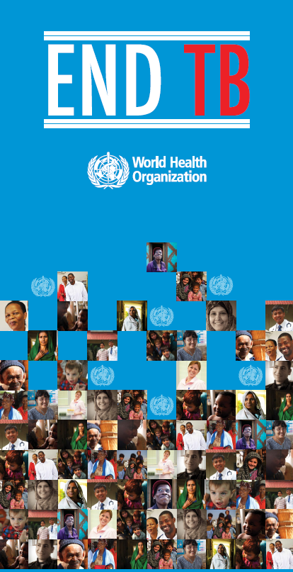
Let us
UNITE TO
END TB

Slide 17

Global Burden of TB
Estimated number
of cases
Estimated number
of deaths
10.4 million
142 cases per 100,000
  1 million children
  3.5 million women
  5.9 million men
1.4 million*
170,000 in children
350,000 in women
860,000 in men
All forms of TB
HIV-associated TB
1.2 million (11%)
400,000
MDR/RR-TB
580,000
250,000
Source: WHO Global TB Report 2016 * excluding deaths attributed to HIV/TB

Slide 18
Regional Burden of TB: SEAR
Estimated number
of cases
Estimated number
of deaths
4.7 million
246 cases per 100,00
  1.7 million women
  3 million men
0.7 million*
All forms of TB
HIV-associated TB
227,000
74,000
MDR-/RR- TB
200,000
Source: WHO Global TB Report 2016 * excluding deaths attributed to HIV/TB

Slide 19
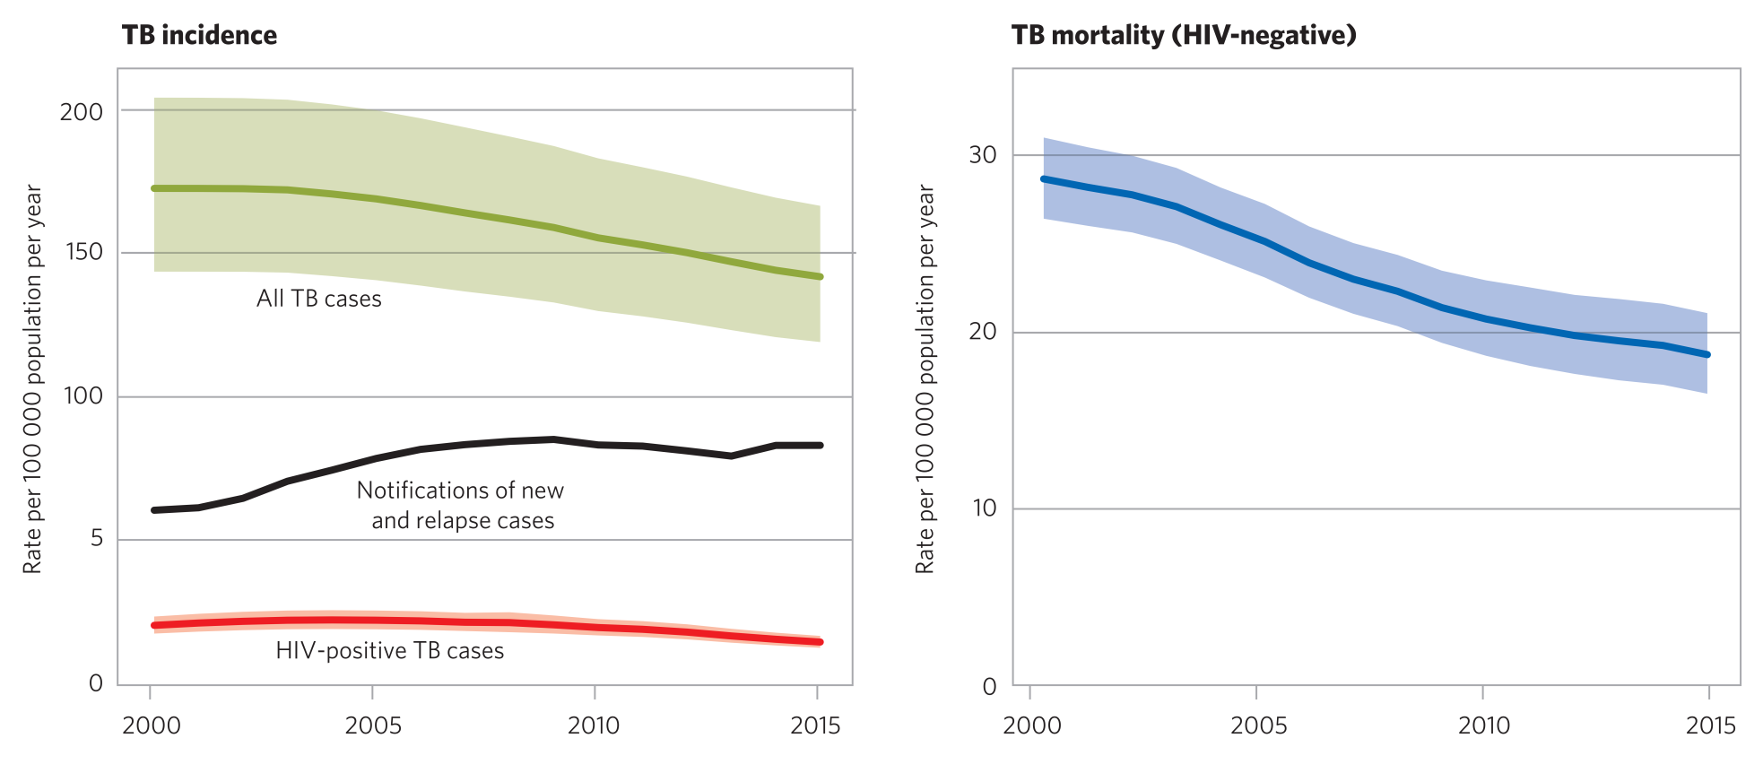
The global TB situation (2)
TB incidence and mortality, 2000-2015
Notes:
Global TB incidence and mortality rates have been falling for the last decade in all six WHO regions (estimates of TB deaths among HIV-positive people are also on the decline). The rate of decrease in incidence rate (at 1.4% per year between 2000 and 2015) remains far too low to achieve the TB elimination threshold by 2050.

Slide 20
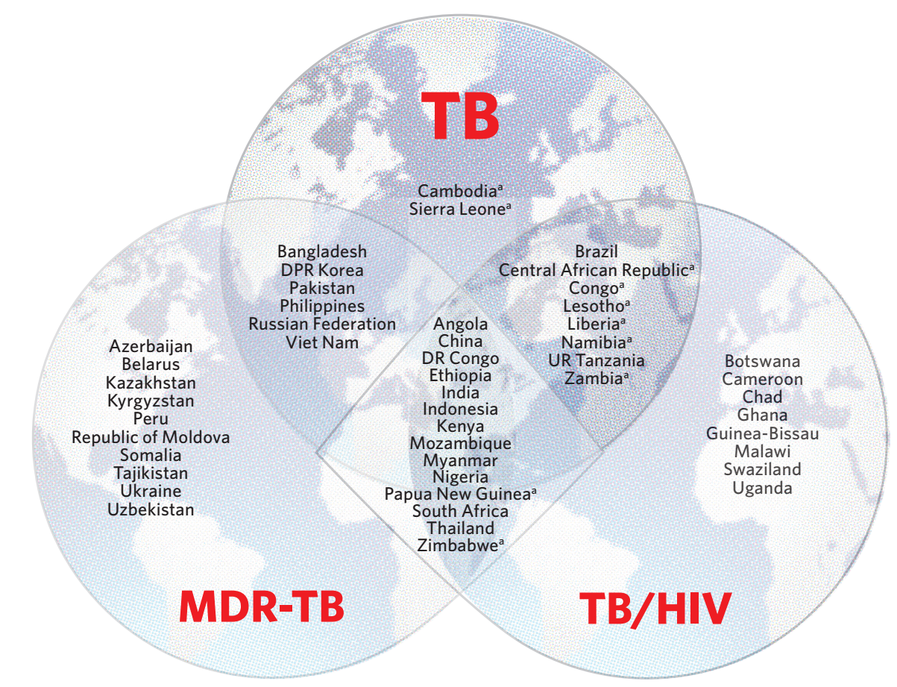

30 High MDR-TB burden countries
Notes:
30 countries concentrate about 90% of the global disease burden of MDR/RR-TB. These countries are defined as the top 20 countries in terms of estimated numbers of incident MDR-TB and the top 10 by estimated MDR-TB incidence rate per population in 2014 (above a threshold of 1,000 estimated incident MDR-TB cases that year)

Slide 21
MDR-TB in SEAR
Estimates
  Newly detected cases - 2.6%, (range: 2.3–3.0%).
  Retreatment cases - 17% (range 15–19%)
However, given the large number of TB cases in the SEA Region, this translates to a total of 110 000 estimated MDR-/RR-TB cases among notified pulmonary TB in 2015
Six of the 30 high MDR-TB-burden countries are in the SEA Region: Bangladesh, Democratic People’s Republic of Korea, India, Indonesia, Myanmar and Thailand.
Source: WHO Global Tuberculosis Report 2016

Slide 22
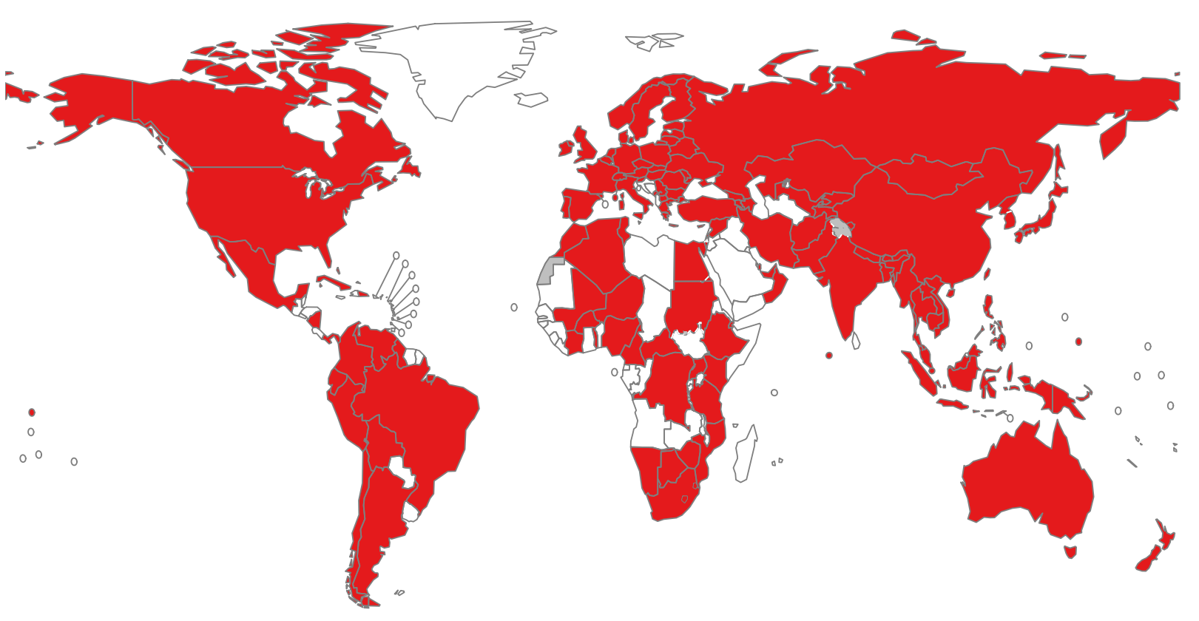
Countries ever notifying an XDR−TB case
The boundaries and names shown and the designations used on this map do not imply the expression of any opinion whatsoever on the part of the World Health Organization concerning the legal status of any country, territory, city or area or of its authorities, or concerning the delimitation of its frontiers or boundaries. Dotted lines on maps represent approximate border lines for which there may not yet be full agreement.
© WHO 2016. All rights reserved
Notes:
By October 2016, extensively drug-resistant TB (XDR-TB) had been reported by 118 WHO Member States. About 51% have resistance to a fluoroquinolone or a second-line injectable agent or both (XDR-TB). Overall, 9.5% (95% CI: 7.0–12.1%) of MDR-TB cases have XDR-TB. In some countries the proportion of cases with strains resistant to second-line drugs is much higher than the global average.

Slide 23






16 - 17 NOVEMBER 2017, MOSCOW, RUSSIAN FEDERATION
OVERVIEW PRESENTATION

Slide 24
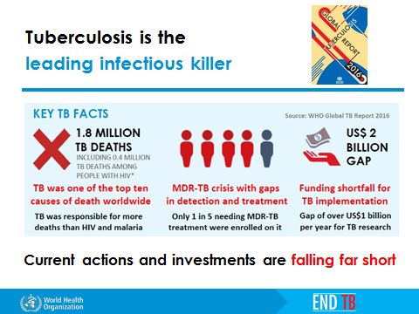

Slide 25






FIRST WHO GLOBAL MINISTERIAL CONFERENCE
ENDING TB IN THE SUSTAINABLE DEVELOPMENT ERA: A MULTISECTORAL RESPONSE
Conference Vision
The WHO Global Ministerial Conference “Ending TB in the Sustainable Development Era: A Multisectoral Response” aims to accelerate implementation of the WHO End TB Strategy - with immediate action addressing gaps in access to care and the MDR- TB crisis - in order to reach the End TB targets set by the World Health Assembly and the United Nations (UN) Sustainable Development Goals (SDGs) through national
and global commitments, deliverables and accountability. The Ministerial Conference
will inform the UN General Assembly High-Level Meeting on TB in 2018.

Slide 26


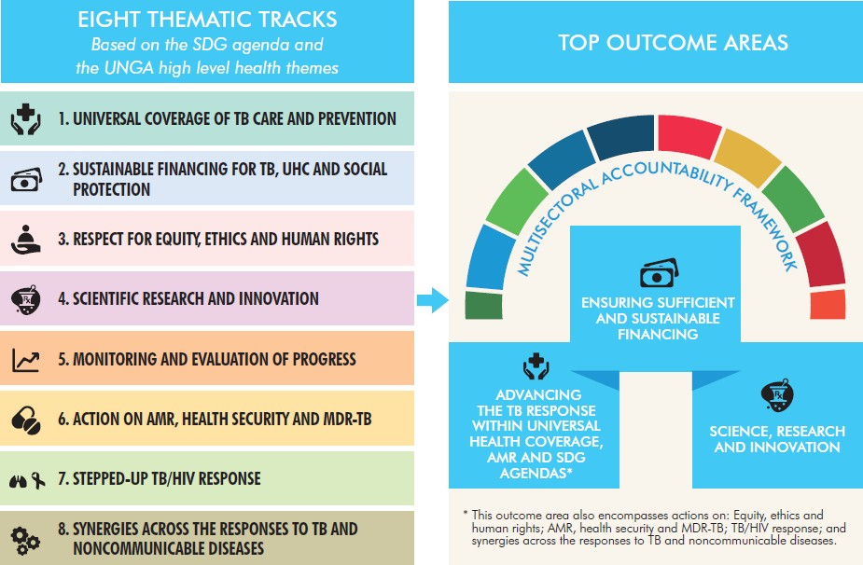
FIRST WHO GLOBAL MINISTERIAL CONFERENCE
ENDING TB IN THE SUSTAINABLE DEVELOPMENT ERA: A MULTISECTORAL RESPONSE
Top outcome areas and thematic tracks

Slide 27



FIRST WHO GLOBAL MINISTERIAL CONFERENCE
ENDING TB IN THE SUSTAINABLE DEVELOPMENT ERA: A MULTISECTORAL RESPONSE
All 194 Member States invited (Ministers of Health and other Ministers)
List of Member States for which travel support is available
40 TB and MDR-TB highest burden countries, according to the WHO Global Tuberculosis Report 2016, will be supported by WHO headquarters with financing provided by the Russian Federation
18 additional priority countries identified by the WHO regional offices will be supported with financing of regional offices
WHO WILL COVER TRAVEL EXPENSES OF TWO HIGH-LEVEL REPRESENTATIVES FROM EACH MEMBER STATE LISTED BELOW
AFR
Angola
Central African Republic Congo
DR Congo Ethiopia Kenya Lesotho Liberia Mozambique Namibia Nigeria
Sierra Leone South Africa UR Tanzania Zambia Zimbabwe Guinea* Swaziland* Uganda*
EUR
Azerbaijan Belarus
Kazakhstan
Kyrgyzstan
Republic of Moldova Russian Federation Tajikistan
Ukraine Uzbekistan Armenia* Georgia*
SEAR
Bangladesh DPR Korea
India Indonesia Myanmar Thailand Bhutan* Maldives* Nepal*
Sri Lanka* Timor-Leste*
WPR
Cambodia China
Philippines Viet Nam
Papua New Guinea Mongolia*
Lao PDR*
AMR
Brazil Peru Bolivia*
Colombia* Mexico* Haiti*
EMR
Pakistan Somalia Afghanistan * Egypt *
* Supported by WHO regional office

Slide 28
FIRST WHO GLOBAL MINISTERIAL CONFERENCE
ENDING TB IN THE SUSTAINABLE DEVELOPMENT ERA: A MULTISECTORAL RESPONSE
All partners invited
UN organizations
Multilateral agencies
Bilateral agencies
International development agencies
Regional bodies
Partnerships
Nongovernmental organizations; faith-based organizations
Civil society representatives; affected people and communities
Professional societies
Academic and research institutions
Philanthropic foundations
Private sector entities
Bilateral discussions and consultations with all key partners
Partners Group Consultation held on 21 May 2017

Slide 29

Decision by the
UN General Assembly for
a High-Level Meeting on TB in 2018
High Level Meeting on TB
UNITED NATIONS GENERAL ASSEMBLY RESOLUTION A/RES/71/159 - 15 DECEMBER 2016
Global health and foreign policy: Health Employment and Economic Growth
The General Assembly, (...)
Takes note of the initiative to hold, in Moscow in November 2017, a global ministerial conference on the fight against tuberculosis in the context of public health and the Sustainable Development Goals;
Decides to hold a high-level meeting in 2018 on the fight against tuberculosis, and requests the Secretary-General, in close collaboration with the Director-General of the World Health Organization and in consultation with Member States, as appropriate, to propose options and modalities for the conduct of such a meeting, including potential deliverables, building on existing efforts in this regard;
(...)

Slide 30

THANK YOU

