Slide 1
CLINICAL EXPERIENCE OF NSCLC in RSDM
Ana Rima

Slide 2
PENDAHULUAN
Penyebab utama kematian akibat kanker
Kanker Paru
Terdiagnosis pada stadium lanjut

Slide 3
Pembagian pasien kanker paru berdasarkan stadium di bangsal paru RSDM
Th 2014 terdiagnosis 118 px;
;Th 2015 terdiagnosis 211 px
Hesti, RSDM 2016

Slide 4
Keterlambatan diagnosis
Pasien : gejala tdk khas
Dokter
Sistem
1 Jan 2014 – 31 Des 2015:
Dari 275 px Ca paru, 28,7%
nya misdiagnosis sbg TB
Dimana 73,4%nya ditx > 1bl
Risiko tinggi
- Laki-laki
- Lebih dari 40 th
- Perokok
- Paparan industri tertentu
- Perempuan perokok pasif
- Anggota keluarga dekat
terkena kanker paru

Slide 5
Jenis kelamin (data 2015, n= 211)
Hesti, RSDM 2016

Slide 6
Umur ( data 2015, n= 211)
94% berusia lebih dari 40 th
Hesti, RSDM 2016

Slide 7
Merokok ( data 2015, n= 211)
Hesti, RSDM 2016

Slide 8
Skala karnofski (data 2015, n= 211)
Hesti, RSDM 2016

Slide 9
Komplikasi (data 2015, n= 211)

Slide 10
KANKER PARU
Karsinoid
/neuroendokrin
KPKBSK
KPKSK
85 %
10-15 %
5 %
Ca sel skuamous
RSDM ( data 2015, n= 211)
Adeno Ca, 40%
Mutasi (++)
Ca sel besar

Slide 11
Penatalaksanaan NSCLC
STAGE I-II
SURGERY
CHEMO/RADIO ADJUVANT
STAGE III.A
CHEMO/RADIO NEOADJUVANT
SURGERY
STAGE III.B-IV
CHEMOTHERAPY
RADIOTHERAPY
NEW TARGETED THERAPY

Slide 12
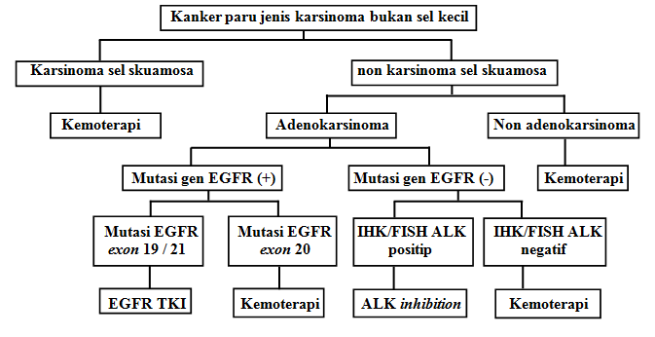
Diagram pilihan terapi KPKBSK berdasar jenis sel kanker dan perubahan biologi molekuler
(PDPI. Kanker paru (KPKBSK). 2016)

Slide 13
Anti-Cancer Systemic Therapy
Chemotherapy
  “Traditional” drugs
  Acts on components of cell:
    Tubulin (mitotic spindles)
    DNA
    Protein synthesis
newTargeted agents
  Newer drugs
  Act on processes that drives cancer cells:
    Oncogenes
    Overexpressed enzymes
    Overexpressed receptors

Slide 14
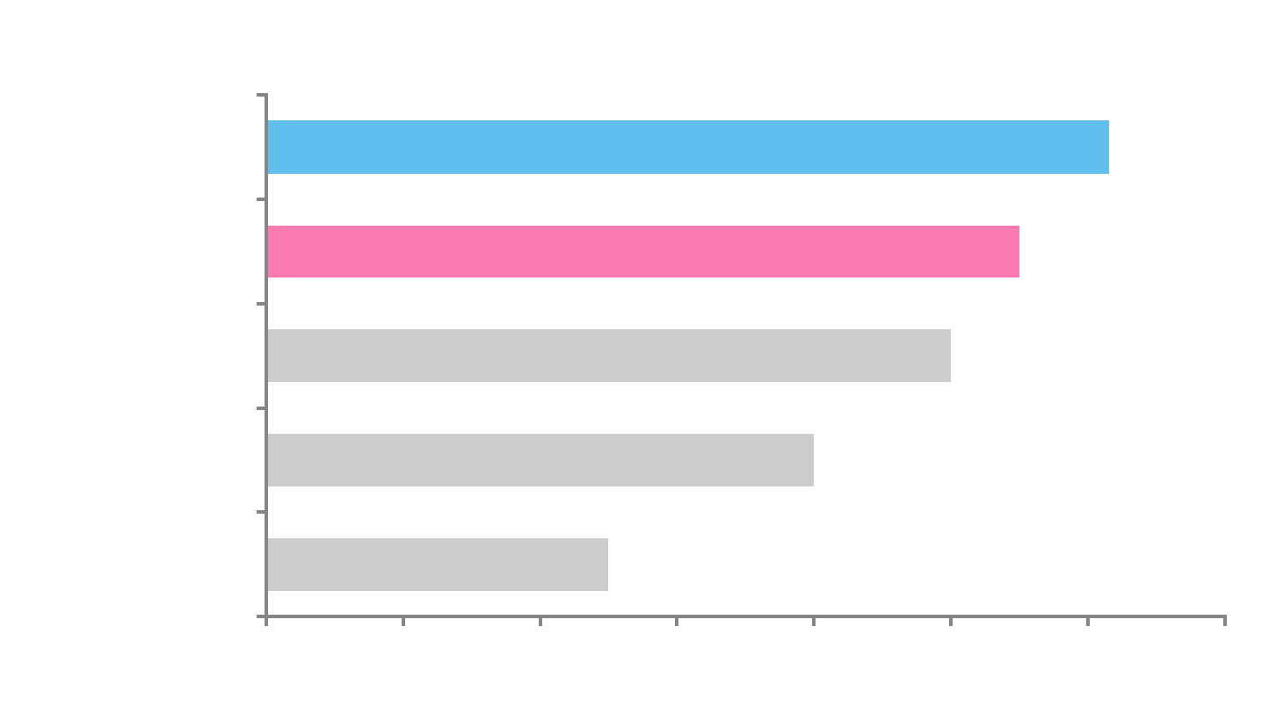
Contemporary treatment regimens extend survival beyond 1 year
2000s (E4599)*
Carboplatin + paclitaxel + bevacizumab: 12.3 months⁶
2000s (JMDB)*
Cisplatin + pemetrexed: 11.0 months^{4,5}
1990s‡
Platinum doublets: 8–10 months³
1980s‡
Single-agent platinum: 6–8 months²
1970s‡
BSC: 2–5 months¹
0
2
4
6
8
10
12
14
Median survival (months)
For Health Care Professional Only
1. Ganz, et al. Cancer 1989; 2. Bunn, et al. Clin Cancer Res 1998
3. Schiller, et al. N Engl J Med 2002; 4. Scagliotti, et al. J Clin Oncol 2008
5. Scagliotti, et al. Oncologist 2009; 6. Sandler, et al. N Engl J Med 2006
*Non-squamous histology
‡All NSCLC histologies

Slide 15
Historical context: chemotherapy reached a therapeutic plateau in early 2000s
1.0
0.8
0.6
0.4
0.2
0
Median survival time ~ 8 months
Cisplatin/paclitaxel
Cisplatin/gemcitabine
Cisplatin/docetaxel
Carboplatin/paclitaxel
OS estimate
0 5 10 15 20 25 30
Time (months)
For Health Care Professional Only
Schiller, et al. NEJM 2002

Slide 16
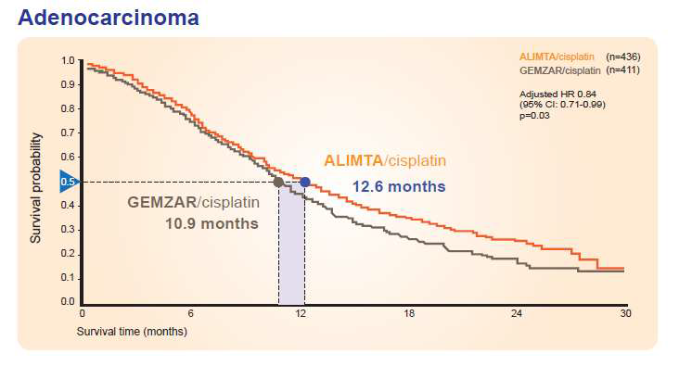
JMDB: Pemetrexed/Cisplatin shows superior survival in adenocarcinoma histology (N=847)
Scagliotti,
Scagliotti, G. V. et al. J Clin Oncol 2008; 26:3543-3551

Slide 17
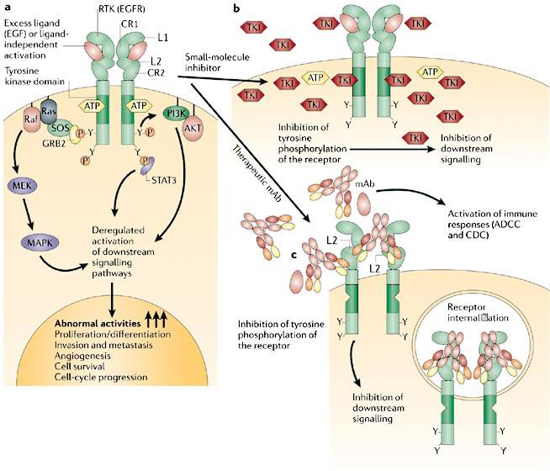
Gambar 2. Mekanisme molekul kecil TKI dan antibodi monoklonal
(Imai K, Takaoka A. Nature reviews Cancer. 2006)

Slide 18
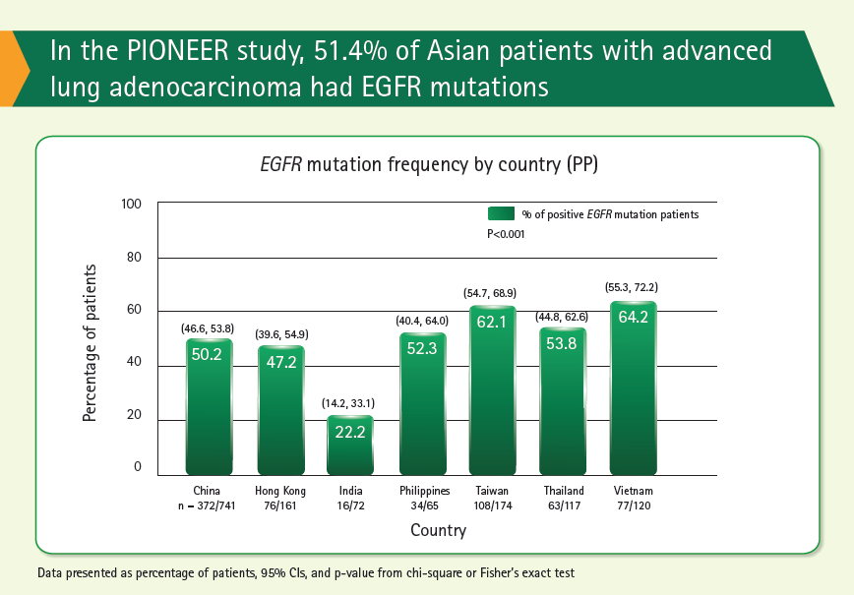
(57.2, 64.1)
Shi Y ,et al. J Thorac Oncol. 2014;9:154-162

Slide 19
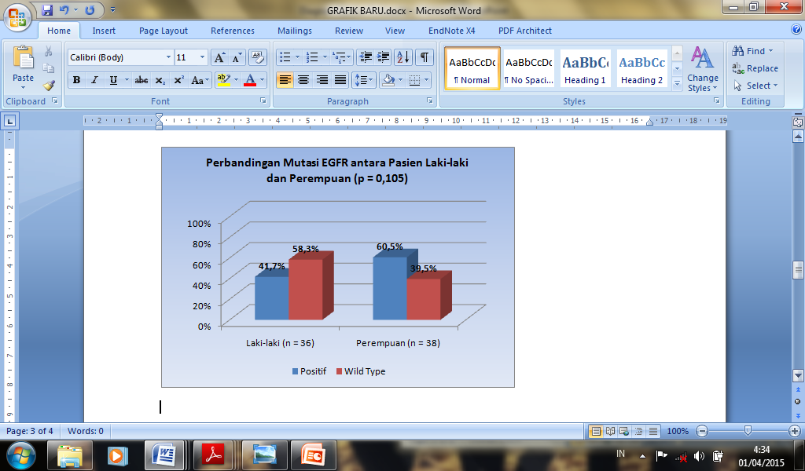
Data Adeno Ca yg diperiksa mutasi EGFR RSDM 2014 (n=74)

Slide 20
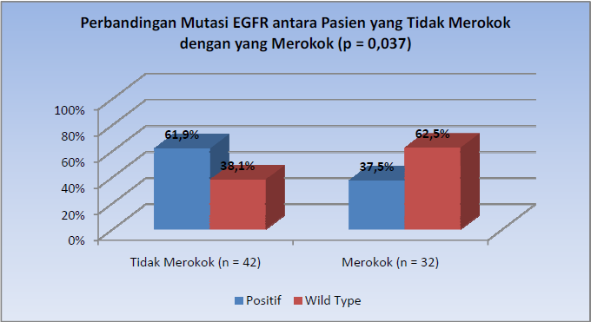

Slide 21
Mutasi EGFR pada Adenocarcinoma
RSDM th 2015
Dikirim ke Lab 132, sebanyak 5 sampel tidak bisa dianalisis krn jumlah sel kurang.(n=127)
Hesti, RSDM 2016

Slide 22
Adeno Ca Mutasi EGFR (+) n= 127
Hesti, RSDM 2016

Slide 23
Terapi
Hesti, RSDM 2016

Slide 24
IRESSA Pan-Asia Study (IPASS)
Phase III, multicentre, randomised, open-label, parallel-group study comparing gefitinib with carboplatin/paclitaxel in clinically selected chemonaïve patients in Asia with aNSCLC
Patients
Chemonaïve
Age ≥18 years
Adenocarcinoma histology
Never or light
ex-smokers*
PS 0–2
Measurable stage
IIIB/IV disease
Endpoints
Primary
PFS (non-inferiority)
Secondary
ORR
OS
QoL
Disease-related symptoms
Safety and tolerability
Exploratory
Biomarkers
  EGFR mutation‡
  EGFR-gene-copy number
  EGFR protein expression
Gefitinib
(250 mg daily)
n=609
1:1 randomisation
Carboplatin (AUC 5 or 6) / paclitaxel (200 mg/m²)
3 weekly†
n=608
ARMS, amplification-refractory mutation system
*Never smokers, <100 cigarettes in lifetime; light ex-smokers, stopped ≥15 years ago and smoked ≤10 pack years; †Limited to a maximum of 6 cycles; carboplatin /paclitaxel was offered to gefitinib patients at progression ‡EGFR mutations were detected with the use of ARMS and the DxS EGFR29 mutation-detection kit
Mok, et al. N Engl J Med 2009;361:947–957; Fukuoka, et al. J Clin Oncol 2011;29:2866–2874
Notes:
Chemotherapy-naïve adult patients with advanced NSCLC with adenocarcinoma histology, who were never or light ex-smokers and with a PS 0–2 were eligible
Patients were randomised to receive either gefitinib (250 mg/day orally) until disease progression or discontinuation, or carboplatin (AUC 5 or 6) and paclitaxel (200 mg/m² every 3 weeks) for a maximum of 6 cycles, or until disease progression or discontinuation
Patients who progressed in the gefitinib arm received subsequent treatment with carboplatin/paclitaxel, if appropriate
The primary objective was to assess non-inferiority of gefitinib vs carboplatin/paclitaxel for PFS
Secondary objectives and exploratory objectives are also shown on the slide
Reference
Mok, et al. N Engl J Med 2009;361:947–957.

Slide 25

OBJECTIVE RESPONSE RATE IN EGFR MUTATION
POSITIVE AND NEGATIVE PATIENTS (IPASS STUDY)
Overall
response
rate (%)
Gefitinib
Carboplatin / paclitaxel
EGFR M+ odds ratio (95% CI) = 2.75
(1.65, 4.60), p=0.0001
EGFR M- odds ratio (95% CI) = 0.04
(0.01, 0.27), p=0.0013
71.2%
47.3%
23.5%
1.1%
(n=132)
(n=129)
(n=91)
(n=85)
Mok et al ESMO LBA 2, 2008
Odds ratio >1 implies greater chance of response on gefitinib
Notes:
25
25

Slide 26
NEJ002 study
A Phase III study of gefitinib vs carboplatin/paclitaxel in patients with EGFRm aNSCLC in Japan
Gefitinib
(250 mg daily)
n=115
Patients
EGFRm*
Stage IIIB/IV NSCLC or postoperative relapse
Chemonaïve
ECOG PS 0 or 1
Primary endpoint
PFS
Secondary endpoints
OS
ORR
AEs
QoL
1:1 randomisation
Carboplatin (AUC 6) / paclitaxel (200 mg/m²)
3-weekly
n=115
*Exon 19 deletions, L858R, L861Q, G719A, G719C, or G719S, as detected using PNA-LNA PCR clamp method; T790M mutation was an exclusion criteria
Maemondo, et al. N Engl J Med 2010;362:2380–2388
Notes:
Eligible patients had EGFRm aNSCLC (exon 19 deletions, L858R, L861Q, G719A, G719C, or G719S), absence of the resistant EGFR mutation T790M, no history of chemotherapy and were aged ≤75 years
Patients were randomised to receive either gefitinib (250 mg/day orally) or carboplatin (AUC 6) and paclitaxel (200 mg/m²) every 3 weeks
Chemotherapy was continued for at least 3 cycles
Gefitinib was given until disease progression, development of intolerable AEs or consent withdrawal
The primary objective was to assess the superiority of gefitinib vs carboplatin/paclitaxel for PFS
Secondary objectives included OS, ORR, time to deterioration of PS, and AEs
Reference
Maemondo, et al. N Engl J Med 2010;362:2380–2388

Slide 27
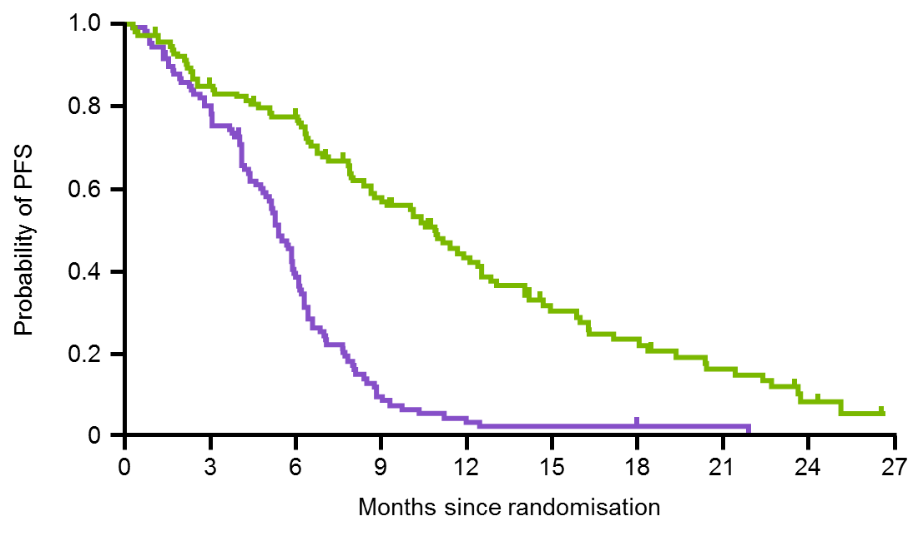
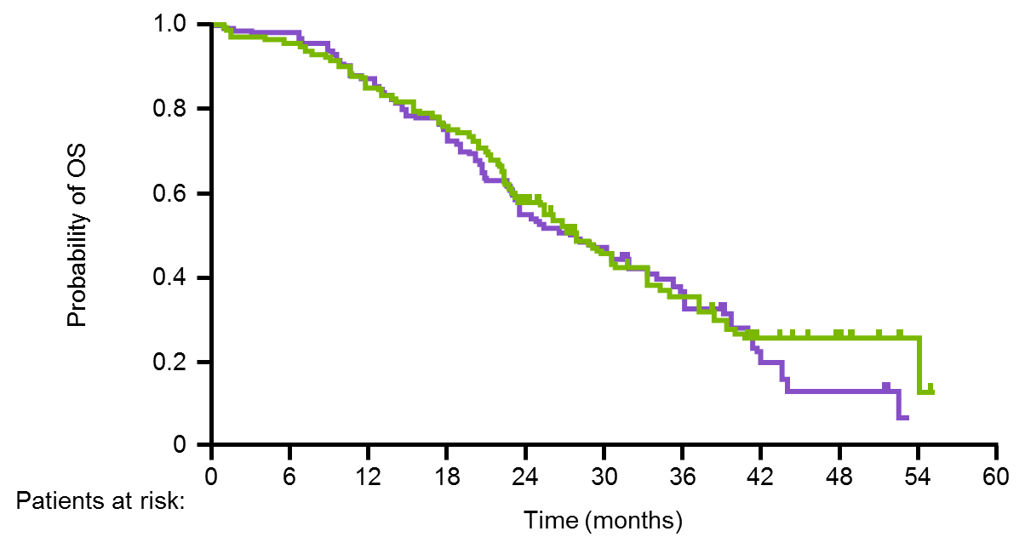
NEJ002: significant clinical benefit with gefitinib vs carboplatin/paclitaxel¹
The ORR was significantly higher in the gefitinib group vs the carboplatin/paclitaxel group
(73.7% vs 30.7%; p<0.001)¹
Superior PFS with gefitinib vs carboplatin/paclitaxel (Median 10.8 vs 5.4; HR 0.30 [95% CI 0.22, 0.41]; p<0.001)¹
PFS¹
OS²
Median PFS (months)
10.8
5.4
Median OS (months)
27.7
26.6
Gefitinib (n=114)
Carboplatin/paclitaxel (n=110)
Gefitinib (n=114)
Carboplatin/paclitaxel (n=114)
HR (95% CI) 0.30 (0.22, 0.41); p<0.001
HR (95% CI) 0.887 (0.634, 1.241); p=0.483
Gefitinib
C/P
114
114
57
48
22
15
7
3
97
99
There was no significant difference between the gefitinib and carboplatin/paclitaxel groups with respect to OS (HR [95% CI] 0.887 [0.634, 1.241]; p=0.483)²
1. Maemondo, et al. N Engl J Med 2010;362:2380–2388; 2. Inoue, et al. Ann Oncol 2013;24:54–59
Notes:
1-year and 2-year PFS rates were 42.1% and 8.4% for gefitinib and 3.2% and 0% for carboplatin/paclitaxel¹
In patients with exon 19 deletion or L858R mutations (n=215), the median PFS was 11.4 months in the gefitinib arm and 5.4 months in the carboplatin/paclitaxel arm²
An analysis of OS was conducted at the data cut-off point in December 2010 for the entire ITT population (n=228)³
There was no significant difference between the gefitinib and carboplatin/paclitaxel groups with respect to OS (HR [95% CI] 0.887 [0.634, 1.241]; p=0.483)
Median OS was 27.7 months with gefitinib and 26.6 months with carboplatin/paclitaxel
The lack of a survival benefit in favour of gefitinib could possibly be due to the high crossover use of gefitinib in the carboplatin/paclitaxel group³
In patients with exon 19 deletion or L858R mutations (n=215), the median OS was 29.3 months in the gefitinib arm and 28.0 months in the carboplatin/paclitaxel arm²
In patients with exon 19 deletion or L858R mutations (n=215), ORR was 76% in the gefitinib arm and 32% in the carboplatin/paclitaxel arm²
References
Maemondo, et al. N Engl J Med 2010;362:2380–2388
Watanabe, et al. J Thorac Oncol 2014;9:189–194
Inoue, et al. Ann Oncol 2013;24:54–59

Slide 28
Ref :
Mok TS et al. J Clin Oncol 2013;31:1081-1088.

Slide 29
WJOG5108L

Slide 30
No Difference between Gefitinib & Erlotinib in Efficacy

Slide 31
NEJ002: Fewer grade ≥3 AEs with gefitinib than with chemotherapy¹
Elevated aminotransferase, diarrhoea and rash were the most common AEs in the gefitinib group, while haematologic and neurologic AEs were more common in the chemotherapy group¹
The AE profiles of both treatment regimens were consistent with previous studies¹⁻⁴
 | Any grade |  | Grade ≥3
n (%) | Gefitinib (n=114) | Carboplatin/paclitaxel (n=113) | Gefitinib (n=114) | Carboplatin/paclitaxel (n=113) | p-value for Grade ≥3
Any | 108 (94.7) | 110 (97.3) | 47 (41.2)* | 81 (71.7) | <0.001
Diarrhoea | 39 (34.2) | 7 (6.2) | 1 (0.9) | 0 | <0.001
Appetite loss | 17 (14.9) | 64 (56.6) | 6 (5.3) | 7 (6.2) | <0.001
Fatigue | 12 (10.5) | 31 (27.4) | 3 (2.6) | 1 (0.9) | 0.002
Rash | 81 (71.1) | 25 (22.1) | 6 (5.3) | 3 (2.7) | <0.001
Neuropathy (sensory) | 1 (0.9) | 62 (54.9) | 0 | 7 (6.2) | <0.001
Arthralgia | 4 (3.5) | 54 (47.8) | 1 (0.9) | 8 (7.1) | <0.001
Pneumonitis | 6 (5.3) | 0 | 3 (2.6)* | 0 | 0.02
Aminotransferase elevation | 63 (55.3) | 37 (32.7) | 30 (26.3) | 1 (0.9) | <0.001
Neutropenia | 7 (6.1) | 87 (77.0) | 1 (0.9) | 74 (65.5) | <0.001
Anaemia | 21 (18.4) | 73 (64.6) | 0 | 6 (5.3) | <0.001
Thrombocytopenia | 8 (7.0) | 32 (28.3) | 0 | 4 (3.5) | <0.001
*One patient counted here had a grade 5 toxic effect
1. Maemondo, et al. N Engl J Med 2010;362:2380–2388; 2. Douillard, et al. Br J Cancer 2014;110:55–62; 3. Mok, et al. N Engl J Med 2009;361:947–957; 4. Mitsudomi, et al. Lancet Oncol 2010;11:121–128
Notes:
The incidence of AEs of CTC grade ≥3 was significantly higher in the chemotherapy group compared with the gefitinib group (72% [n=81] vs 41% [n=47], p<0.001)
Interstitial lung disease was reported in six patients (5.3%) in the gefitinib group; three cases were severe, and one of the three was fatal
Reference
Maemondo, et al. N Engl J Med 2010;362:2380–2388

Slide 32
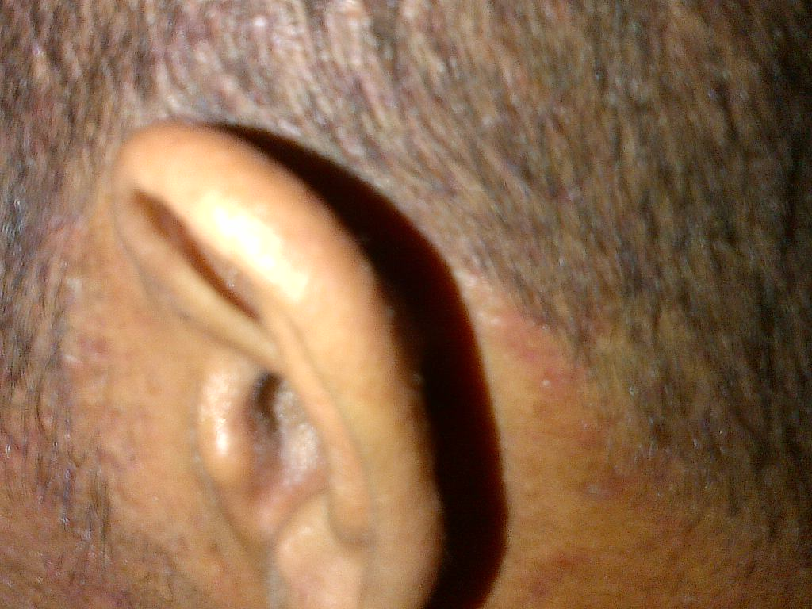
Efek samping TKI: Rash akneiform di Wajah dan Kepala

Slide 33
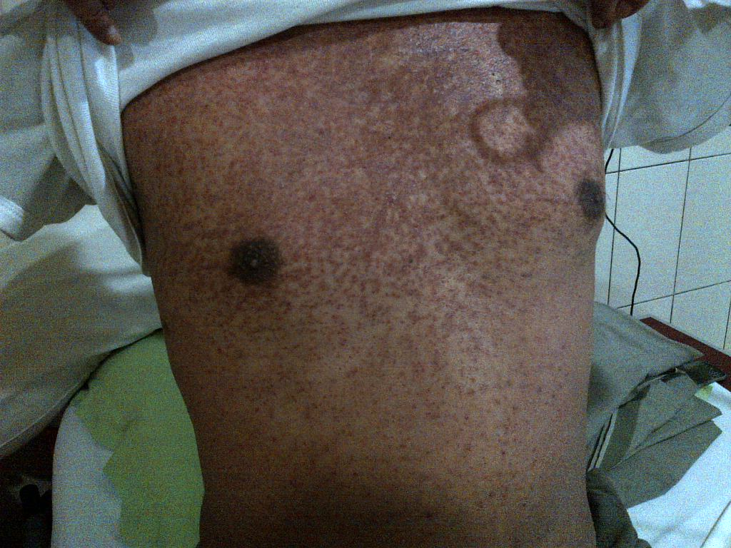
Gambar (2):
Rash akneiform di Dada sesudah terapi

Slide 34
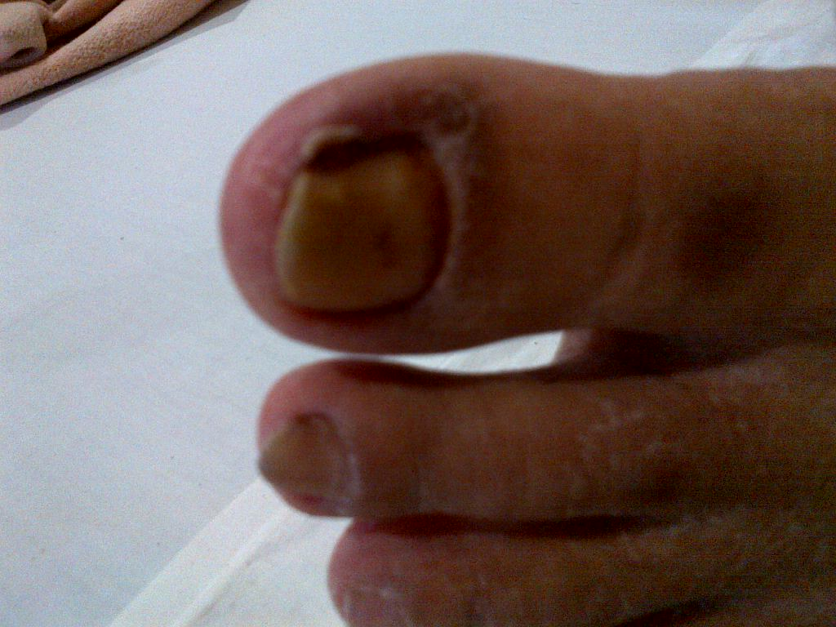
Paronikia di kaki

Slide 35
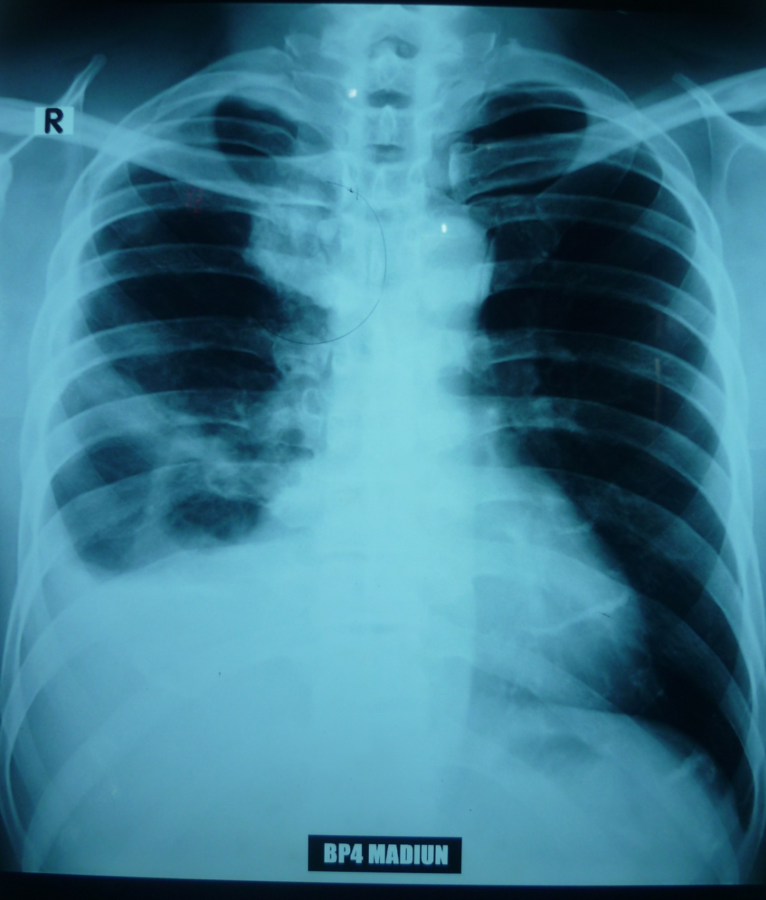
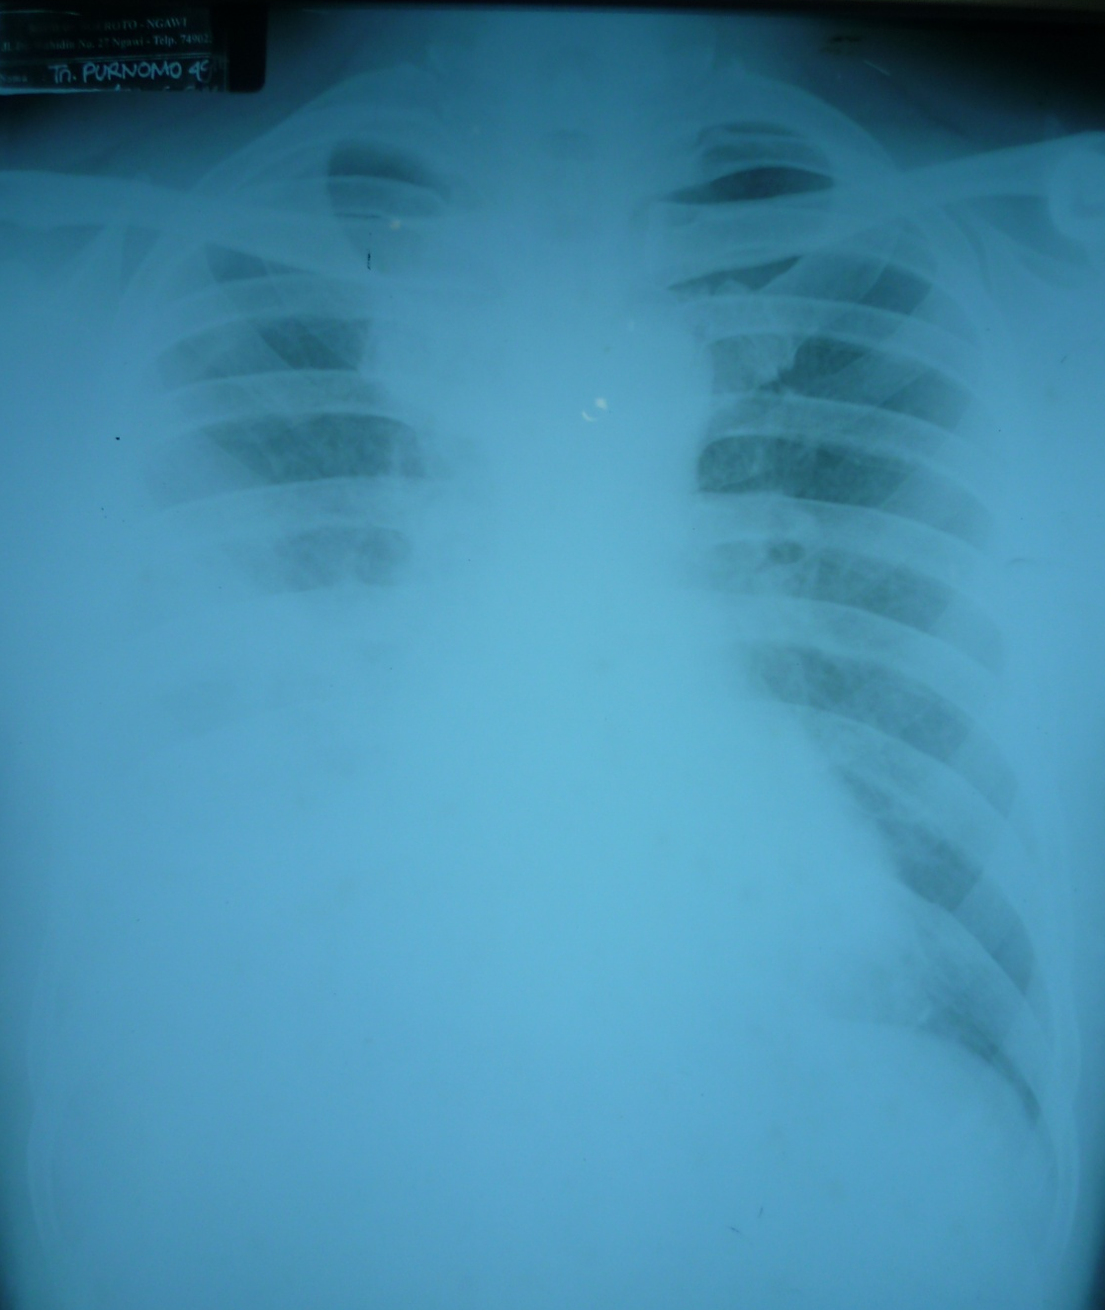
Laki2. 48 th. Keluhan batuk
09-06-2014
24-06-14

Slide 36
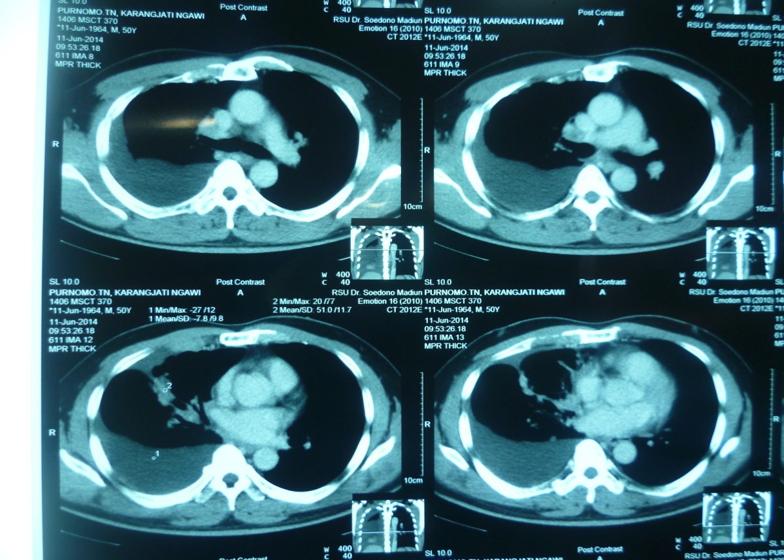
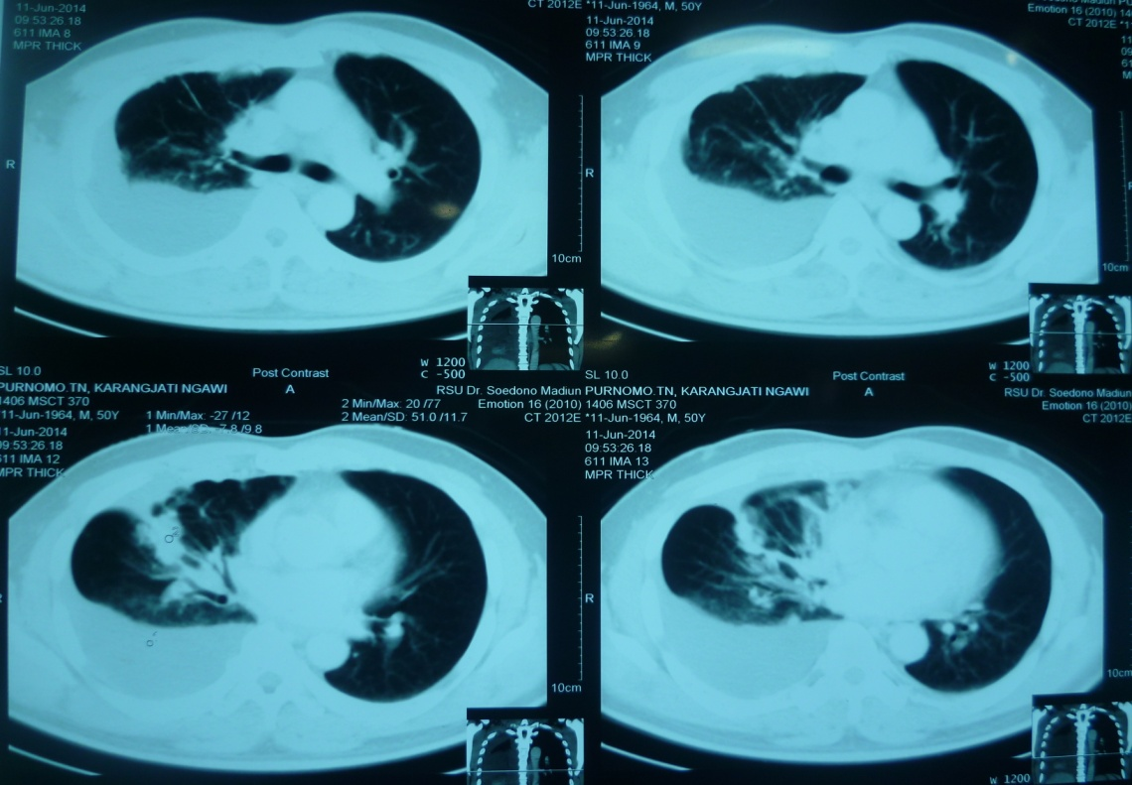
CT Scan 11-6-14
11-06-14. TTNA: Adeno Ca
01-07-14. Mutasi EGFR positif
05-07-14. terapi Gefitinib 250 mg

Slide 37
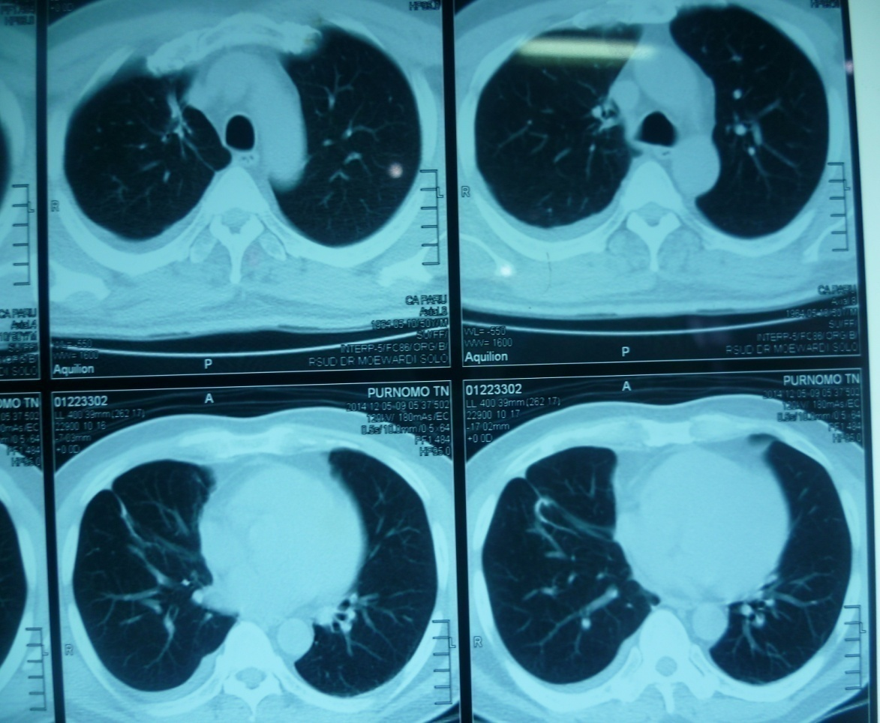
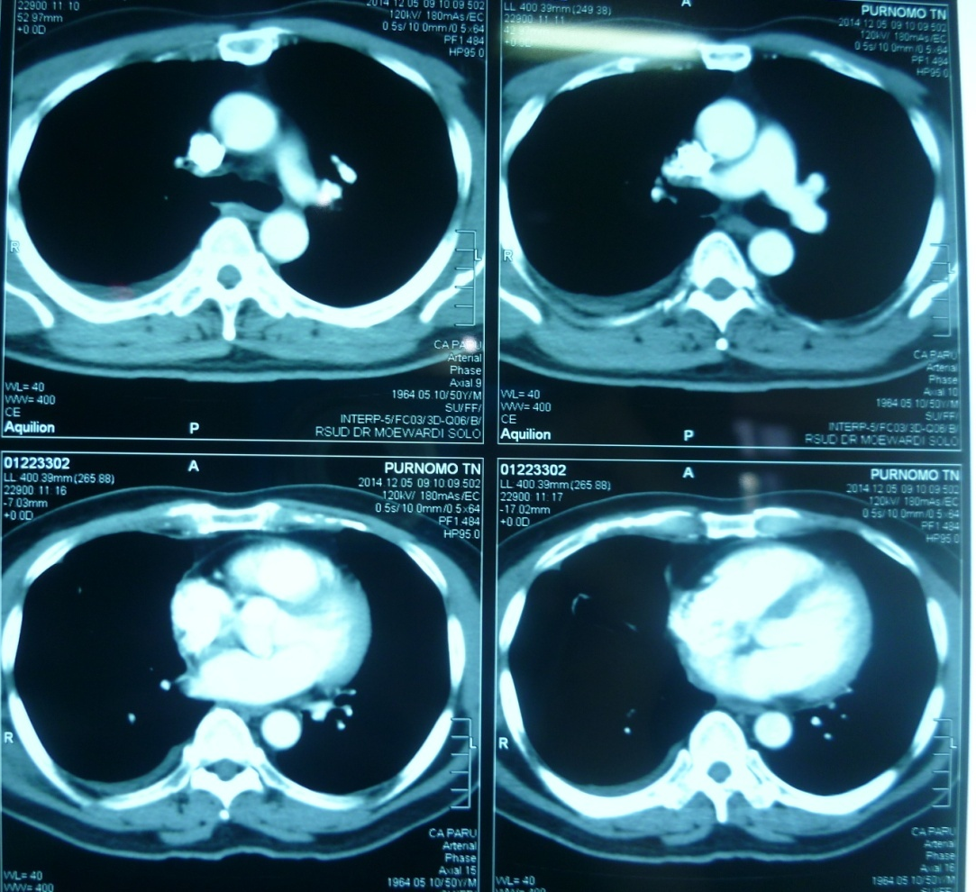
CT Scan 5-12-14 ( bl ke6)

Slide 38
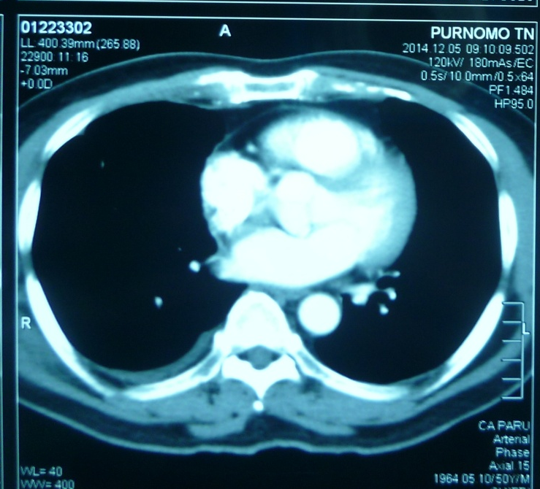
CT Scan 11-6-14 CT Scan 5-12-14
Terapi Iresa bl ke 5.
Respon komplit
Pra-Iressa

Slide 39
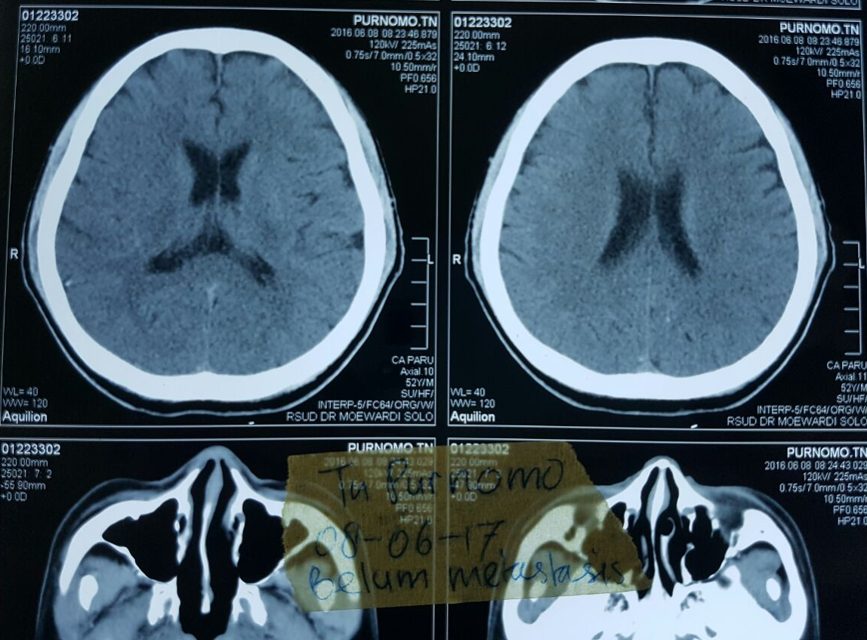
09-06-16. kel: pusing. CT brain kontras: tidak didapatkan metastasis

Slide 40
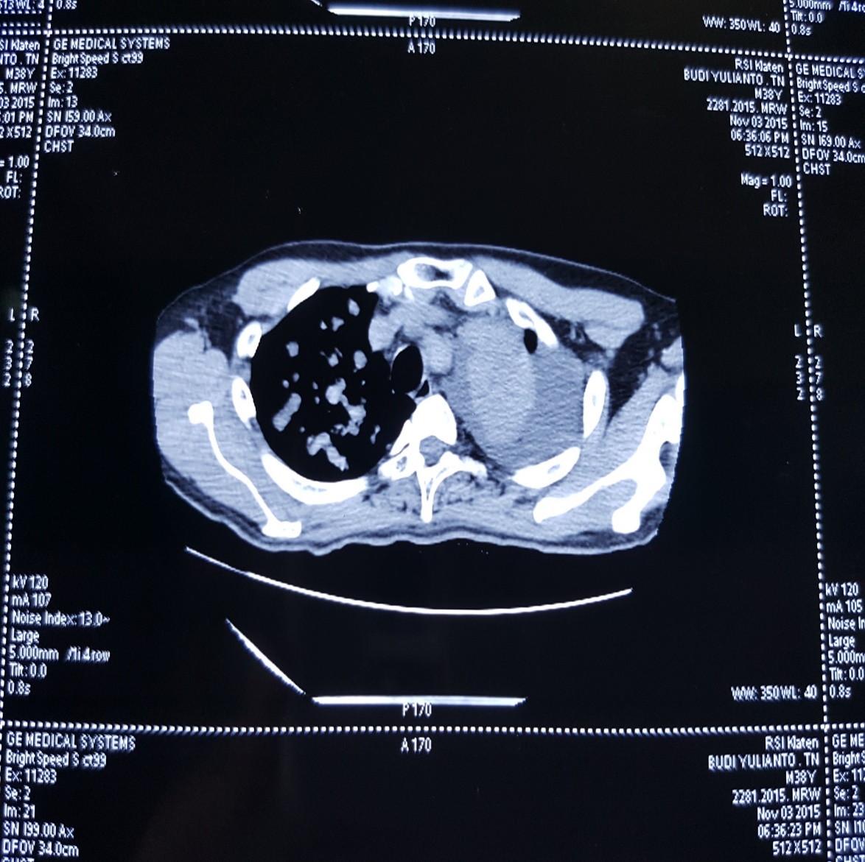
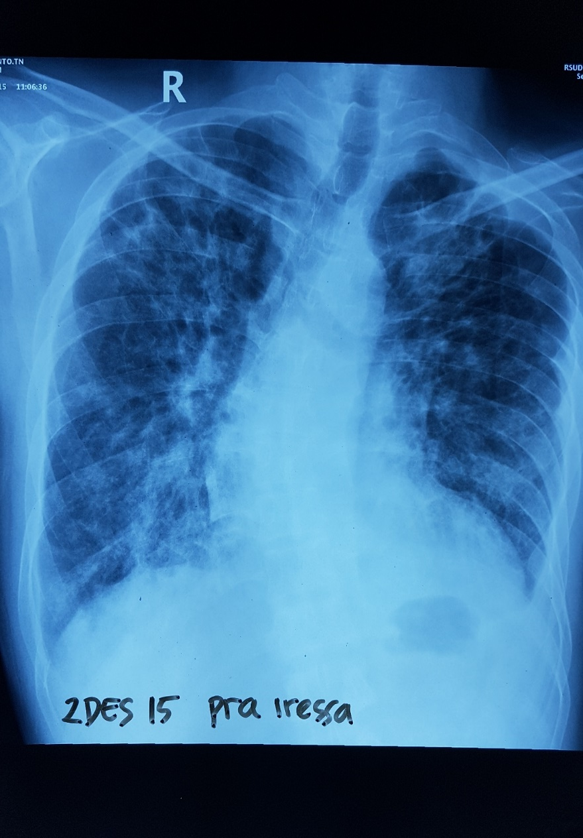
Px laki2, Adeno Ca, mutasi EGFR(+) . Riwayat OAT 2 bl tidak membaik

Slide 41
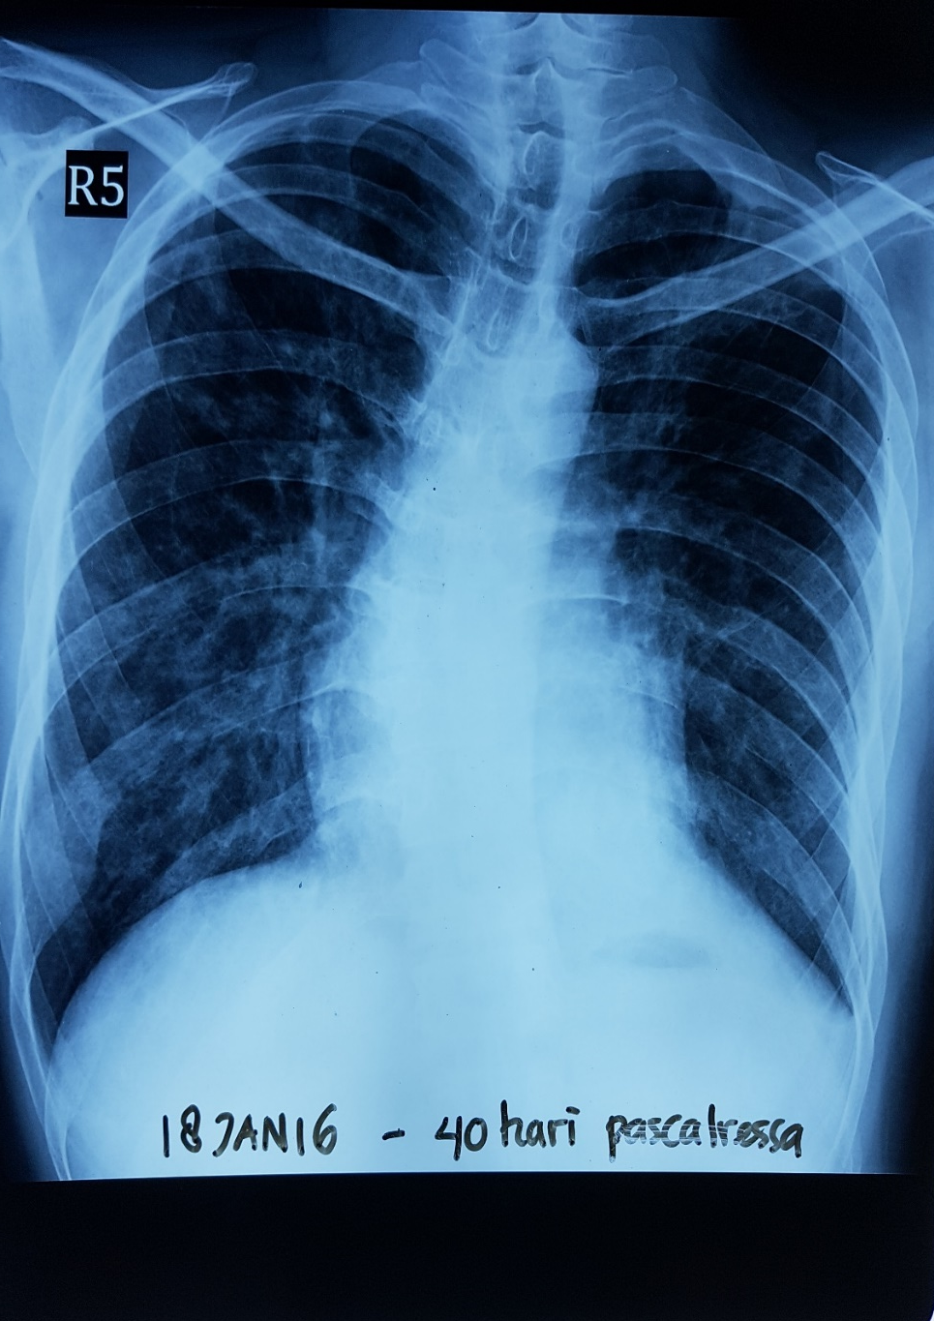
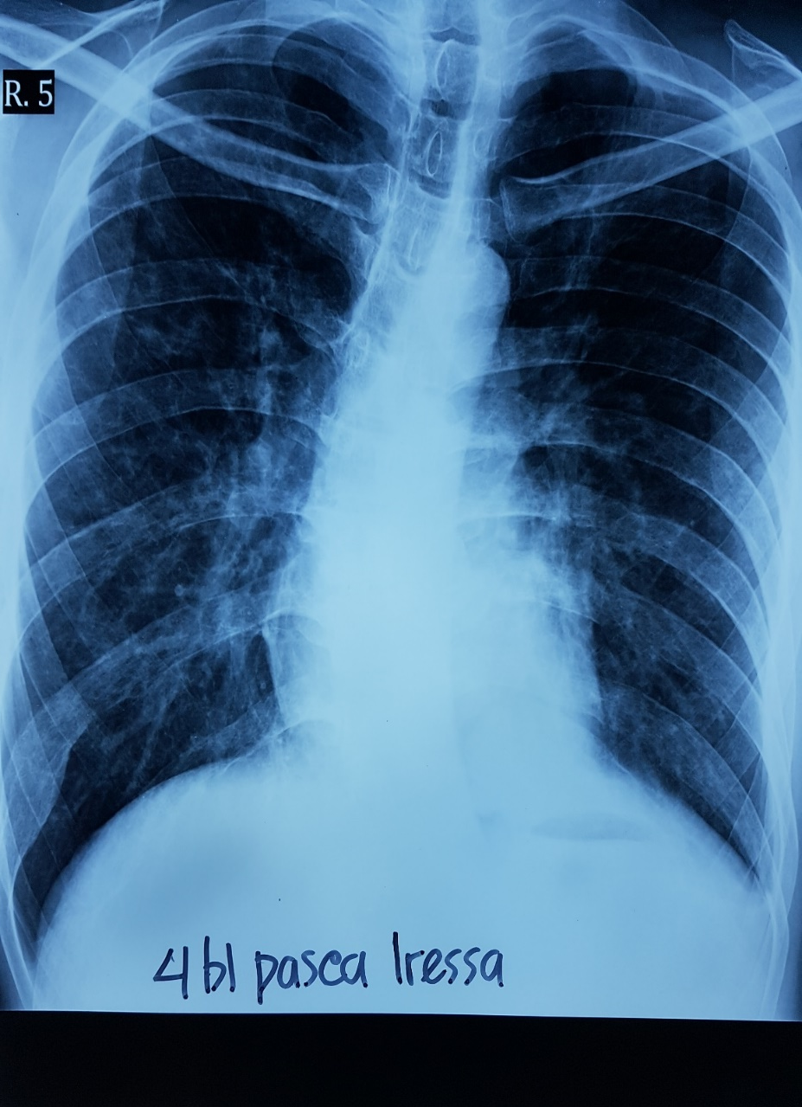

Slide 42
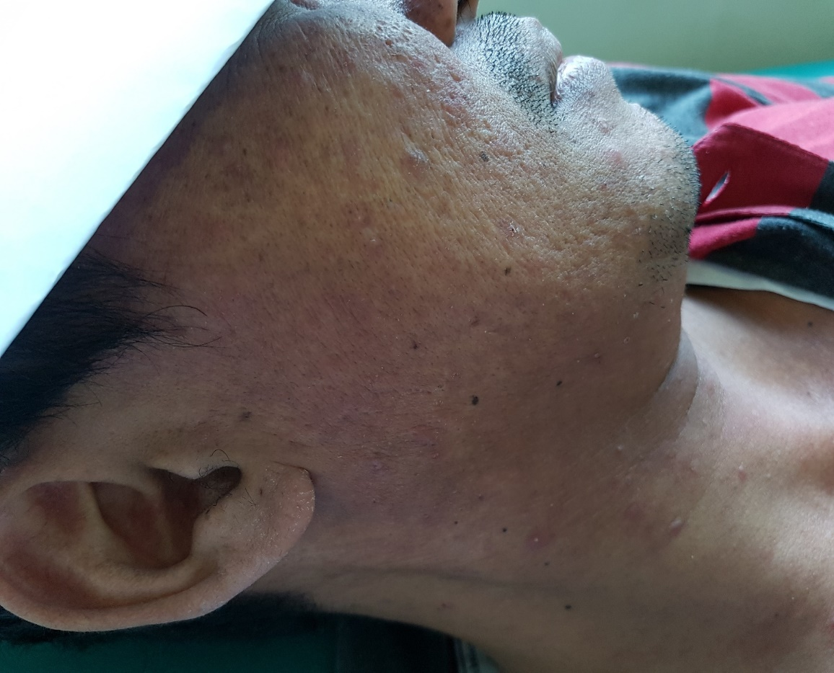
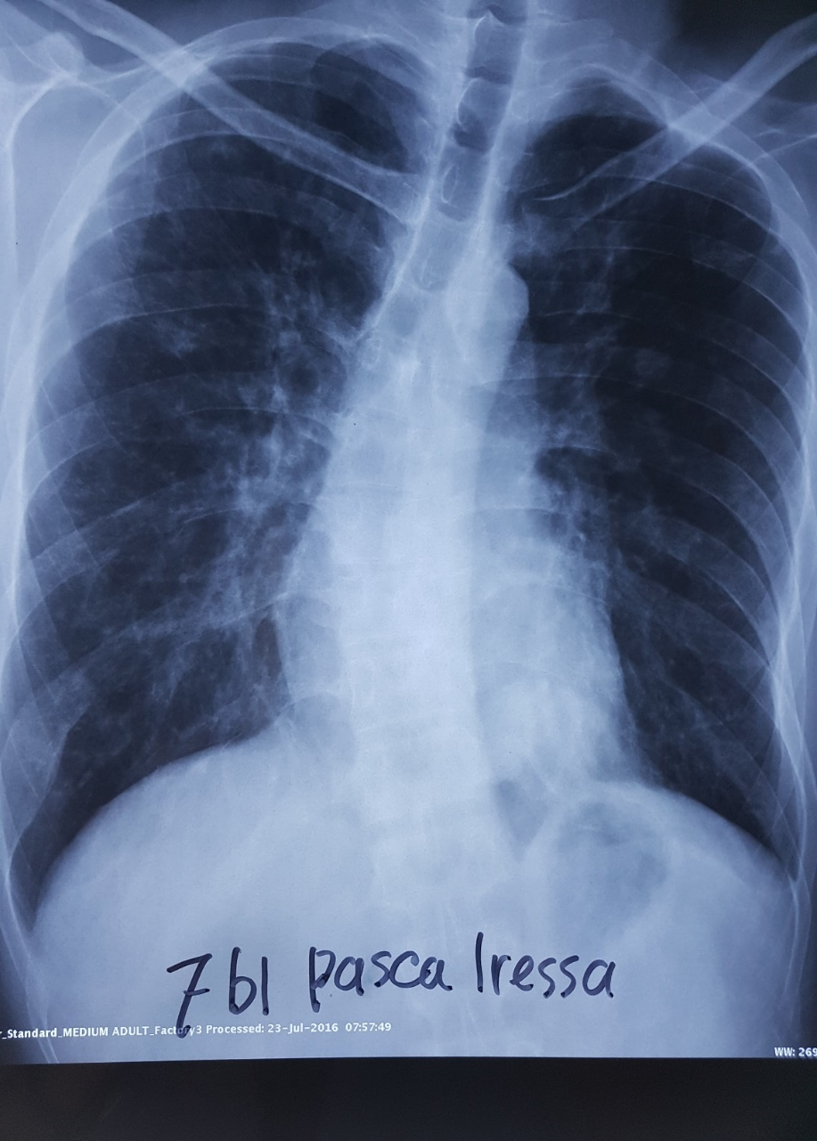
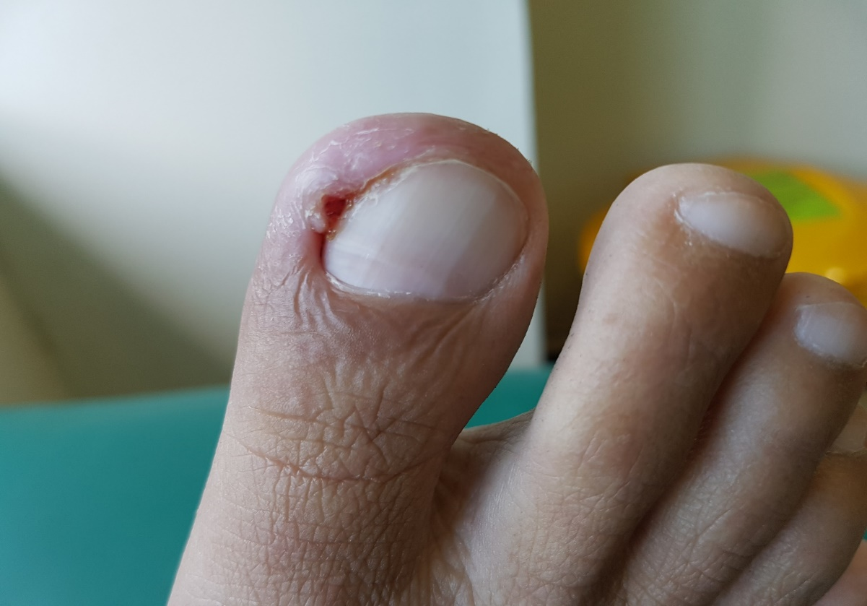

Slide 43
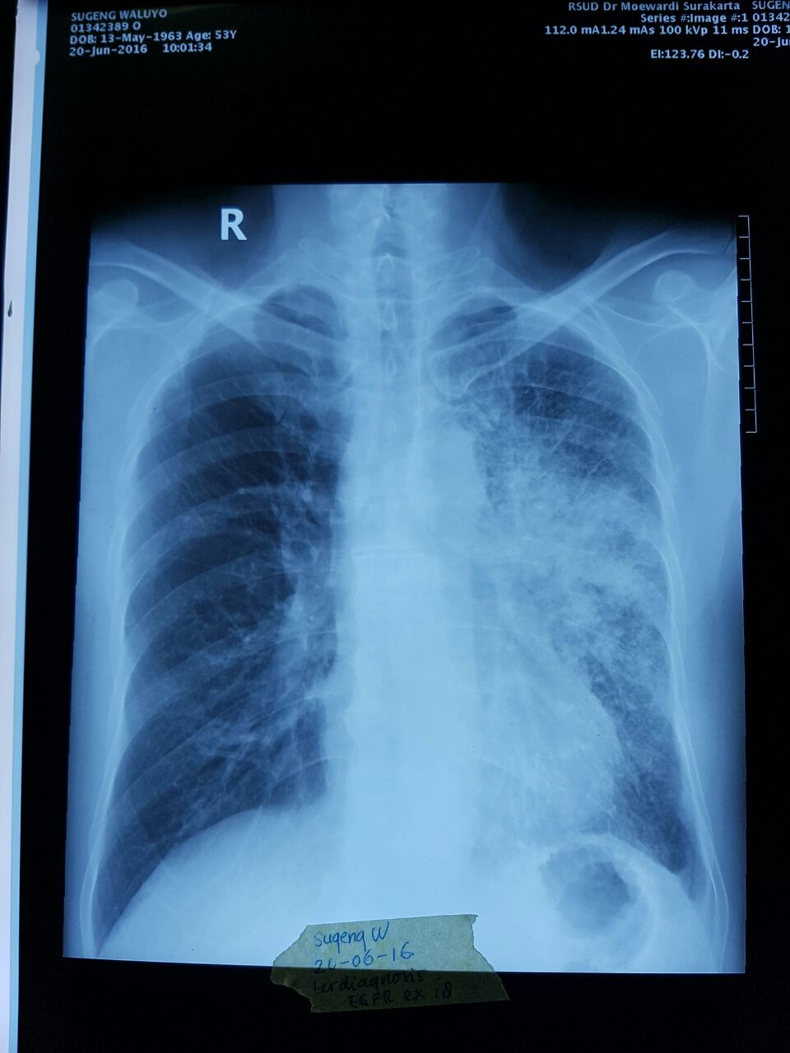
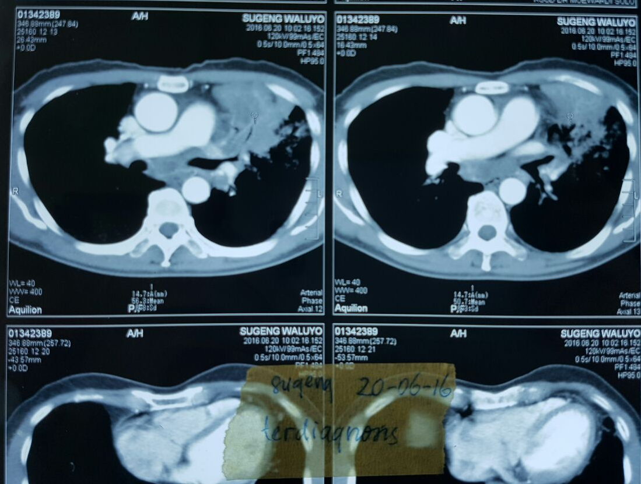
20-06-16. Laki2 50 th, mutasi EGFR ex 18, jumlah sel kurang mohon kirim sampel lagi

Slide 44
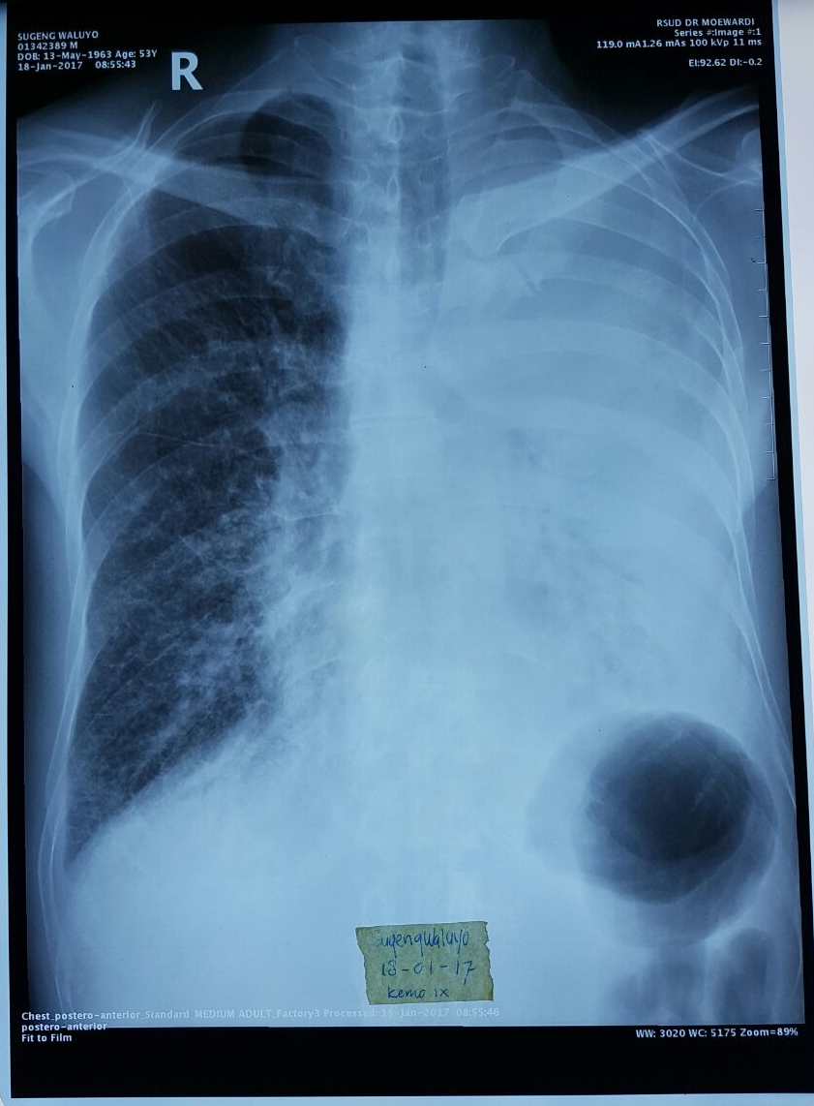
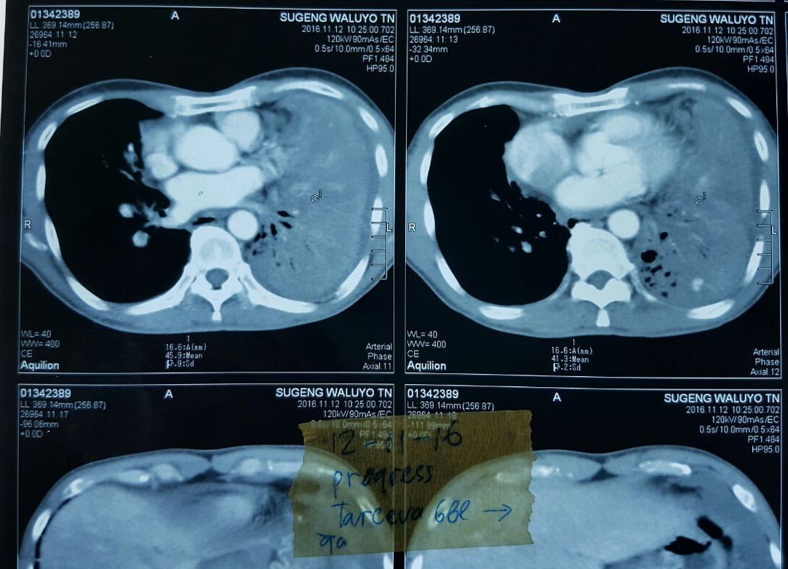
Terapi TKI bulan ke 5. paru progress+metastasis hepar

Slide 45
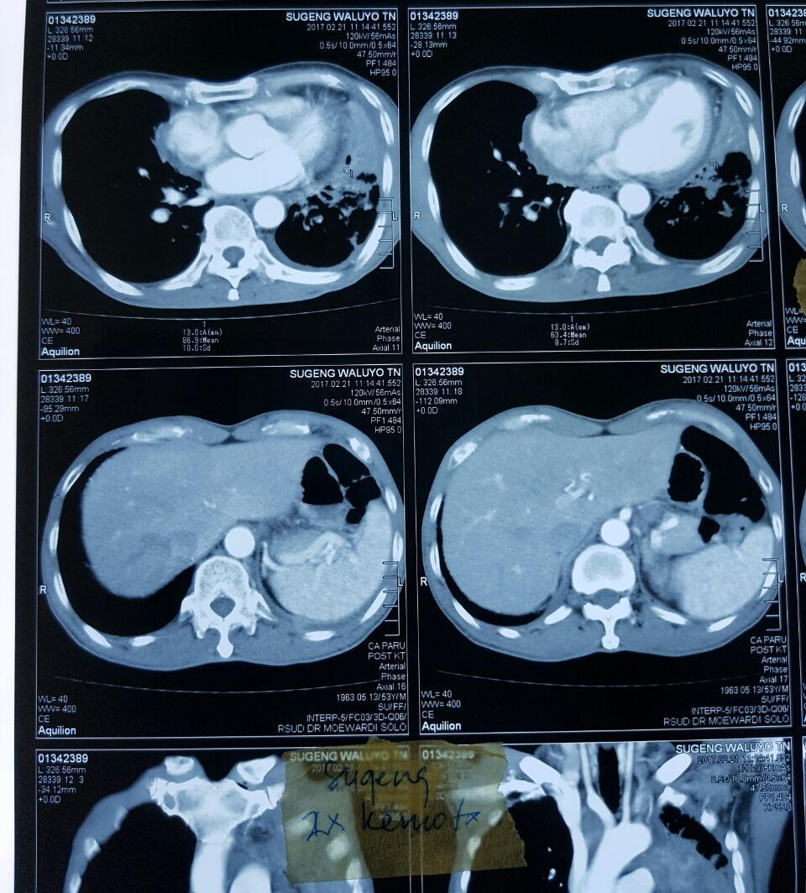
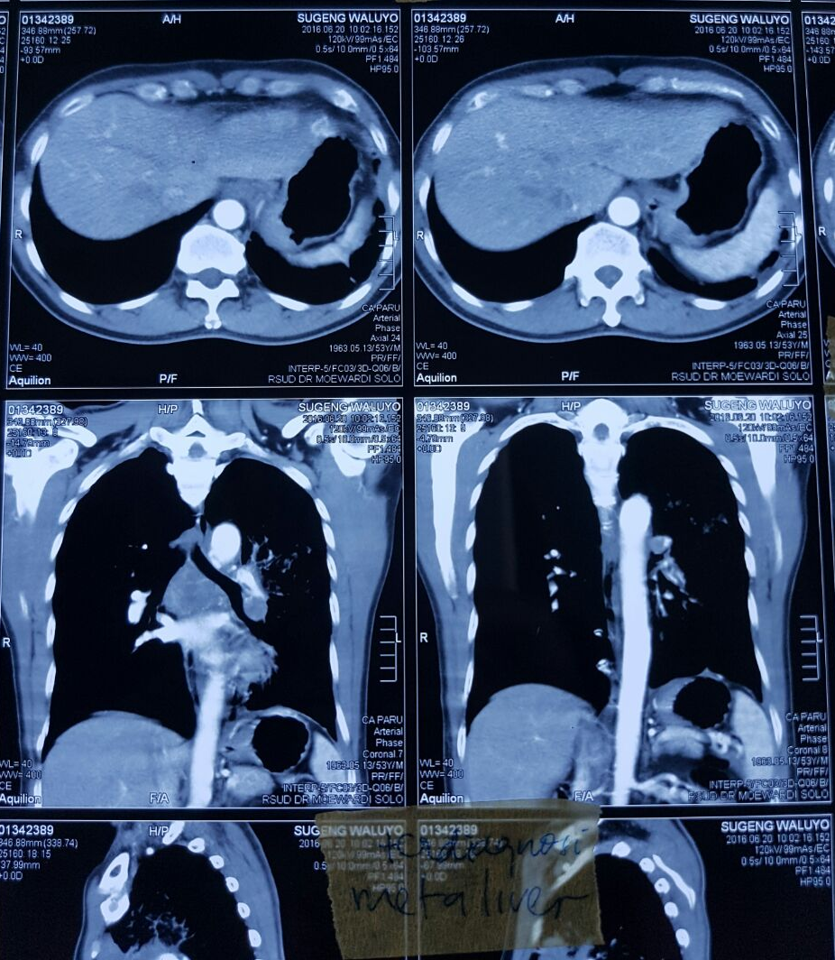
Kemoterapi ke 3. klinis perbaikan

Slide 46
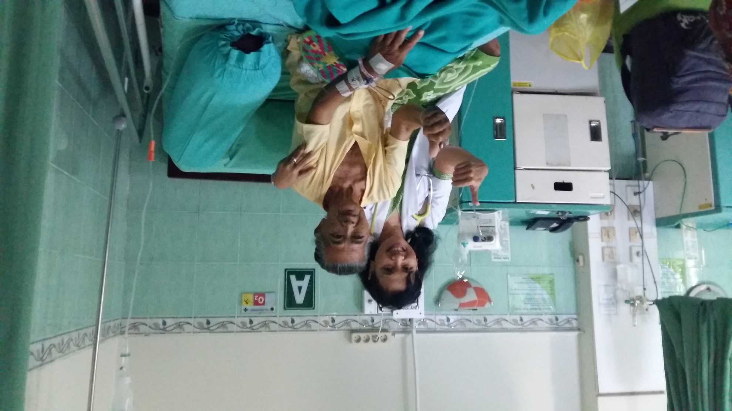
Quality of live hrs diutamakan pada penatalaksanaan Ca stad lanjut
Ditayangkan sudah dengan seijin pasien

Slide 47
Resume
Kasus kanker paru cenderung meningkat
Terbanyak kasus adalah stadium lanjut
Untuk NSCLC jenis Adeno Ca disarankan dilakukan pemeriksaan mutasi EGFR
Persentase mutasi EGFR pada AdenoCa di RSDM 47%
Pemberian Gefitinib pada Adeno Ca dng mutasi EGFR memberikan hasil yang baik
Gefitinib dapat diberikan pada Adeno Ca mutasi EGFR meskipun dengan performance state yang buruk
Tujuan utama penatalaksanaan kanker paru stadium lanjut adalah meningkatkan quality of live

Slide 48
Terimakasih

