Slide 1
The Advanced Role of Tiotropium in
Asthma
Ana Rima
GPM-SV-0006-ID

Slide 2
Outline
Role of tiotropium in asthma
  Efficacy as add-on to ICS/LABA
  Efficacy in subpopulations
  Safety
  Effectiveness in real life

Slide 3

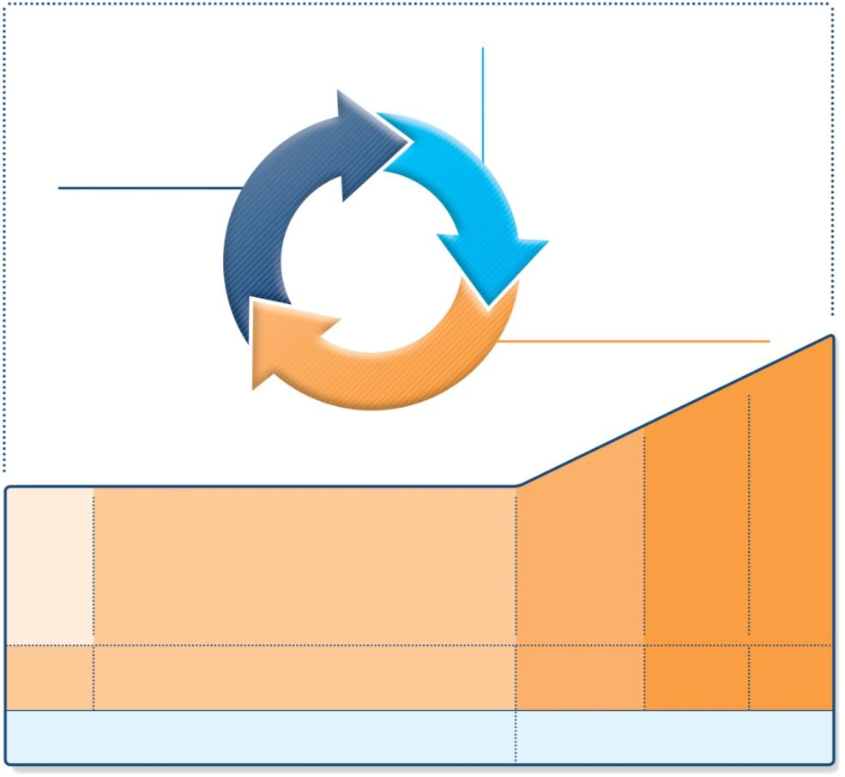
Stepwise management - pharmacotherapy
Diagnosis
Symptom control & risk factors
(including lung function)
Inhaler technique & adherence
Patient preference
ASSESS
REVIEW RESPONSE
Symptoms
Exacerbations
Side-effects
Patient satisfaction
Lung function
ADJUST TREATMENT
Asthma medications
Non-pharmacological strategies
Treat modifiable risk factors
*Not for children <12 years
**For children 6-11 years, the preferred Step 3 treatment is medium dose ICS
#For patients prescribed BDP/formoterol or BUD/ formoterol maintenance and reliever therapy
 Tiotropium by mist inhaler is an add-on treatment for patients ≥12 years with a history of exacerbations
STEP 5
STEP 4
Refer for
add-on
treatment
e.g.
Tiotropium*†
Omalizumab, mepolizumab*
STEP 1
STEP 2
STEP 3
PREFERRED
CONTROLLER
CHOICE
Med/high
ICS/LABA
Low dose ICS
Low dose
ICS/LABA**
Other
controller
options
Consider low dose ICS
Leukotriene receptor antagonists (LTRA)
Low dose theophylline*
Med/high dose ICS
Low dose ICS+LTRA
(or + theoph*)
Add tiotropium*†
High dose ICS
+ LTRA
(or + theoph*)
Add low
dose OCS
RELIEVER
As-needed short-acting beta²-agonist (SABA)
As-needed SABA or
low dose ICS/formoterol#
GINA 2017, Box 3-5

Slide 4

Choosing between controller options: individual patient decisions
Decisions for individual patients Use shared decision-making with the patient/parent/carer to discuss:
Preferred treatment for symptom control and for risk reduction Patient characteristics (phenotype) Does the patient have any known predictors of risk or response? (eg, smoker, history of exacerbations, blood eosinophilia) Patient preference What are the patient’s goals and concerns for their asthma? Practical issues Inhaler technique: can the patient use the device correctly after training? Adherence: how often is the patient likely to take the medication? Cost: can the patient afford the medication?
Global Initiative for Asthma (GINA). Global Strategy for Asthma Management and Prevention, 2017.
GINA 2014, Box 3-3 (2/2) Provided by H Reddel

Slide 5
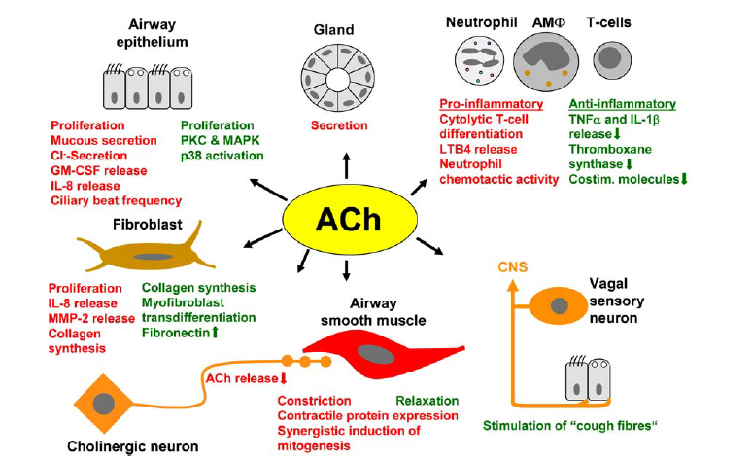
Spectrum of actions of acetylcholine in the airway
Kummer K, et al. Histochem Cell Biol. 2008 130:219–234.
Notes:
Spectrum of actions of acetylcholine (ACh) in the airways. In
cases where ACh may cause opposing eVects, dependent on receptor
subtype being involved, the term is written both in green and red colour
(e.g. collagen synthesis by Wbroblasts). Adopted and extended from
Kummer and Lips (2006), incorporating recent Wndings by ProWta
et al. (2008) and Haag et al. (2008)

Slide 6
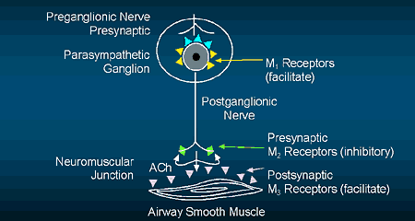
Pharmacological modulation of airway smooth muscle cell
Mechanism of action of anticholinergic bronchodilators
Barnes P. Physiol Rev. 1992; 72(3): 699 – 729.
Ach Acetylcholine

Slide 7
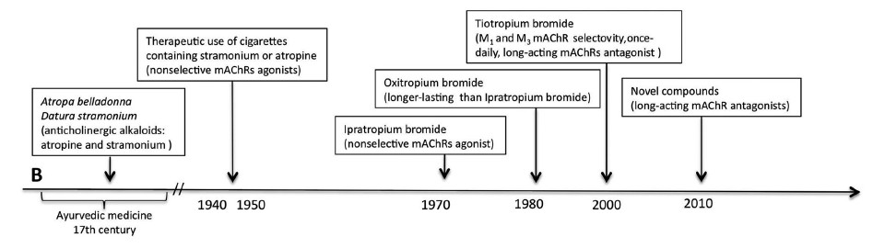

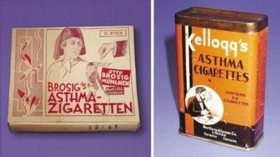
Milestones in the development of anticholinergics
Cazzola M, et al. Pharmacol Rev. 2012;64:450–504.

Slide 8









Tiotropium Respimat® in Asthma clinical development program
ADULT
PEDIATRIC
205.341
Kerstjens et al. JACI. 2011
Phase II PoC; add-on to ICS/LABA
205.424
Vogelberg et al. Respir Med. 2014
Phase II in 12–17 y; add-on to at least ICS
205.464
Ohta et al. PLoS ONE. 2015
Add-on to at least ICS +/– LABA
205.342
Bateman et al. JACI. 2011
Phase II PoC; add-on to ICS
205.444
Phase III in 12–17 y; add-on to at least ICS
205.380
Beeh et al. Respir Res. 2014
Phase II dose-finding; add-on to ICS
205.441
Phase II posology add-on to ICS
205.456
Phase III in 12–17 y
Add-on to ICS + ≥1 controller
205.420
Timmer et al. Respir Med. 2015
Phase II posology bid versus qd;
add-on to ICS
18 trials in over 6000 patients*
205.425
Vogelberg et al. Respir Res. 2015
Phase II in 6–11 y; add-on to at least ICS
205.416 and 205.417
Kerstjens et al. N Engl J Med. 2012
Twin phase III add-on to at least ICS/LABA
Age groups (y):
1–5
6–11
12–17
18+
205.445
Phase III in 6–11 y; add-on to at least ICS
205.418 and 205.419
Kerstjens et al. Lancet Respir Med. 2015
Twin phase III add-on to at least ICS
205.446
Phase III in 6–11 y
Add on to ICS + ≥1 controller
205.442
Paggiaro et al. JACI Pract. 2015
Phase III; add-on to low-dose ICS
205.443
Phase II/III in 1–5 y; add-on to at least ICS
PoC, proof of concept; qd, once daily.
*In the full clinical development program.

Slide 9
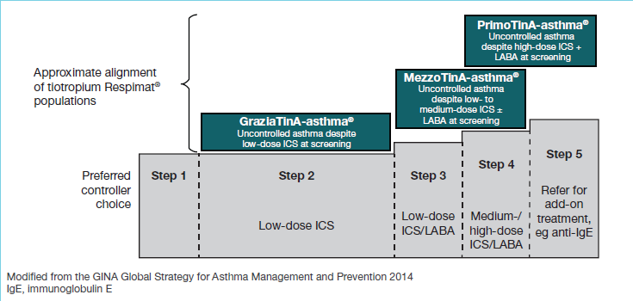
Tiotropium Respimat® in Asthma clinical development program

Slide 10
Tiotropium Respimat® in Asthma clinical development program

Slide 11
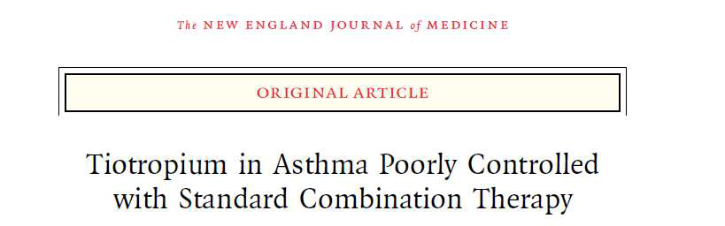

Tiotropium 5 µg qd morning
Placebo
I
Visit 0
I
Visit 1
(screening)
I
Visit 2
(randomization)
I
Visit 3–4
I
Visit 5–8
I
Visit 9
(end of treatment)
I
Visit 10
-4
I
0
I
48
I
52
I
4-week
screening
48-week double-blind
treatment period
4-week
follow-up
Three co-primary endpoints:
All patients at least on ICS maintenance therapy (budesonide or equivalent)+LABA
FEV₁ peak_{(0–3 h)} after 24 weeks
FEV₁ trough after 24 weeks
Time to first severe asthma exacerbation in pooled analysis after 48 weeks
148 centres, 5 continents
Kerstjens H, et al. N Engl J Med. 2012;367:1198–1207.
FEV₁, forced expiratory volume in 1 second; ICS, inhaled corticosteroid; LABA, long-acting β₂-agonist; qd, once daily.
Patients on at least ICS+LABA

Slide 12
Inclusion criteria: poorly controlled asthma
  Asthma diagnosis:
    Asthma diagnosed <40 years, documented by BHR, PEF var, or SABA/OCS response
    5-year history of asthma
    18−75 years
    Never-smoker or ex-smoker ≥1 year cessation and <10 pack-years
  Poorly controlled:
      Despite ICS+LABA and potential other controllers
        Mandatory: high-dose ICS+LABA
        Permitted: stable theophylline, leukotriene modifiers, omalizumab, oral steroids (≤5 mg/day)
      Symptomatic
        Mean ACQ ≥1.5 at screening and baseline visit
      Persistent obstruction
        Postbronchodilator FEV1 ≤80% predicted; FEV1/FVC ≤70%
    At least one severe asthma exacerbation in previous year treated with systemic steroids
Kerstjens H, et al. N Engl J Med. 2012;367:1198–1207.
Patients on at least ICS+LABA

Slide 13
Pooled demographics
Total treated, N (%) | Tiotropium 5 µg 456 (100) | Placebo 456 (100) | Total 912 (100)
Gender, n (%)
Female | 273 (59.9) | 278 (61.0) | 551 (60.4)
Race, n (%)
White | 376 (82.5) | 383 (84.0) | 759 (83.2)
Black | 22 (4.8) | 25 (5.5) | 47 (5.2)
Asian | 56 (12.3) | 47 (10.3) | 103 (11.3)
Other | 2 (0.4) | 1 (0.2) | 3 (0.3)
Age, years
Current age, mean (SD) | 52.2 (12.5) | 53.8 (12.2) | 53.0 (12.4)
Median age of onset | 26 | 26 | 26
Median duration | 28 | 28 | 28
Never smoked | 340 (74.6) | 352 (77.2) | 692 (75.9)
Ex-smoker | 116 (25.4) | 104 (22.8) | 220 (24.1)
Mean pack years (SD) | 5.4 (2.8) | 4.8 (2.7) | 5.1 (2.7)
Kerstjens H, et al. N Engl J Med. 2012;367:1198–1207.
SD, standard deviation.
Patients on at least ICS+LABA

Slide 14
Pooled disease characteristics
Total treated, N (%) | Tiotropium 5 µg 456 (100) | Placebo 456 (100) | Total 912 (100)
FEV₁, L mean (prebronchodilator) | 1.63 | 1.58 | 1.60
FEV₁, % predicted (prebronchodilator) | 54.9 | 54.8 | 54.8
FEV₁, % predicted (postbronchodilator) | 62.0 | 62.5 | 62.2
FEV₁ bronchodilator rev, ml (mean)* | 214 | 219 | 217
FVC, % predicted (postbronchodilator) | 87.3 | 88.1 | 87.7
FEV₁/FVC % (postbronchodilator) | 59.4 | 59.0 | 59.2
FEV₁ % predicted classes, n (%) (postbronchodilator)
<60% | 179 (39.3) | 183 (40.1) | 362 (39.7)
≥60% to <80% | 274 (60.0) | 264 (57.9) | 538 (59.0)
≥80% to <90% | 3 (0.7) | 9 (2.0) | 12 (1.3)
Weekly mean PEF (% predicted)** | 62.7 | 61.3 | 62.0
*Performed 30 minutes after four puffs of 100 µg salbutamol. **Last week prior to Visit 2.
Kerstjens H, et al. N Engl J Med. 2012;367:1198–1207.
FEV₁, forced expiratory volume in 1 second; FVC, forced vital capacity; PEF, peak expiratory flow.
Patients on at least ICS+LABA

Slide 15
Pooled medications at Visit 1 (screening)
 | Treatment arms, N (%)
 | Tiotropium 5 µg | Placebo | Total
Total treated | 456 (100.0) | 456 (100.0) | 912 (100.0)
ICS | 452 (99.1) | 449 (98.5) | 901 (98.8)
OCS | 24 (5.3) | 24 (5.3) | 48 (5.3)
Anticholinergics Long-acting Short-acting | 45 (9.9) 13 (2.9) 34 (7.5) | 45 (9.9) 11 (2.4) 33 (7.2) | 90 (9.9) 24 (2.6) 67 (7.3)
LABA | 442 (96.9) | 444 (97.4) | 886 (97.1)
Antibiotics | 22 (4.8) | 36 (7.9) | 58 (6.4)
Mucolytics | 13 (2.9) | 7 (1.5) | 20 (2.2)
Theophyllines | 75 (16.4) | 77 (16.9) | 152 (16.7)
Anti-allergic agents, excluding corticosteroids | 18 (3.9) | 17 (3.7) | 35 (3.8)
Leukotriene modifiers | 96 (21.1) | 107 (23.5) | 203 (22.3)
Omalizumab | 12 (2.6) | 24 (5.3) | 36 (3.9)
Kerstjens H, et al. N Engl J Med. 2012;367:1198–1207.
ICS, inhaled corticosteroid; LABA, long-acting β₂-agonist; OCS, oral corticosteroid.
Patients on at least ICS+LABA

Slide 16
Significant lung function improvement in
FEV₁ peak_{(0–3 h)} and trough: Trials 1 and 2
 | Baseline, mL | Adjusted mean change (SE), mL | Difference from placebo
 |  |  | Adjusted mean of difference (SE), mL | 95% CI, mL | P-value
Trial 1
FEV₁ peak_{(0–3h)}
Tiotropium Respimat® (n=217) | 1578 | 401 (25) | 86 (34) | 20, 152 | <0.05
Placebo Respimat® (n=211) |  | 315 (26)
FEV₁ trough
Tiotropium Respimat® (n=217) | 1578 | 144 (24) | 88 (31) | 27, 149 | <0.01
Placebo Respimat® (n=211) |  | 56 (25)
Trial 2
FEV₁ peak_{(0–3h)}
Tiotropium Respimat® (n=205) | 1628 | 401 (25) | 154 (32) | 91, 217 | <0.0001
Placebo Respimat® (n=218) |  | 248 (24)
FEV₁ trough
Tiotropium Respimat® (n=204) | 1628 | 155 (23) | 111 (30) | 53, 169 | <0.001
Placebo Respimat® (n=218) |  | 44 (22)
Kerstjens H, et al. N Engl J Med. 2012;367:1198–1207.
CI, confidence interval; FEV₁, forced expiratory volume in 1 second; SE, standard error.
Patients on at least ICS+LABA

Slide 17
Significant lung function improvement in
FEV₁ peak_{(0–3 h)}: Trials 1 and 2
500
FEV₁ peak_{(0–3 h)} at Week 24
Add-on to ICS+LABA
450
400
**
**
350
*
300
*
250
FEV₁ peak: Change from baseline (mL)
***
200
**
150
100
Trial 1; mean difference
86±34 mL (P=0.01)
Trial 2; mean difference
154±32 mL (P<0.001)
P<0.0001 unless shown otherwise:
*P<0.05
**P<0.01
50
0
0
0.5
1.0
2.0
3.0
Time post-dosing (h)
Tiotropium Respimat® 5 µg Trial 1
Placebo Respimat® Trial 1
Tiotropium Respimat® 5 µg Trial 2
Placebo Respimat® Trial 2
FEV₁ response results from Kerstjens H, et al. N Engl J Med. 2012;367:1198–1207.
Error bars represent standard errors.
FEV₁, forced expiratory volume in 1 second; ICS, inhaled corticosteroid; LABA, long-acting β₂-agonist.
Patients on at least ICS+LABA

Slide 18
Third co-primary endpoint:
severe asthma exacerbation
Definition of severe asthma exacerbation: the need for initiation or doubling of systemic corticosteroid therapy for at least 3 days*
Time to first severe exacerbation
Per protocol: pooled analysis over 48 weeks
*ATS/ERS Statement Asthma Control and Exacerbations: Standardizing Endpoints for Clinical Asthma Trials and Clinical Practice (Reddel H, et al, AJRCCM 2009)
Kerstjens H, et al. N Engl J Med. 2012;367:1198–1207.
ATS, American Thoracic Society; ERS, European Respiratory Society.
Patients on at least ICS+LABA

Slide 19
Risk of severe asthma exacerbation for tiotropium versus placebo
HR=0.79 (95% CI: 0.62, 1.00); risk reduction 21% (P=0.034)
Number needed to treat to prevent one severe exacerbation
during the 48-week treatment period: 15
50
Tiotropium Respimat® 5 µg qd n=122 (26.9%);
placebo Respimat® qd n=149 (32.8%)
Tiotropium Respimat® 5 µg qd: 282 days;
placebo Respimat® qd: 226 days (25th percentile)
40
Placebo Respimat® qd
30
Patients with ≥1 severe
asthma exacerbation (%)
20
Tiotropium Respimat® 5 µg qd
10
Increased the time to first exacerbation by an average of 56 days
0
0
25
50
75
100
125
150
175
200
225
250
275
300
325
Patients at risk:
Days
Placebo Respimat® qd
454
435
412
388
379
367
356
339
332
319
303
290
282
272
Tiotropium Respimat®
5 µg qd
453
430
409
401
389
378
363
353
348
339
331
319
308
298
Kerstjens H, et al. N Engl J Med. 2012;367:1198–1207. Full analysis set. Pooled data. Add-on to high-dose
ICS+LABA. Severe exacerbation defined as asthma necessitating the initiation or doubling of systemic corticosteroid therapy for ≥3 days. CI, confidence interval; HR, hazard ratio; qd, once daily.
Patients on at least ICS+LABA
Notes:
PrimoTinA-asthma: double-blind parallel-group trial including asthma patients with post-bronchodilator FEV₁<80% predicted while on at least ICS/LABA.
A total of 912 patients were randomized to additional tiotropium Respimat® 5 µg (n=256) or placebo (n=256) for 48 weeks
A pre-planned sub-group analysis of the allergic status was carried out.
Evaluated the use of tiotropium for 48 weeks in placebo-controlled trial of 912 poorly controlled asthmatics receiving standard combination therapy (ICS/LABA). Tiotropium increased the time to the first exacerbation by an average of 56 days and reduction of 21% in the risk of a severe exacerbation. Adverse effects were similar in both groups.

Slide 20
Episodes of asthma worsening
Definition of asthma worsening:
  One or more asthma symptoms outside of the patient’s usual range of day-to-day asthma that lasted for ≥2 consecutive days; and/or
  Decrease of patient’s best morning PEF of ≥30% from patient’s mean morning PEF for at least 2 consecutive days
  As documented by the investigator in the CRF
Includes severe exacerbations
  → loss of control
Time to first episode of asthma worsening
Pooled analysis over 48 weeks
Kerstjens H, et al. N Engl J Med. 2012;367:1198–1207.
CRF, case report form; PEF, peak expiratory flow.
Patients on at least ICS+LABA

Slide 21
Episodes of asthma worsening
Risk reduction
of 31%
P<0.0001
Add-on to ICS+LABA
100
90
80
70
Placebo
60
Tiotropium 5 µg
Patients with at least one
episode of asthma worsening (%)
50
40
30
20
10
0
0
25
50
75
100
125
150
175
200
225
250
275
300
325
Days
Kerstjens H, et al. N Engl J Med. 2012;367:1198–1207 (supplementary information).
ICS, inhaled corticosteroid; LABA, long-acting β₂-agonist.
Patients on at least ICS+LABA
Notes:
Reduced risk to any asthma excerbation by 31 %
significant increase in symptoms or PEF drop >30 % over >2 days

Slide 22
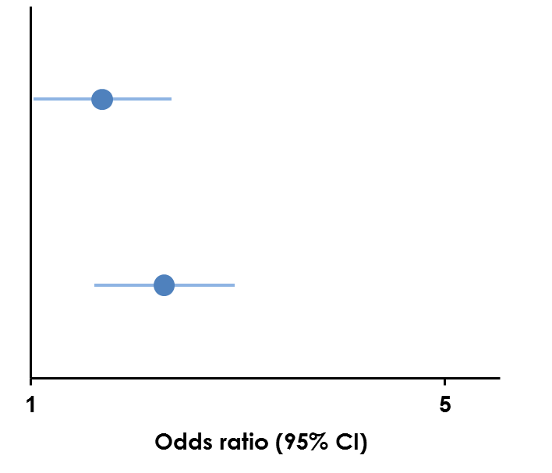
ACQ-7 responder rate at Weeks 24 and 48
(post-hoc analysis of pooled data)
→
→
 | Placebo Respimat® (n=453) | Tiotropium Respimat® (n=454)
24 weeks
Responders (%) | 46.9 | 53.9
Odds ratio |  | 1.32
(95% CI) |  | (1.01, 1.73)
P-value |  | 0.043
48 weeks
Responders (%) | 45.2 | 58.1
Odds ratio |  | 1.68
(95% CI) |  | (1.28, 2.21)
P-value |  | <0.001
Favors
placebo
Respimat®
Favors
tiotropium
Respimat®
FitzGerald M, et al. ERS 2014 oral presentation.
Data on file, Boehringer Ingelheim, September 2015.
ACQ-7, 7-question Asthma Control Questionnaire; CI, confidence interval.
Patients on at least ICS+LABA

Slide 23
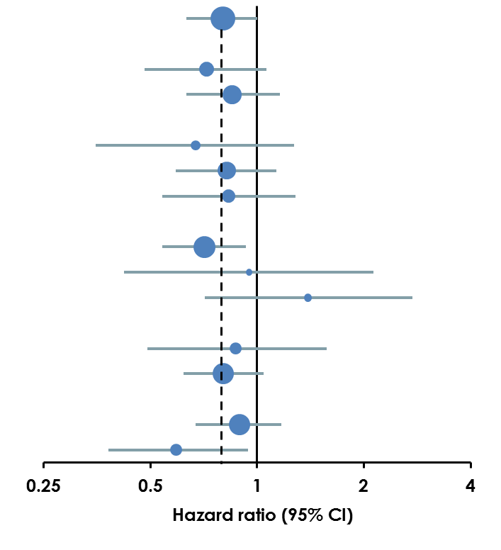
Time to first severe exacerbation by baseline characteristics
Favors
tiotropium
Respimat®
Favors
placebo
Respimat®
Baseline characteristic | Placebo Respimat® |  | Tiotropium Respimat® | Hazard ratio (95% CI) | Interaction P-value
Overall | 454 |  | 453 | 0.80 (0.63, 1.01)
Gender |  |  |  |  | 0.4882
Male | 176 |  | 182 | 0.72 (0.48, 1.06)
Female | 278 |  | 271 | 0.85 (0.63, 1.16)
Age group, years |  |  |  |  | 0.8334
<40 |  | 67 | 69 | 0.67 (0.35, 1.27)
40–60 |  | 238 | 256 | 0.82 (0.59, 1.13)
>60 |  | 149 | 128 | 0.83 (0.54, 1.28)
Race |  |  |  |  | 0.1766
White |  | 382 | 376 | 0.71 (0.54, 0.93)
Black |  | 25 | 20 | 0.95 (0.42, 2.13)
Asian |  | 46 | 55 | 1.39 (0.71, 2.74)
Duration of asthma, years |  |  |  |  | 0.7863
5–<20 |  | 101 | 113 | 0.87 (0.49, 1.57)
≥20 |  | 353 | 340 | 0.80 (0.62, 1.04)
Smoking status |  |  |  |  | 0.1534
Never |  | 352 | 338 | 0.89 (0.67, 1.17)
Ex-smoker |  | 102 | 115 | 0.59 (0.38, 0.94)
Data on file, Boehringer Ingelheim, September 2015.
CI, confidence interval.
Patients on at least ICS+LABA

Slide 24
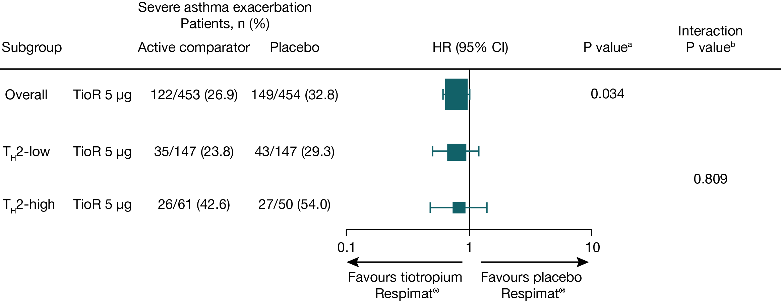
Time to first severe asthma exacerbation by overall T_{H}2 status
T_{H}2-low and T_{H}2-high subgroups defined at baseline:
  T_{H}2-low: low total serum IgE, ≤430 μg/L (equivalent to 179.2 IU/L), and low blood eosinophils, ≤0.6×10⁹/L (equivalent to 600/μL)
  T_{H}2-high: high total serum IgE, >430 μg/L, and high blood eosinophils, >0.6×10⁹/L
The height/width of the boxes in the forest plots represents the number of events proportionate to the number of events in PrimoTinA-asthma®.
ªIn PrimoTinA-asthma®, final P-value adjusted for interim analysis; ^{b}P-value adjusted for treatment-by-subgroup interaction. CI, confidence interval; HR, hazard ratio; TioR, tiotropium Respimat®.
Patients on at least ICS+LABA

Slide 25
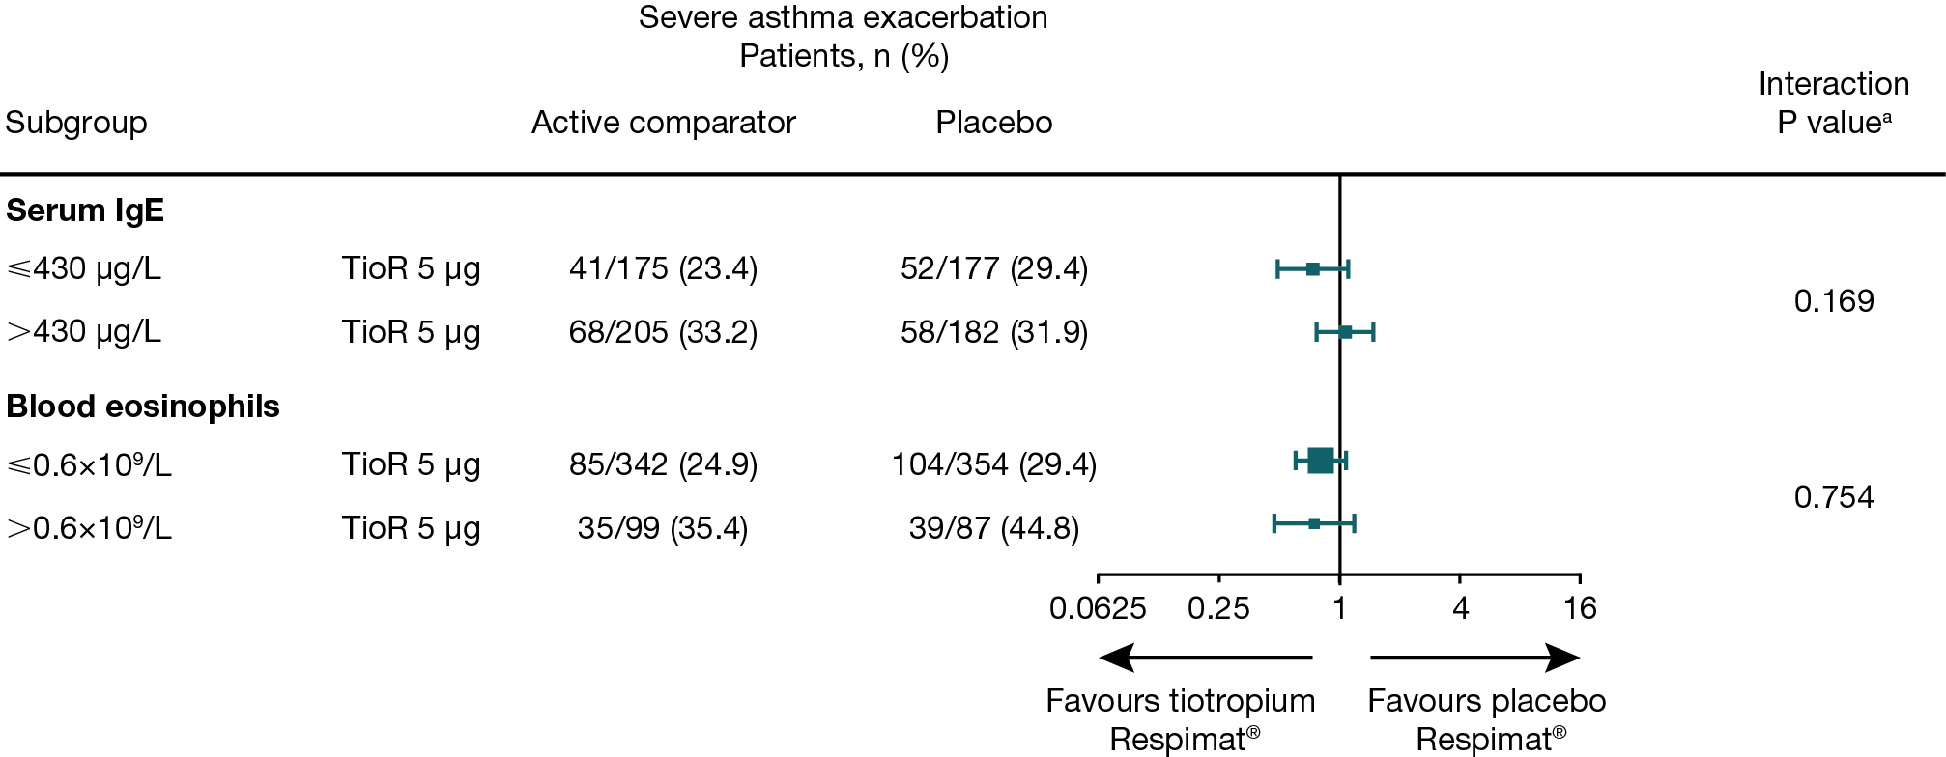
Time to first severe asthma exacerbation by IgE and blood eosinophil status
The height/width of the boxes in the forest plots represents the number of events proportionate to the number of events in PrimoTinA-asthma®.
ªP-value adjusted for treatment-by-subgroup interaction.
Patients on at least ICS+LABA

Slide 26
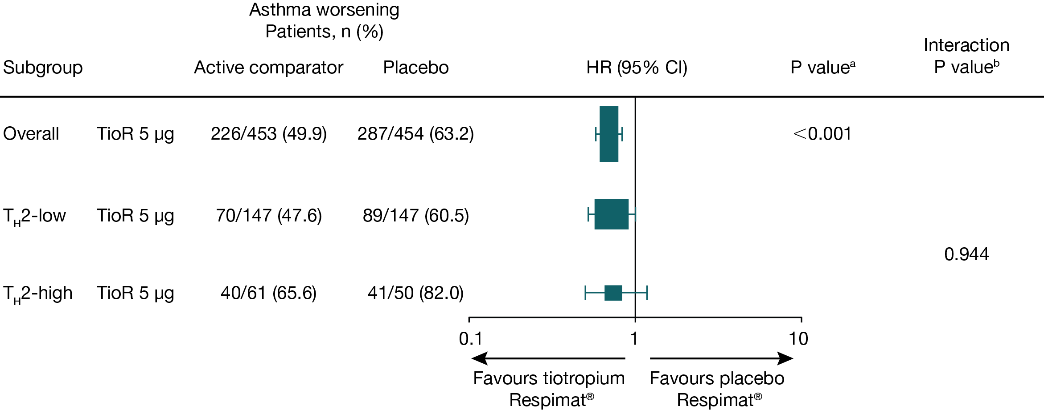
Time to first asthma worsening by overall T_{H}2 status
The height/width of the boxes in the forest plots represents the number of events proportionate to the number of events in PrimoTinA-asthma®
ªIn PrimoTinA-asthma®, final P value adjusted for interim analysis; ^{b}P value adjusted for treatment-by-subgroup interaction

Slide 27
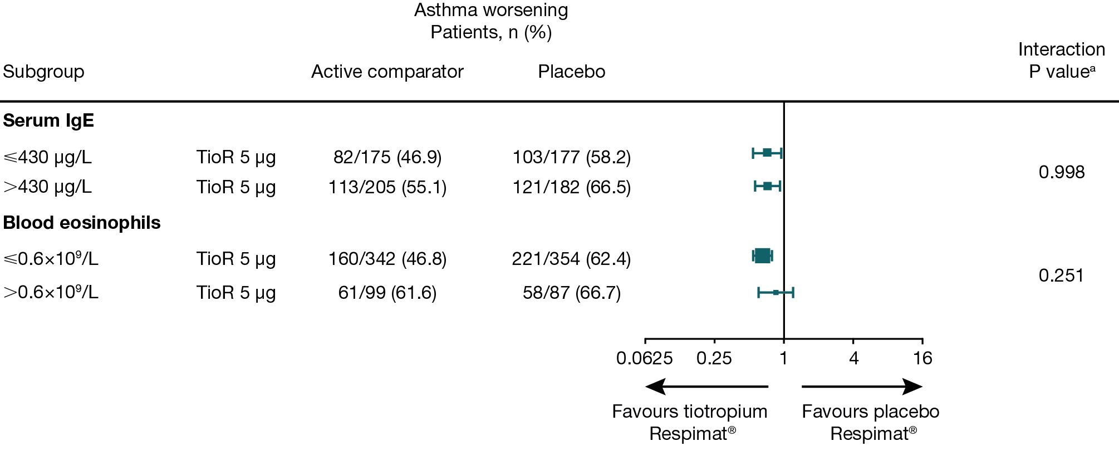
Time to first asthma worsening by IgE and blood eosinophil status
The height/width of the boxes in the forest plots represents the number of events proportionate to the number of events in PrimoTinA-asthma®
ªP value adjusted for treatment-by-subgroup interaction

Slide 28
Tiotropium Respimat® in Asthma clinical development program

Slide 29
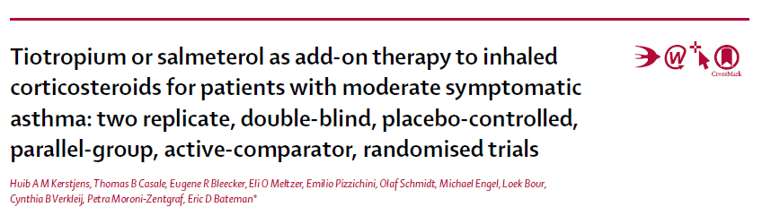

Screening
Treatment: add-on therapy
to medium-dose ICS
Follow-
up
Tiotropium Respimat® 5 µg qdª
Tiotropium Respimat® 2.5 µg qdª
Salmeterol HFA-MDI 50 µg bid^{b}
Placebo Respimat® qdª
Visit
0
1
2
3
4
5
6
7
Week
−4
0
4
8
12
24
27
Randomization
Co-primary endpoints included: ACQ-7 responder rate (pooled data)
Other co-primary endpoints were peak FEV_{1(0–3h)} and trough FEV₁ responses
Kerstjens H, et al. Lancet Respir Med. 2015;3:367–376.
ªPlus placebo HFA-MDI bid; ^{b}Plus placebo Respimat®.
HFA-MDI, hydrofluoroalkane metered-dose inhaler.
Patients on at least ICS

Slide 30
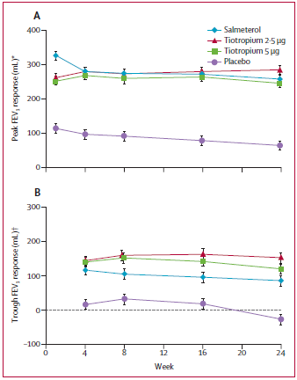
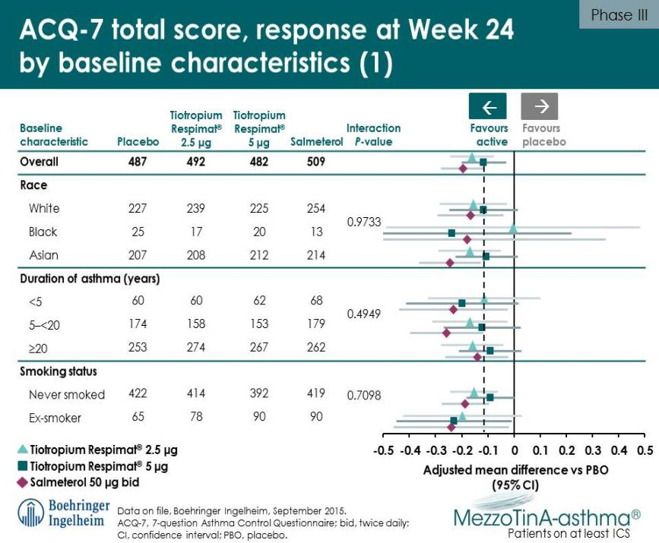
Kerstjens H, et al. Lancet Respir Med. 2015;3:367–376.
Patients on at least ICS
Notes:
We did two 24-week, replicate, randomized, double-blind, placebo-controlled, parallel-group, activecomparator
trials at 233 sites in 14 countries. Eligible patients were aged 18–75 years with symptomatic asthma and a
pre-bronchodilator forced expiratory volume in 1 s (FEV1) of 60–90% predicted despite use of medium-dose inhaled
corticosteroids, and had never smoked or were ex-smokers for 1 year or more with 10 pack-years or less. Patients were
randomly assigned (1:1:1:1), with computer-generated pseudorandom numbers, to receive once-daily tiotropium 5 μg
or 2・5 μg, twice-daily salmeterol 50 μg, or placebo, while maintaining inhaled corticosteroids. Patients and study
investigators were masked to treatment allocation. Prespecifi ed co-primary endpoints, assessed at week 24 in the full
analysis set, were peak FEV1 response, measured within the fi rst 3 h after evening dosing; trough FEV1 response; and
responder rate assessed according to the seven-question Asthma Control Questionnaire (ACQ-7). These studies are
registered with ClinicalTrials.gov, numbers NCT01172808 and NCT01172821.
Findings Between Aug 24, 2010, and Nov 13, 2012, we randomly assigned 2103 patients to the tiotropium 5 μg group
(n=519), the tiotropium 2・5 μg group (n=520), the salmeterol group (n=541), or the placebo group (n=523); 1972
(94%) patients completed the study. Peak and trough FEV1 responses were signifi cantly greater with tiotropium and
salmeterol than with placebo and were similar in both studies. With pooled data, difference versus placebo in peak
FEV1 was 185 mL (95% CI 146–223) in the tiotropium 5 μg group, 223 mL (185–262) in the tiotropium 2・5 μg group,
and 196 mL (158–234) in the salmeterol group (all p<0・0001); diff erence in trough FEV1 was 146 mL (95% CI 105–188),
180 mL (138–221), and 114 mL (73–155; all p<0・0001), respectively. There were more ACQ-7 responders in the
tiotropium 5 μg (OR 1·32, 95% CI 1·02–1·71; p=0·035) and 2・5 μg (1·33, 1·03–1·72; p=0·031) groups, and the salmeterol
group (1·46, 1·13–1·89; p=0·0039), than in the placebo group. 48 (2%) of 2100 patients had serious adverse events
(tiotropium 5 μg n=11, tiotropium 2・5 μg n=12, salmeterol n=11, placebo n=14).

Slide 31
Overall summary of adverse events for all parallel-group trials
 | Patients, %
 | PrimoTinA-asthma^{®a} |  | MezzoTinA-asthma^{®a} |  |  |  | GraziaTinA-asthma®
 | TioR 5 μg qd (n=456) | PboR qd (n=456) | TioR 5 μg qd (n=517)^{b} | TioR 2.5 μg qd (n=519)^{b} | Sal 50 μg bid (n=541)^{c} | Pbo (n=523)^{d} | TioR5 μg qd (n=155) | TioR2.5 μg qd (n=154) | PboR qd (n=155)
Any AE | 73.5 | 80.3 | 57.3 | 58.2 | 54.3 | 59.1 | 32.3 | 31.2 | 29.0
Drug-related AEs^{e} | 5.7 | 4.6 | 7.4 | 6.9 | 5.2 | 5.4 | 1.3 | 1.3 | 1.3
AEs leading to discontinuation | 1.8 | 3.1 | 1.7 | 1.2 | 1.8 | 2.5 | 0.6 | 1.3 | 0
Serious AEs | 8.1 | 8.8 | 2.1 | 2.3 | 2.0 | 2.7 | 0.6 | 0 | 0.6
Immediately life-threatening | 0.7 | 0 | 0.4 | 0.2 | 0.2 | 0 | 0 | 0 | 0.6
Disabling / incapacitating | 0.4 | 0 | 0 | 0 | 0 | 0 | 0 | 0 | 0
Requiring hospitalization | 7.7 | 8.6 | 1.5 | 2.3 | 1.8 | 2.5 | 0.6 | 0 | 0
Prolonging hospitalization | 0.7 | 0.2 | 0 | 0.2 | 0.4 | 0.2 | 0 | 0 | 0.6
Other | 0.7 | 0 | 0.4 | 0 | 0.2 | 0.2 | 0.6 | 0 | 0
Treated set.
ªPooled data; ^{b}Plus placebo HFA-MDI bid; ^{c}Plus placebo Respimat® qd; ^{d}Placebo Respimat® qd plus placebo HFA-MDI bid; ^{e}Investigator-defined.
Pbo, placebo; PboR, placebo Respimat®; TioR, Tiotropium Respimat®.

Slide 32
Adverse events reported by ≥5% of patients
 | Patients, %
 | PrimoTinA-asthma^{®a} |  | MezzoTinA-asthma^{®a} |  |  |  | GraziaTinA-asthma®
 | TioR 5 μg qd (n=456) | PboR qd (n=456) | TioR 5 μg qd (n=517)^{b} | TioR 2.5 μg qd (n=519)^{b} | Sal 50 μg bid (n=541)^{c} | Pbo (n=523)^{d} | TioR5 μg qd (n=155) | TioR2.5 μg qd (n=154) | PboR qd (n=155)
Asthma worsening / exacerbation | 39.9 | 50.9 | 21.5 | 15.8 | 19.4 | 22.0 | 11.0 | 15.6 | 12.9
Bronchitis | 5.5 | 4.4 | 2.1 | 1.7 | 1.7 | 1.0 | 1.9 | 0 | 0.6
Decreased peak expiratory flow rate | 20.4 | 26.8 | 11.4 | 9.4 | 8.7 | 15.1 | 3.9 | 5.8 | 3.9
Headache | 6.4 | 7.2 | 1.5 | 3.5 | 1.1 | 2.7 | 1.9 | 0.6 | 0
Nasopharyngitis | 11.2 | 12.3 | 7.9 | 9.4 | 7.6 | 9.2 | 0.6 | 1.3 | 3.2
Upper respiratory tract infection | 4.6 | 3.5 | 3.7 | 5.2 | 7.6 | 7.8 | 4.5 | 1.3 | 4.5
No deaths in any trial
Treated set.
ªPooled data; ^{b}Plus placebo HFA-MDI bid; ^{c}Plus placebo Respimat® qd; ^{d}Placebo Respimat® qd plus placebo HFA-MDI bid.
Pbo, placebo; PboR, placebo Respimat®; TioR, Tiotropium Respimat®.

Slide 33
Drug-related AEs
A small number of AEs considered to be drug related were reported
Asthma worsening/exacerbation and dry mouth were among the most frequently reported, in all trials:
 | Patients, %
 | PrimoTinA-asthma^{®a} |  | MezzoTinA-asthma^{®a} |  |  |  | GraziaTinA-asthma®
 | TioR 5 μg qd (n=456) | PboR qd (n=456) | TioR 5 μg qd (n=517)^{b} | TioR 2.5 μg qd (n=519)^{b} | Sal 50 μg bid (n=541)^{c} | Pbo (n=523)^{d} | TioR5 μg qd (n=155) | TioR2.5 μg qd (n=154) | PboR qd (n=155)
Asthma worsening / exacerbation, n (%) | 7 (1.5) | 7 (1.5) | 2 (0.4) | 2 (0.4) | 0 | 4 (0.8) | 0 | 1 (0.6) | 0
Dry mouth, n (%) | 6 (1.3) | 2 (0.4) | 5 (1.0) | 2 (0.4) | 1 (0.2) | 2 (0.4) | 0 | 0 | 1 (0.6)
Treated set.
ªPooled data; ^{b}Plus placebo HFA-MDI bid; ^{c}Plus placebo Respimat® qd; ^{d}Placebo Respimat® qd plus placebo HFA-MDI bid.

Slide 34
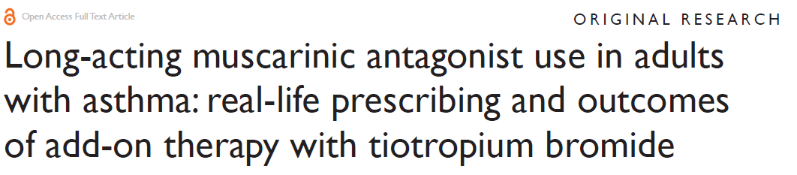
Traditional clinical studies (RCT)
→ Efficacy
Real life
→ Effectiveness
Price D. et al. Journal of Asthma and Allergy 2015:8 1–13
Notes:
Of the 2,042 study patients, 83% were prescribed an inhaled corticosteroid and 68% a long-acting β2 agonist during the baseline year; 67% were prescribed both.

Slide 35
Medical records of adults with asthma (aged >18 years) prescribed tiotropium were obtained from the UK Optimum Patient Care Research Database for the period 2001–2013.
Primary outcomes were compared in the year before (baseline) and the year after (outcome) addition of tiotropium: exacerbations (asthma-related hospital emergency department attendance or inpatient admission, or acute oral corticosteroid course) and acute respiratory events (exacerbation or antibiotic prescription).
Secondary outcomes included lung function test results and short-acting β₂ agonist use.
Price D. et al. Journal of Asthma and Allergy 2015:8 1–13
Notes:
Of the 2,042 study patients, 83% were prescribed an inhaled corticosteroid and 68% a long-acting β2 agonist during the baseline year; 67% were prescribed both.

Slide 36
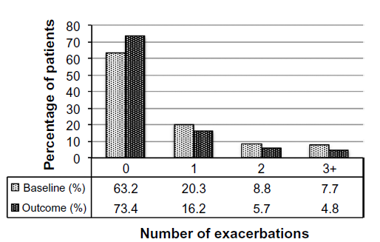
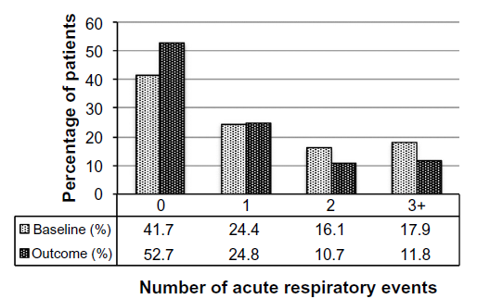
Percentage of patients having at least one exacerbation decreased from 37% to 27% (P<0.001) and the percentage having at least one acute respiratory event decreased from 58% to 47% (P<0.001)
Price D. et al. Journal of Asthma and Allergy 2015:8 1–13
Notes:
Of the 2,042 study patients, 83% were prescribed an inhaled corticosteroid and 68% a long-acting β2 agonist during the baseline year; 67% were prescribed both.

Slide 37

Summary
Once-daily tiotropium Respimat® use in asthma complements the use of other existing asthma medications
Tiotropium provides an important therapeutic option for patients with symptomatic asthma despite ICS+LABA, without the need for phenotyping
The addition of tiotropium to ICS/LABA in patients with symptomatic asthma resulted in:
  up to
  154 mL improvement in lung function
  31%
  risk reduction in asthma worsening
  21%
  risk reduction for severe asthma exacerbation
  Safety profile comparable
  to placebo
  31%
  risk reduction in asthma worsening

Slide 38
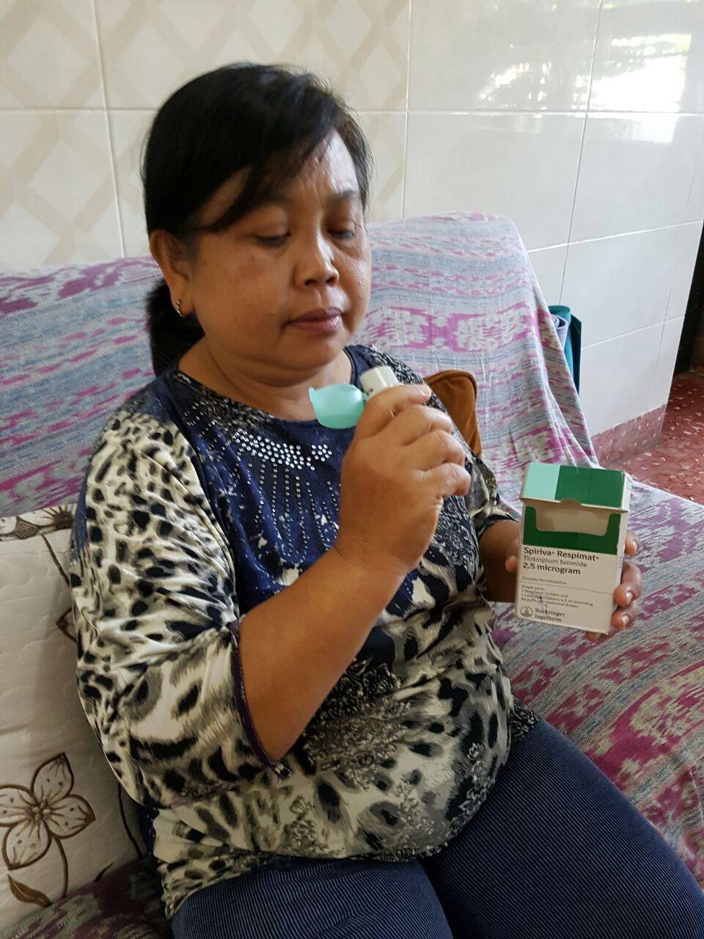
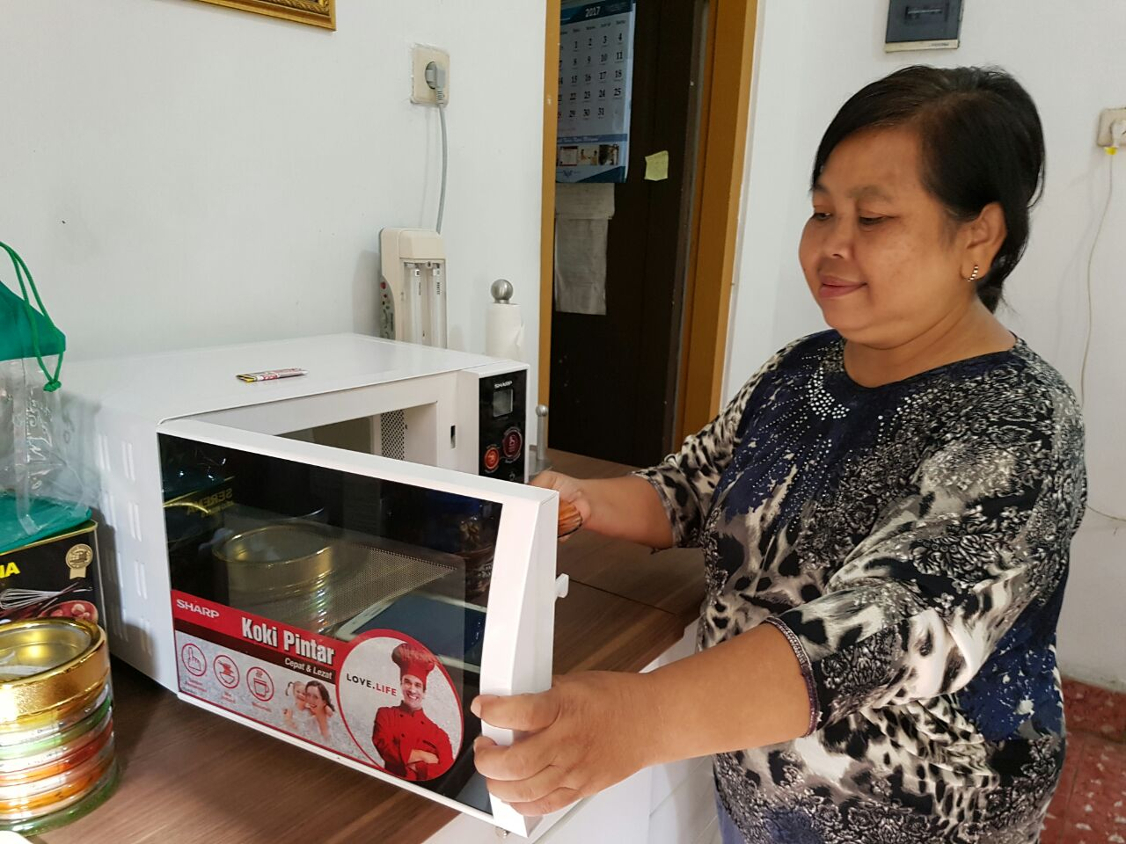
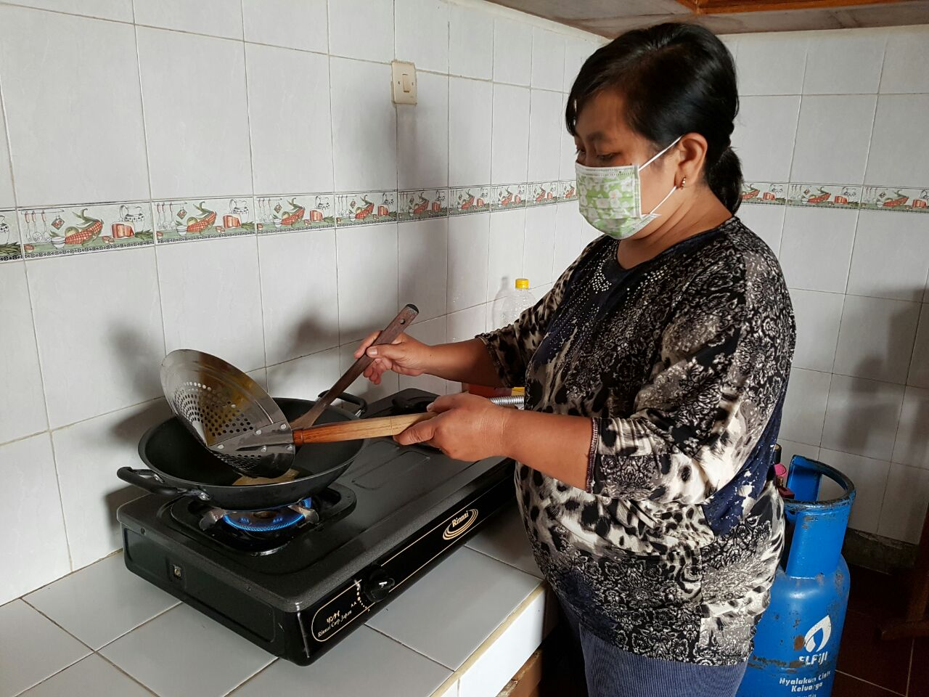
Thank you

