Slide 1
Pulmonary Rehabilitation
Nicolino Ambrosino FERS
ERS Programme Director nico.ambrosino@gmail.com
Notes:
1
1

Slide 2
Conflict of interest disclosure
X
I have no, real or perceived, direct or indirect conflicts of interest that relate to this presentation.

Slide 4
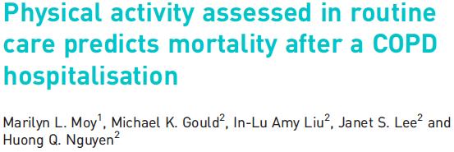
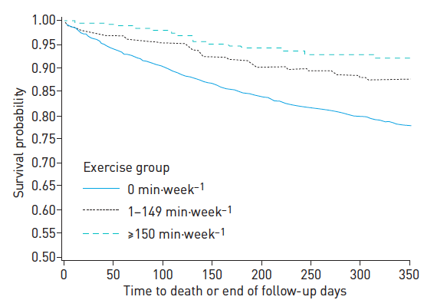

Slide 5
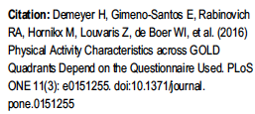
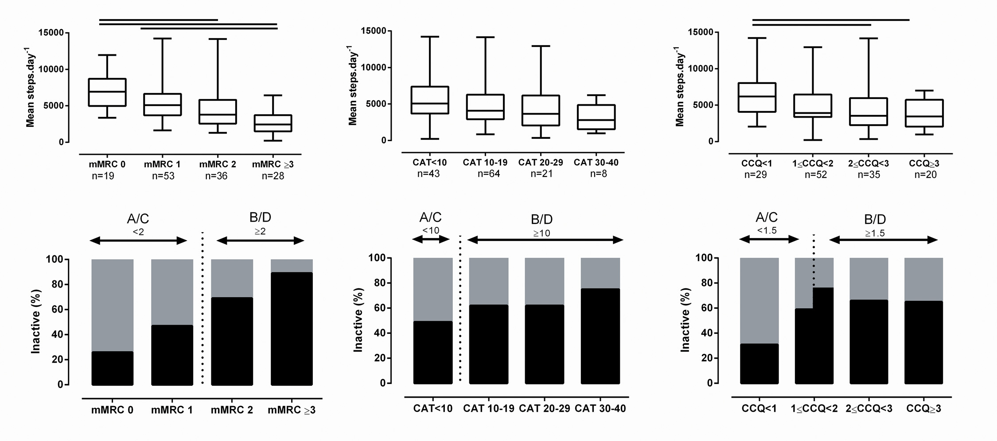

Slide 6
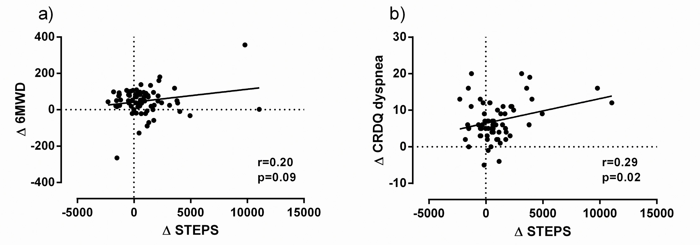
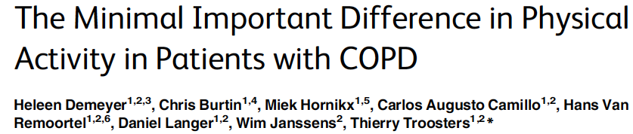
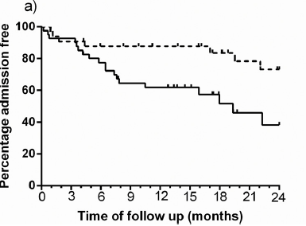
PLoS One. 2016 Apr 28;11(4):e0154587

Slide 8
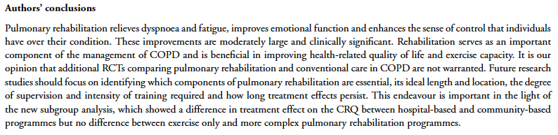

Slide 10
Siapa ?

Slide 12
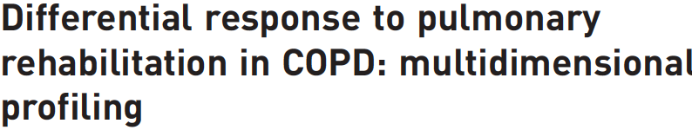

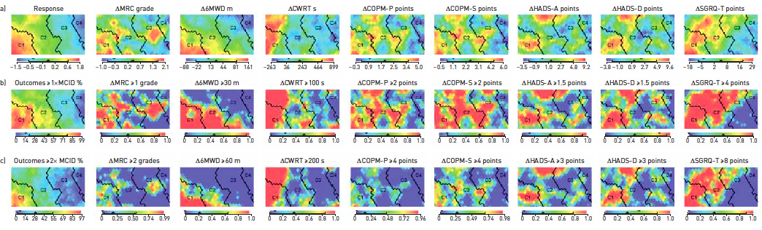
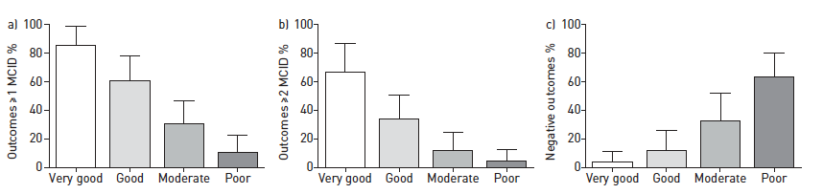

Slide 13
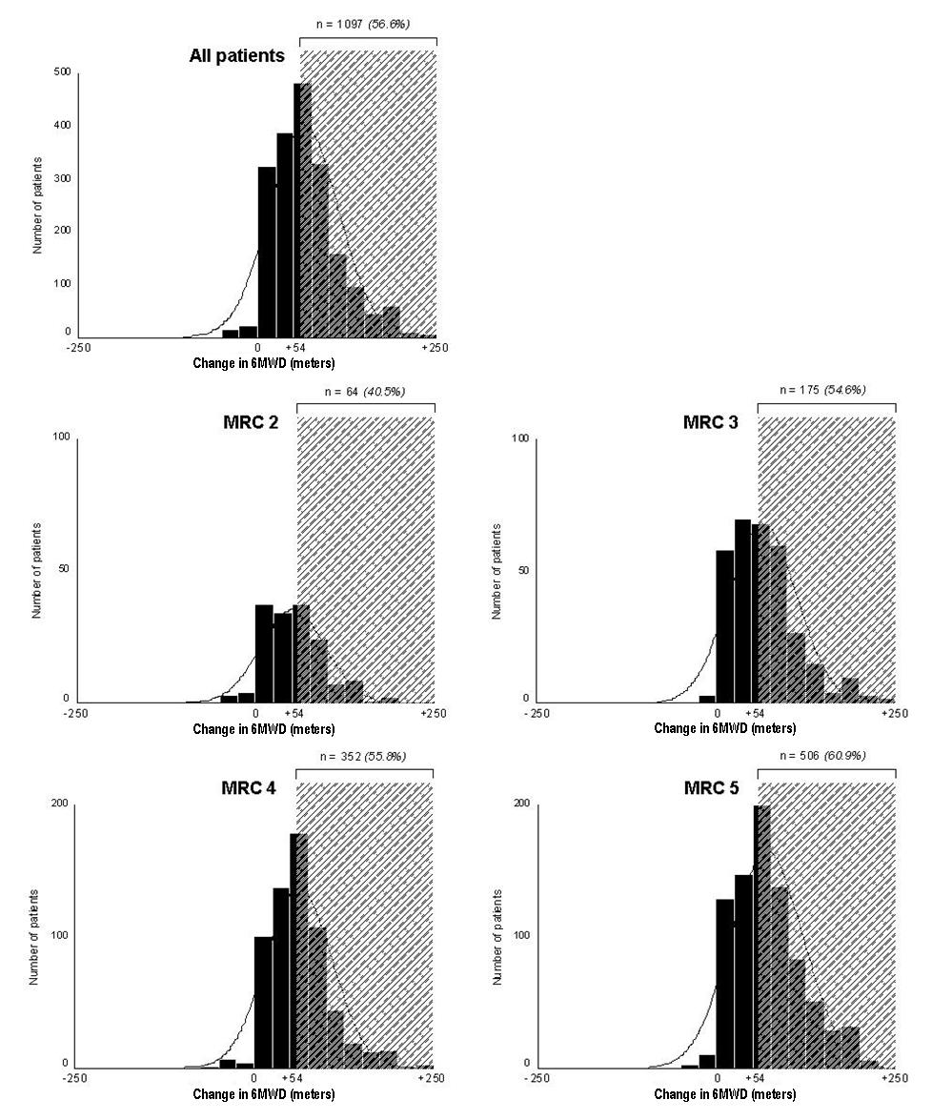
1938 AECOPD patients
Clini et al Resp Med 2009 103, 1526-1531

Slide 14
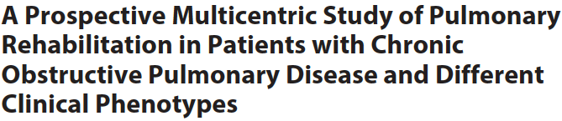

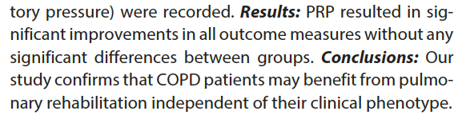

Slide 15
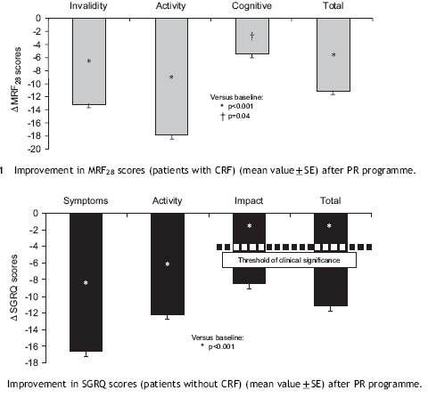

Slide 16
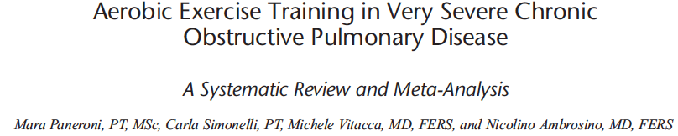
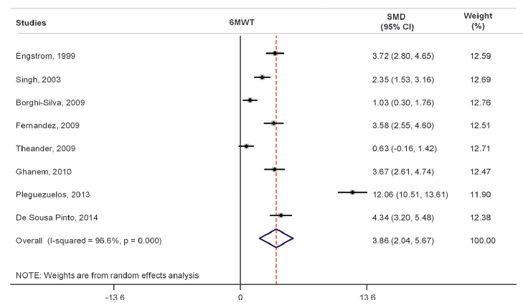
Am J Phys Med Rehabil. 2017 Jan 17

Slide 17
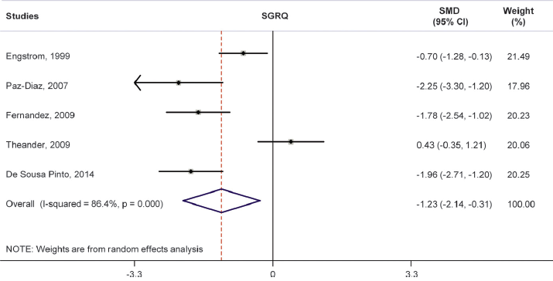
Am J Phys Med Rehabil. 2017 Jan 17

Slide 18
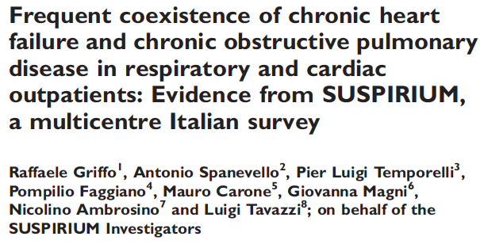

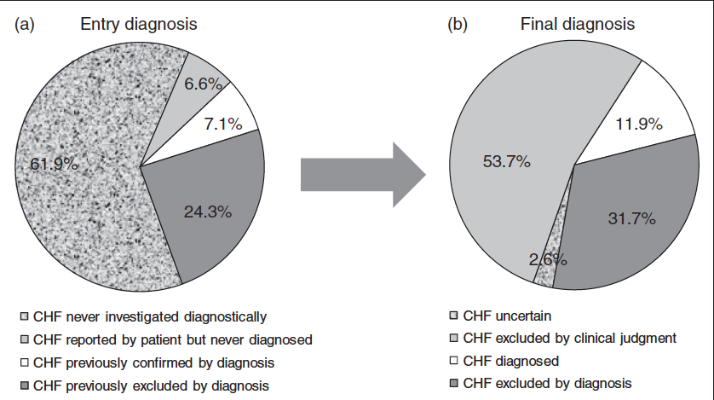
Eur J Prev Cardiol. 2017 Apr;24(6):567-576
2017 Jan 1

Slide 19
APA ?

Slide 20
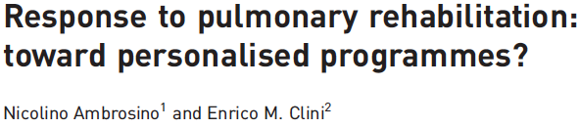

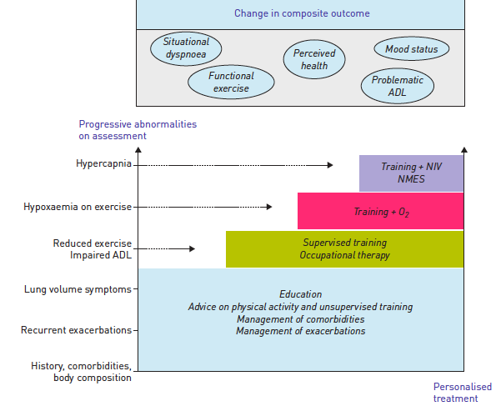

Slide 21
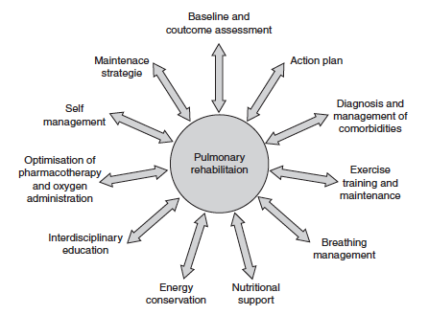

Slide 22


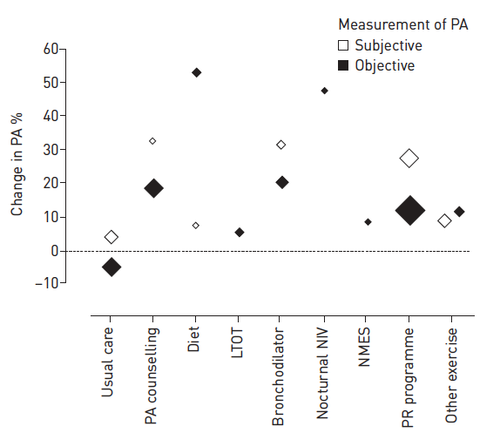

Slide 23

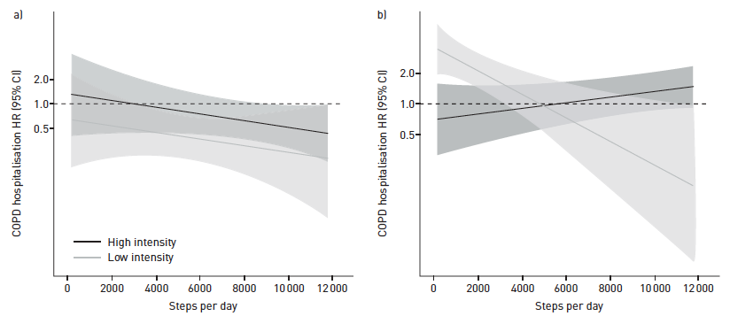

Slide 24
dimana ?

Slide 26
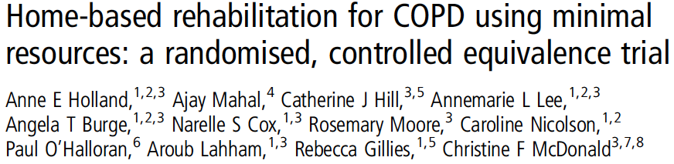
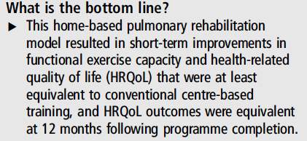
Thorax. 2017 Jan;72(1):57-65

Slide 27
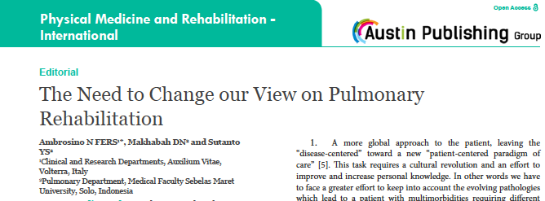




Slide 28
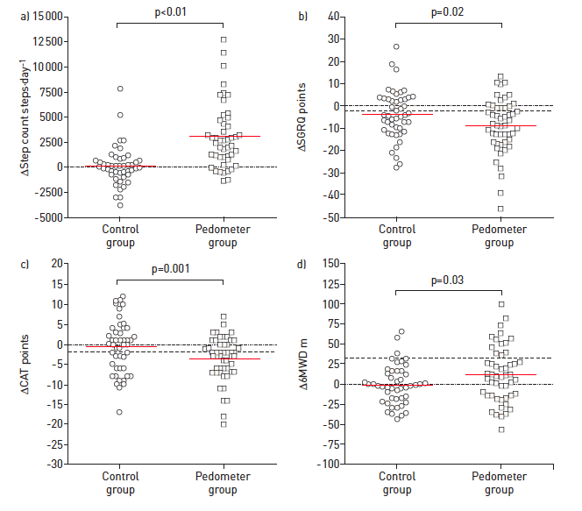


Slide 29
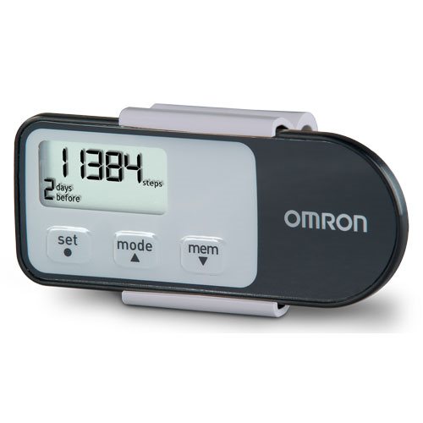
Pedometer Omron HJ 321
(Omron Healthcare Co Ltd, Kyoto, Japan)
Dr Kiki Widyastuti thesis

Slide 30
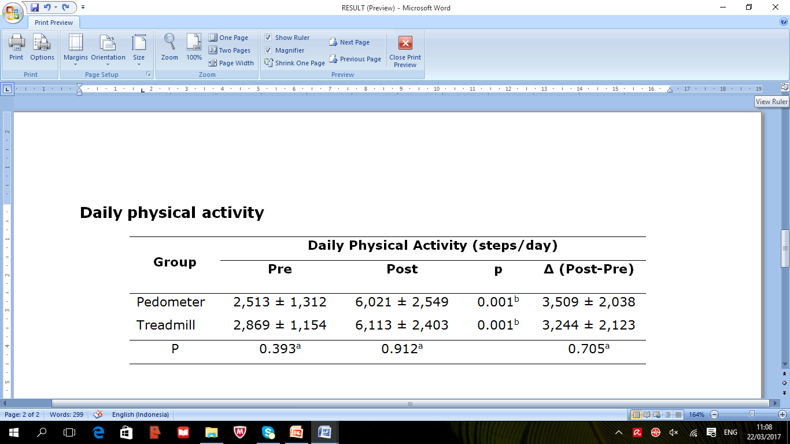
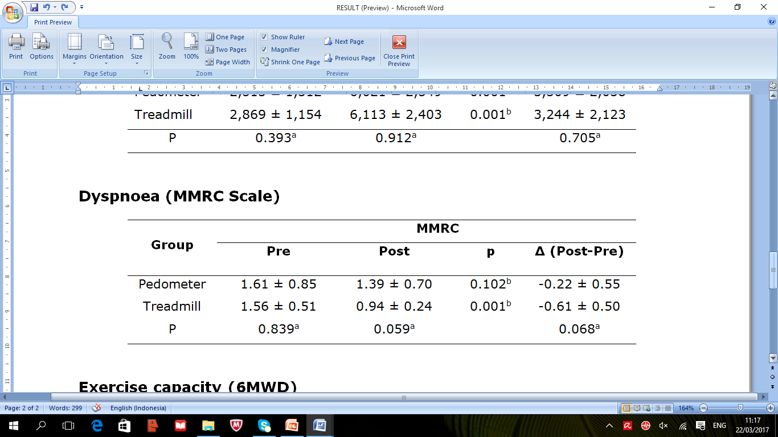
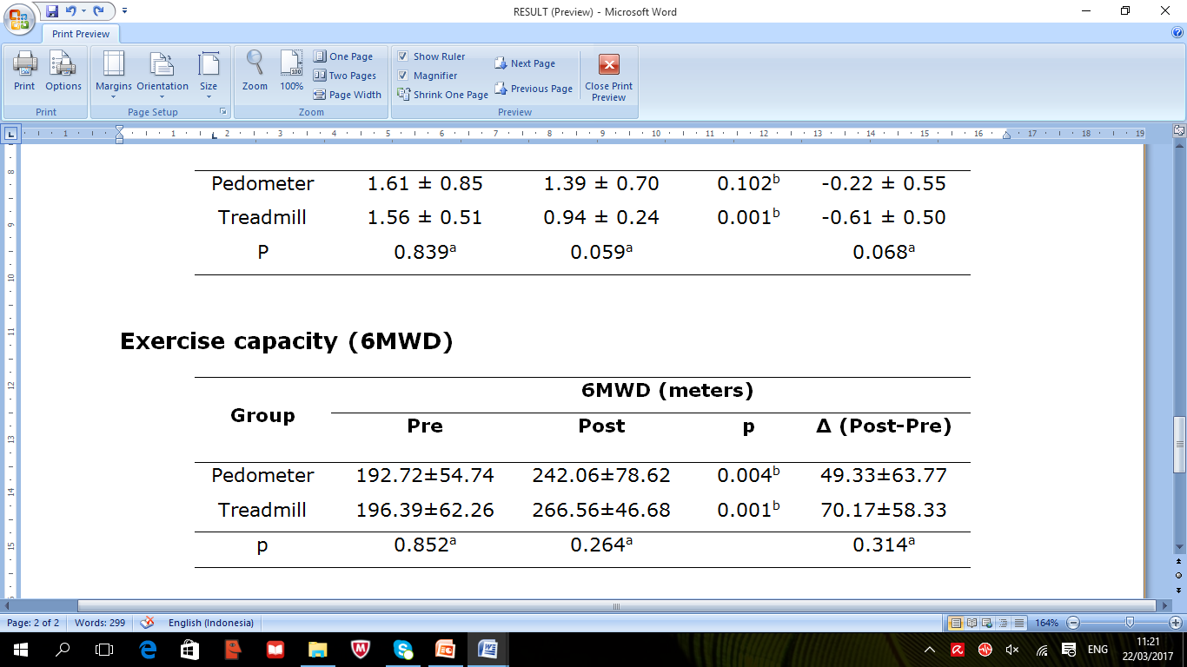

Slide 31
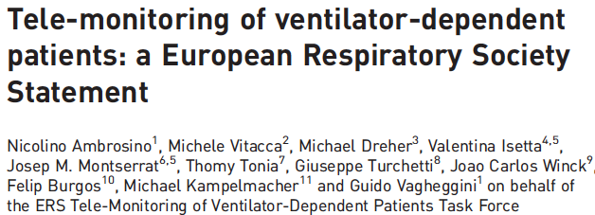

Slide 33
berita ?

Slide 34
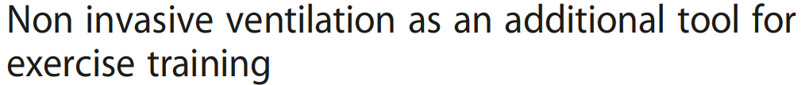
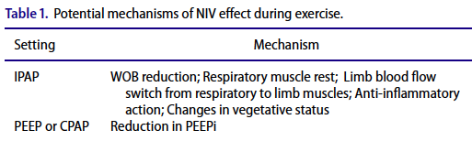
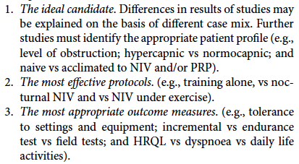

Slide 35
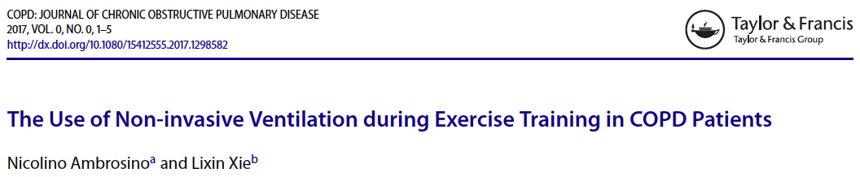
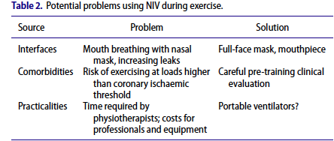

Slide 36
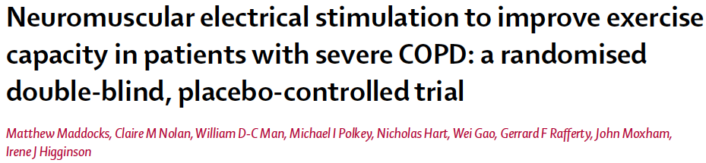

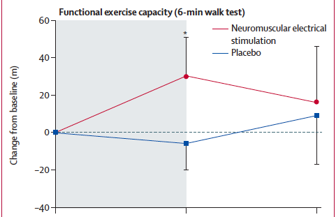
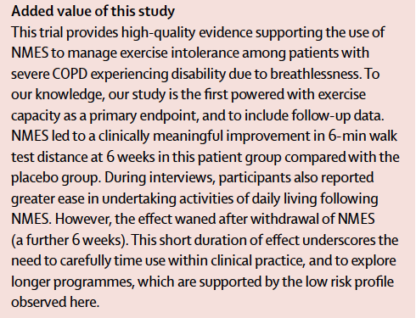
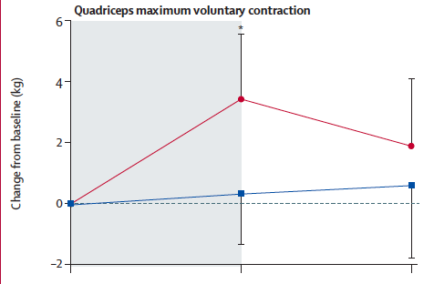

Slide 37
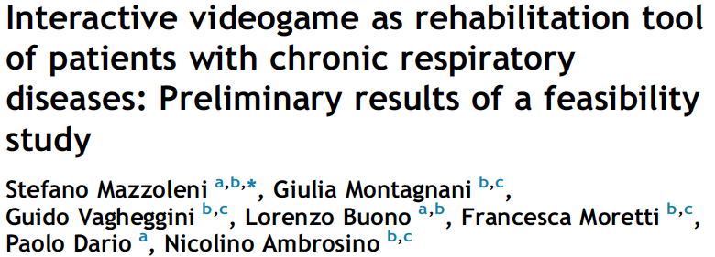
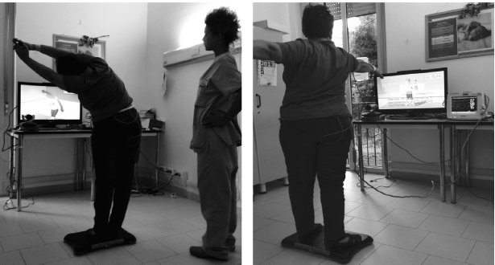
Respiratory Medicine (2014) 108, 1516-1524

Slide 38
Berapa ?

Slide 39
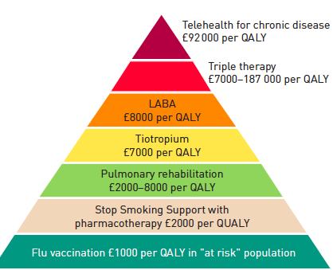

Slide 40
Kesimpulan
Physical activity important for prognosis
PR cornerstone of COPD management
Physiological changes after PR, no changes in LF
Additional tools effective
Different locations and tele-rehab effective

Slide 41

Terima Kasih

Slide 42

Effects of exercise training in COPD
Endurance
Strength (active or even passive i.e. NEMS)
Notes:
42
Arm Exercise Training g PT general Physioterapy

Slide 43
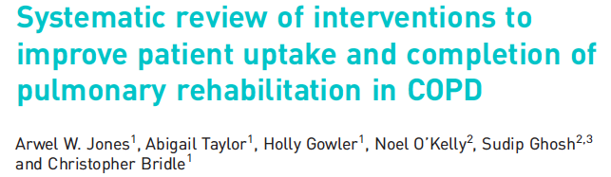
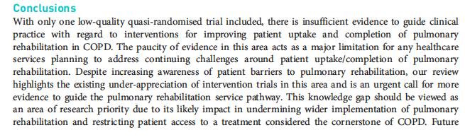

Slide 44
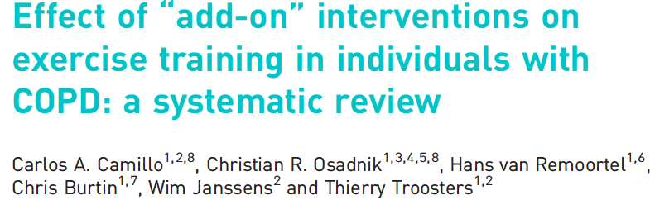

Slide 45
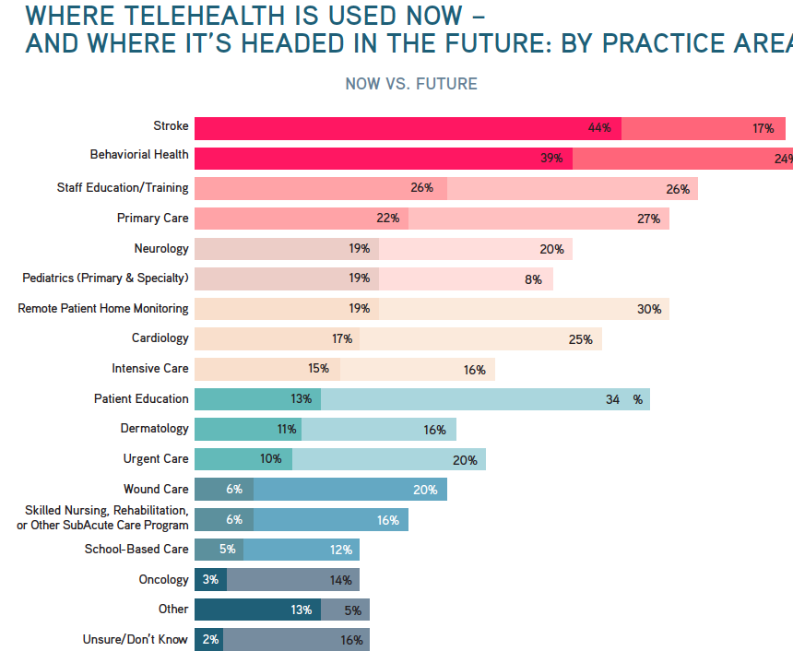

Slide 46



