Slide 1
Why LAMA is Fundamental Treatment for COPD ?
Suradi, Santi
Bagian Pulmonologi dan Kedokteran Respirasi
FKUNS / RSUD Dr. Moewardi
Surakarta
GPM-SV-0004-ID

Slide 2
Pathophysiology of COPD: Vagal Nerve System
Central
nervous
system
Vagus nerve
Airway smooth muscle
constriction
ACh
Parasympathetic
ganglion
ACh
Submucosal
gland
ACh
Cholinergic
receptors
Inflammatory
cell mediators
Airway epithelium
Irritants
(e.g. cigarette smoke, bacteria, viruses)
Mucus
Hypersecretion
Hansel TT and Barnes PJ. Drugs of Today. 2002; 38(9): 585-600
Notes:
The vagus nerve innervates the airway walls and postganglionic fibres terminate in airway smooth muscle and submucosal glands. Stimulation of the vagus nerve results in the release of acetylcholine and its interaction with M3 muscarinic receptors on airway smooth muscle cells and goblet cells in submucosal glands. This in turn leads to smooth muscle contractions and bronchoconstriction; as well as mucous production and secretion. The airways are under a constant, low level vagal stimulation which causes a certain amount of resting airway “tone”.
Further stimulation of the vagus nerve can result from the presence of chemical or mechanical irritants which are sensed by afferent C-fibres. Stimulation of these nerves leads to transmission to the CNS and increased vagal stimulation, resulting in bronchoconstriction and mucus hypersecretion in an effort to prevent the irritant from penetrating further into the lungs.
Nervus vagus menginnervasi ddg sal.npasa dan serabutpostganglion berakhir diselototpolossal.npsdankelenjar submukosa. Stimulasinervusvagus menghasilkan pelepasanasetiulkolindan ia akanberiteraksi dengan M3 reseptor muskarinik pada sel otot polos saluran napas dan goblet selpada kelenjar submukosa shg menyebabkan kontraksi otot polos dan bronkokontriksi dan juga produksi dan sekresi mukus.
Stimulasi dari nervus vagus ini dapat disebabkan dari adanya zaat kimiayang terhirupatau iritasimekanik yang disensasi olehserabut afferen lalu disampaikanke CNS dan terjadi peningkatan stimulasi N vagus shg menghasilkan bronkokontriksi dan hipersekresi mukus dlm usaha mencegah iritan masuk kedalam paru.

Slide 3
SISTEM SARAF OTONOM
PARASIMPATIS
SIMPATIS
AFEREN
ASETILKOLIN
(KOLINERGIK)
MUSKARINIK
NIKOTINIK
NOREPINEFRIN
(ADRENERGIK)

Slide 4
RESEPTOR MUSKARINIK DI PARU
Senyawa kolinergik → jalur neural dominan pada nafas manusia
Asetilkolin yang dilepaskan → kontraksi otot polos dan sekresi mukus
Senyawa antikolinergik memblok reseptor muskarinik→ mencegah terjadinya bronkokonstriksi

Slide 5
Antagonis reseptor muskarinik
 | Afinitas reseptor M3 | Afinitas M3>M2 | Waktu paruh M3
Atropin | 9.68 | Tidak ada | 3.5
Ipratropium | 9.58 | Tidak ada | 3.2
Tiotroprium | 11.02 | Selektifitas fungsional | 34.7
Glycopyrronium | 10.04 | 3-5x lebih selektif | 3.7
Aclinidium | 10.74 | Selektifitas fungsional | 29

Slide 6
GOLD 2017 UPDATE

Slide 7
Refined ABCD Assessment Grid
The ABCD assessment grid has been refined to utilize exclusively respiratory symptoms and exacerbation history to assign categories
confirmed diagnosis
of airflow limitation
Spirometrically
Assessment
Assessment of
symptoms/risk
of exacerbations
Exacerbation history
FEV (% predicted)
GOLD 1 | ≥ 80
GOLD 2 | 50 – 79
GOLD 3 | 30 – 49
GOLD 4 | <30
≥ 2 or ≥ 1 leading to hospital admission
Post-bronchodilator
FEV₁/FVC < 0.7
C
D
0 or 1 (not leading to hospital admission)
A
B
mMRC 0-1
CAT < 10
mMRC ≥ 2
CAT ≥ 10
Symptoms
@2017 Global Initiative for Chronic Obstructive Lung Disease, all rights reserved. Use is by express license from the owner
Notes:
Spirometry relevant for diagnosis, prognostication and treatment with non-pharmacological therapies
Exclusively, respiratory symptoms and exacerbation history used to assign groups and to guide therapy

Slide 8
Pharmacologic Treatment Algorithm by GOLD Group
Recommended therapy by GOLD 2017 (Blue box and Bold arrow refer to the preferred therapy)
Grup C
Grup D
Consider roflumilast if FEV1 < 50% pred. and patient has chronic bronchitis
Consider macrolide
(in former smokers)
LAMA+LABA
LABA + ICS
Further exacerbation(s)
Further
Exacerbation(s)
LAMA+LABA+ICS
Persistent symptoms/further exacerbation(s)
Further
Exacerbation(s)
LAMA
LAMA
LAMA+LABA
LABA
+ ICS
Grup A
Grup B
LAMA+LABA
Continue, stop or try alternative class of bronchodilator
Persistent Symptoms
Evaluate effect
A long-acting bronchodilator
(LAMA or LABA )
A bronchodilator
@2017 Global Initiative for Chronic Obstructive Lung Disease, all rights reserved. Use is by express license from the owner

Slide 9
Tiotropium Trials in COPD

Slide 10
Antagonis reseptor muskarinik
 | Afinitas reseptor M3 | Afinitas M3>M2 | Waktu paruh M3
Atropin | 9.68 | Tidak ada | 3.5
Ipratropium | 9.58 | Tidak ada | 3.2
Tiotroprium | 11.02 | Selektifitas fungsional | 34.7
Glycopyrronium | 10.04 | 3-5x lebih selektif | 3.7
Aclinidium | 10.74 | Selektifitas fungsional | 29

Slide 11
...Tiotropium
Durasi lebih panjang dalam berikatan M1 dan M3 dibandingkan M2, menghambat reseptor M2 pada pada saat awal pemberian
Onset : puncak bronkodilatasi 3-4 jam. Durasi kerja lama (1-2 hari), Sebagai bronkodilator yang dikonsumsi 1 kali sehari.
Efek samping inhalasi tiotropium tidak ada

Slide 12
Tiotropium Significantly Reduces Exacerbation Rate and Delays Onset of First Exacerbation
 | Versus | Patient Number | Duration | Exacerbation Number | Patients with >1 Exacerbation | Time to First Exacerbation
Brusasco 2003 | Placebo | 1207 | 6 months | 28% P<0.025 | -18% P=0.06 | P<0.01
Niewoehner 2005* | Placebo | 1829 | 6 months | -19% P=0.031 | -13% P=0.04 | P=0.03
Casaburi 2002 | Placebo | 921 | 1 year | -20% P=0.045 | -14% P<0.05 | P=0.01
Vincken 2002 | Ipratropium | 535 | 1 year | -24% P=0.006 | -11% P=0.01 | P=0.008
Dusser 2006 | Placebo | 1010 | 1 year | -35% P<0.001 | -17% P<0.01 | P<0.001
Powrie 2007 | Placebo | 142 | 1 year | -52% P=0.001 | -33% P=0.01 | P=0.01
Freeman 2007 | Placebo | 395 | 12 weeks | n/a | -47% P=0.01 | n/a
Chan 2007 | Placebo | 913 | 1 year | 4% P=0.599 | + 8% P=0.4 | n/a
*Primary endpoint: exacerbation
1. Brusasco V et al. Thorax 2003; 58:399-404.; 2. Niewoehner DE et al. Ann Intern Med 2005;143:317-26.; 3. Casaburi R et al. Eur Respir J 2002; 19:217-224.; 4. Vincken W et al. Eur Respir J 2002; 19:209-216.; 5. Dusser D et al. Eur Respir J 2006; 27:547-555.; 6. Powrie DJ et al. Eur Respir J 2007; 30: 1–8.; 7. Freeman D et al. Respiratory Research 2007; 8:45-55.; 8. Chan CK et al. Can Respir J 2007;14:465-72.
Notes:
Brusasco V et al. Thorax 2003; 58:399-404.
Niewoehner DE et al. Ann Intern Med 2005;143:317-26.
Casaburi R et al. Eur Respir J 2002; 19:217-224.
Vincken W et al. Eur Respir J 2002; 19:209-216.
Dusser D et al. Eur Respir J 2006; 27:547-555.
Powrie DJ et al. Eur Respir J 2007; 30: 1–8.
Freeman D et al. Respiratory Research 2007; 8:45-55.
Chan CK et al. Can Respir J 2007;14:465-72.

Slide 13
Tiotropium Significantly Reduces Exacerbation Rate and Delays Onset of First Exacerbation
 | Versus | Patient Number | Duration | Exacerbation Number | Patients with >1 Exacerbation | Time to First Exacerbation
Brusasco 2003 | Placebo | 1207 | 6 months | 28% P<0.025 | -18% P=0.06 | P<0.01
Niewoehner 2005* | Placebo | 1829 | 6 months | -19% P=0.031 | -13% P=0.04 | P=0.03
Casaburi 2002 | Placebo | 921 | 1 year | -20% P=0.045 | -14% P<0.05 | P=0.01
Vincken 2002 | Ipratropium | 535 | 1 year | -24% P=0.006 | -11% P=0.01 | P=0.008
Dusser 2006 | Placebo | 1010 | 1 year | -35% P<0.001 | -17% P<0.01 | P<0.001
Powrie 2007 | Placebo | 142 | 1 year | -52% P=0.001 | -33% P=0.01 | P=0.01
Freeman 2007 | Placebo | 395 | 12 weeks | n/a | -47% P=0.01 | n/a
Chan 2007 | Placebo | 913 | 1 year | 4% P=0.599 | + 8% P=0.4 | n/a
Time to First Exacerbation
Means - Prevention
*Primary endpoint: exacerbation
1. Brusasco V et al. Thorax 2003; 58:399-404.; 2. Niewoehner DE et al. Ann Intern Med 2005;143:317-26.; 3. Casaburi R et al. Eur Respir J 2002; 19:217-224.; 4. Vincken W et al. Eur Respir J 2002; 19:209-216.; 5. Dusser D et al. Eur Respir J 2006; 27:547-555.; 6. Powrie DJ et al. Eur Respir J 2007; 30: 1–8.; 7. Freeman D et al. Respiratory Research 2007; 8:45-55.; 8. Chan CK et al. Can Respir J 2007;14:465-72.
Notes:
Brusasco V et al. Thorax 2003; 58:399-404.
Niewoehner DE et al. Ann Intern Med 2005;143:317-26.
Casaburi R et al. Eur Respir J 2002; 19:217-224.
Vincken W et al. Eur Respir J 2002; 19:209-216.
Dusser D et al. Eur Respir J 2006; 27:547-555.
Powrie DJ et al. Eur Respir J 2007; 30: 1–8.
Freeman D et al. Respiratory Research 2007; 8:45-55.
Chan CK et al. Can Respir J 2007;14:465-72.

Slide 14
POET-COPD® Trial
First head-to-head trial comparing a LAMA bronchodilator with a LABA on exacerbations outcomes
Strict focus on exacerbations
History of exacerbations required
All concomitant medications permitted except for anticholinergics or LABAs
LAMA=long-acting Muscarinic Antagonist
LABA=long-acting β₂₋agonist.
Vogelmeier C et al. N Engl J Med 2011;364:1093-1103.
Notes:
14

Slide 15
POET-COPD®: Tiotropium Significantly Delayed Time to First Exacerbation
50
45
Tiotropium
Salmeterol
17%
Risk difference
40
35
30
25
Probability of COPD exacerbation (%)
20
15
Hazard ratio = 0.83*
(95% CI, 0.77, 0.90)
P<0.001 (log-rank test)
10
5
0
0
30
60
90
120
150
180
210
240
270
300
330
360
Time to event (days)
No. of patients at risk:
Tiotropium | 3707 | 3369 | 3136 | 2955 | 2787 | 2647 | 2561 | 2455 | 2343 | 2242 | 2169 | 2107 | 1869
Salmeterol | 3669 | 3328 | 3028 | 2802 | 2605 | 2457 | 2351 | 2251 | 2137 | 2050 | 1982 | 1915 | 1657
Vogelmeier C et al. N Engl J Med 2011;364:1093-1103.
*Cox regression adjusted for (pooled) centre and treatment.
Notes:
15
Tiotropium significantly increased the time to first exacerbation (primary endpoint) compared with salmeterol by 42 days (187 vs 145 days in the first quartile of patients), corresponding to a 17% reduction in risk (HR 0.83; 95% CI 0.77-0.90; P<0.001).
Given that less than 50% of patients experienced an exacerbation, it was not possible to calculate the median time to first exacerbation, therefore the time to first exacerbation in the first quartile of patients was calculated instead.
Randomized patients taking ≥1 dose of study medication included in analysis. COPD exacerbations with onset during actual treatment.
Hazard ratio based on Cox proportional hazards regression model including terms for (pooled) centre and treatment.

Slide 16
POET-COPD®: Tiotropium Significantly Delayed Time to First Severe Exacerbation
20
Tiotropium
Salmeterol
15
28%
Risk difference
Probability of hospitalized COPD exacerbation (%)
10
5
Hazard ratio = 0.72*
(95% CI, 0.61, 0.85)
P<0.001 (log-rank test)
0
0
30
60
90
120
150
180
210
240
270
300
330
360
Time to event (days)
No. of patients at risk:
Tiotropium | 3707 | 3564 | 3453 | 3359 | 3285 | 3217 | 3177 | 3125 | 3066 | 3017 | 2977 | 2984 | 2663
Salmeterol | 3669 | 3502 | 3362 | 3244 | 3172 | 3080 | 3032 | 2982 | 2921 | 2870 | 2834 | 2806 | 2489
*Cox regression adjusted for (pooled) centre and treatment.
Vogelmeier C et al. N Engl J Med 2011;364:1093-1103.
Notes:
16
Randomized patients taking ≥1 dose of study medication included in analysis. COPD exacerbations with onset during actual treatment.
Hazard ratio based on Cox proportional hazards regression model including terms for (pooled) centre and treatment.

Slide 17
Tiotropium Reduced Number of Exacerbations
RR 0.89*
(95% CI 0.83, 0.96)
P=0.002
Tiotropium
RR 0.93*
(95% CI 0.86, 1.00)
P=0.048
Salmeterol
RR 0.73*
(95% CI 0.66, 0.82)
P<0.001
RR=rate ratio.
*Poisson regression correcting for overdispersion and adjusted for treatment exposure.
Vogelmeier C et al. N Engl J Med 2011;364:1093-1103.
Notes:
17
17
Randomized patients taking ≥1 dose of study medication included in analysis.
COPD exacerbations with onset during actual treatment.
Poisson regression correcting for overdispersion and adjusted for treatment exposure.
Analysis using negative binomial regression showed similar results.

Slide 18
POET-COPD®: Time to First Exacerbation by Subgroup Consistent with Overall Cohort
Characteristic
Tiotropium n/N
Salmeterol n/N
Hazard Ratio (95% CI)
P-value*
Hazard ratio for at least one COPD exacerbation
Age group
0.76
<55 y
237/655
258/665
0.88 (0.74, 1.05)
≥55 to <65 y
484/1462
522/1426
0.87 (0.77, 0.98)
≥65 y
556/1590
634/1578
0.83 (0.74, 0.93)
Sex
0.83
Male
913/2759
1016/2747
0.86 (0.78, 0.94)
Female
364/948
398/922
0.84 (0.73, 0.97)
GOLD stage
0.05
Stage II
561/1781
635/1833
0.88 (0.79, 0.99)
Stage III
589/1597
627/1545
0.86 (0.77, 0.97)
Stage IV
127/329
152/291
0.64 (0.50, 0.81)
Smoking status
0.64
Noncurrent
678/1929
746/1896
0.84 (0.75, 0.93)
Current
599/1778
668/1773
0.87 (0.78, 0.97)
BMI group
0.17
<20
105/286
134/271
0.66 (0.51, 0.85)
≥20 to <25
455/1230
501/1254
0.89 (0.79, 1.02)
≥25 to <30
424/1276
468/1284
0.87 (0.76, 0.99)
≥30
293/915
311/860
0.85 (0.72, 1.00)
ICS use at baseline
0.41
Yes
785/1986
839/1955
0.87 (0.79, 0.96)
No
492/1721
575/1714
0.82 (0.73, 0.92)
0.4
0.6
0.8
1
1.2
1.4
*n=no. patients with event; N=total no. patients.
*Subgroup by treatment interaction. GOLD=Global Initiative for Chronic Obstructive Lung Disease; BMI=body-mass index; ICS=inhaled corticosteroid.
Favours tiotropium
Favours salmeterol
Vogelmeier C et al. N Engl J Med 2011;364:1093-1103.
Notes:
Hazard ratios based on subgroup-wise Cox regression with terms for treatment and represented by rectangles with area proportional to the fraction of patients within the subgroup category.
Error bars represent 95% confidence intervals.
n=number of patients with at least one exacerbation.
N=total number of patients.
Patients with low BMI or very severe COPD seemed to benefit most from tiotropium. However, the p-values for testing an interaction between treatment effect and subgroup were 0.17 for BMI and 0.05 for GOLD stage.
Interaction p-values: age group 0.76, gender 0.83, COPD severity stage (GOLD) 0.05, smoking status 0.64, BMI group 0.17, ICS use at baseline 0.41.

Slide 19
POET-COPD®: Time to First Exacerbation by Subgroup Consistent with Overall Cohort
Characteristic
Tiotropium n/N
Salmeterol n/N
Hazard Ratio (95% CI)
P-value*
Hazard ratio for at least one COPD exacerbation
Age group
0.76
<55 y
237/655
258/665
0.88 (0.74, 1.05)
≥55 to <65 y
484/1462
522/1426
0.87 (0.77, 0.98)
≥65 y
556/1590
634/1578
0.83 (0.74, 0.93)
Sex
0.83
Male
913/2759
1016/2747
0.86 (0.78, 0.94)
Tiotropium was significantly more effective across almost all subgroup compared to salmeterol
Female
364/948
398/922
0.84 (0.73, 0.97)
GOLD stage
0.05
Stage II
561/1781
635/1833
0.88 (0.79, 0.99)
Stage III
589/1597
627/1545
0.86 (0.77, 0.97)
Stage IV
127/329
152/291
0.64 (0.50, 0.81)
Smoking status
0.64
Noncurrent
678/1929
746/1896
0.84 (0.75, 0.93)
Current
599/1778
668/1773
0.87 (0.78, 0.97)
BMI group
0.17
<20
105/286
134/271
0.66 (0.51, 0.85)
≥20 to <25
455/1230
501/1254
0.89 (0.79, 1.02)
≥25 to <30
424/1276
468/1284
0.87 (0.76, 0.99)
≥30
293/915
311/860
0.85 (0.72, 1.00)
ICS use at baseline
0.41
Yes
785/1986
839/1955
0.87 (0.79, 0.96)
No
492/1721
575/1714
0.82 (0.73, 0.92)
0.4
0.6
0.8
1
1.2
1.4
*n=no. patients with event; N=total no. patients.
*Subgroup by treatment interaction. GOLD=Global Initiative for Chronic Obstructive Lung Disease; BMI=body-mass index; ICS=inhaled corticosteroid.
Favours tiotropium
Favours salmeterol
Vogelmeier C et al. N Engl J Med 2011;364:1093-1103.
Notes:
Hazard ratios based on subgroup-wise Cox regression with terms for treatment and represented by rectangles with area proportional to the fraction of patients within the subgroup category.
Error bars represent 95% confidence intervals.
n=number of patients with at least one exacerbation.
N=total number of patients.
Patients with low BMI or very severe COPD seemed to benefit most from tiotropium. However, the p-values for testing an interaction between treatment effect and subgroup were 0.17 for BMI and 0.05 for GOLD stage.
Interaction p-values: age group 0.76, gender 0.83, COPD severity stage (GOLD) 0.05, smoking status 0.64, BMI group 0.17, ICS use at baseline 0.41.

Slide 20
POET-COPD® : Discontinuing ICS did not Increase Rate of Exacerbations in Tiotropium Arm
 | Tiotropium n/N | Salmeterol n/N | Hazard Ratio (95%CI) Tio vs Sal | p-value*
Concomitant ICS therapy during study
Continuous | 614/1488 | 629/1444 | 0.91(0.82-1.02) | 0.09
Never | 554/2024 | 650/2022 | 0.81(0.72-0.91)
Cox regression adjusted for treatment, subgroup, and interaction between treatment and subgroup
* for interaction between treatment and subgroup
Vogelmeier C et al. N Engl J Med 2011;364:1093-1103.

Slide 21
POET-COPD®: More Patients Receiving Concomitant ICS Experienced Pneumonia
180 reported pneumonia cases
158 (87.8%) radiologically confirmed
70 in the tiotropium group
88 in the salmeterol group
Higher numbers of patients with ≥1 radiologically confirmed pneumonia were receiving concomitant ICS for ≥1 day on treatment
n=89, 2.7% (n=72 hospitalized) – concomitant ICS
n=59, 1.5% (n=46 hospitalized) – no concomitant ICS
Vogelmeier C et al. N Engl J Med 2011;364:1093-1103.

Slide 22
POET COPD :
GOLD II and Maintenance Naïve Patients
Tiotropium is beneficial even in early COPD patients
Subgroup analysis of the primary endpoint ‘ time to first COPD exacerbation’ for COPD severity stage (GOLD) and patients who were maintenance therapy naïve or receiving prior maintenance therapy
Vogelmeier C, et al. Respiratory Medicine. 2013; 107: 75-83

Slide 23
The POET-COPD Conclusion
Tiotropium was significantly more effective than salmeterol in almost all assessed exacerbation endpoints and across all major patient subgroups
Addition of ICS did not affect the outcome of exacerbation; prevention of exacerbations by tiotropium alone appears to be efficient
Adverse events seen in the POET-COPD® trial were consistent with the well-established, long-term safety profile of tiotropium
Vogelmeier C, et al. Respiratory Medicine. 2013; 107: 75-83
Notes:
prevention of exacerbations by tiotropium alone appears to be efficient

Slide 24
A 4-Year Trial of Tiotropium in Chronic Obstructive Pulmonary Disease
Donald P. Tashkin, M.D., Bartolome Celli, M.D., Stephen Senn, Ph.D., Deborah Burkhart, B.S.N., Steven Kesten, M.D., Shailendra Menjoge, Ph.D., Marc Decramer, M.D., Ph.D., for the UPLIFT Study Investigators
N Engl J Med
Volume 359(15):1543-1554
October 9, 2008

Slide 25
Kaplan-Meier Estimates of the Probability of COPD Exacerbation and Death from Any Cause
Tashkin DP et al. N Engl J Med 2008;359:1543-1554

Slide 26
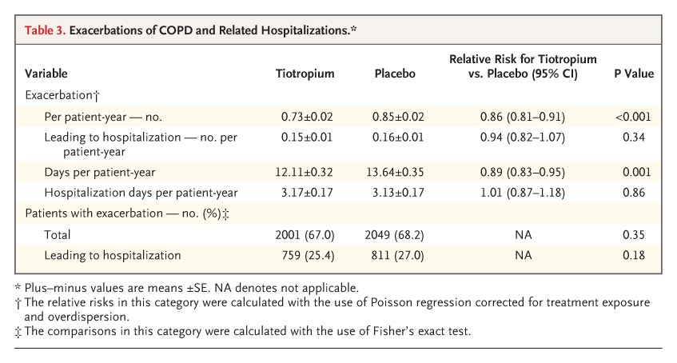
Exacerbations of COPD and Related Hospitalizations
Tashkin DP et al. N Engl J Med 2008;359:1543-1554

Slide 27
Incidence Rate of Serious Adverse Events per 100 Patient-Years
Tashkin DP et al. N Engl J Med 2008;359:1543-1554

Slide 28
Take Home Message
Cholinergic tone impacts bronchoconstriction in COPD
Tiotropium has shown effective to reduce exacerbation rate and delay time to first exacerbation → time to first exacerbation means prevention
LAMA vs. LABA:
Compared to salmeterol (LABA), tiotropium (LAMA) was significantly more effective in preventing exacerbations and prevention of exacerbations by tiotropium alone appears to be efficient
Compared to indacaterol (LABA), tiotropium (LAMA) was statistically significant 20% reducing the risk of the time to first COPD exacerbation
In patients with COPD, therapy with tiotropium was associated with improvements in lung function, quality of life, and exacerbations during a 4-year period but did not significantly reduce the rate of decline in FEV₁

Slide 29
Their future is in our hands
Thank You

Slide 30
Spiriva Inhalers

Slide 31
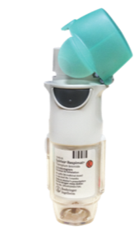
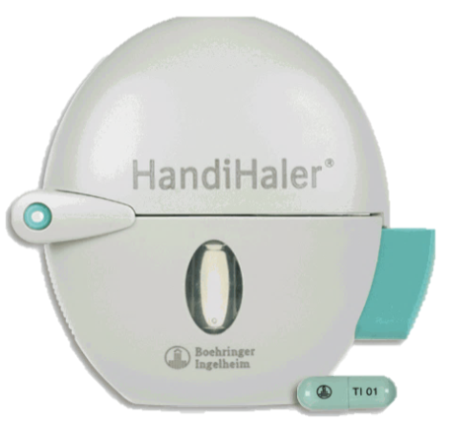
Spiriva® HandiHaler®
Spiriva® Respimat®
Tiap 1 kapsul inhalasi mengandung tiotropium 18 mcg, diinhalasi melalui alat yang disebut dengan HandiHaler®
Dosis 1 kapsul inhalasi/hari
Tiap 1 semprot mengandung 2.5 mcg tiotropium diberikan melalui alat inhalasi yang disebut dengan Respimat®
Dosis 2 semprot sekali sehari
1. Informasi Produk Lokal Spiriva 2015; 2. Informasi Produk Lokal Spiriva Respimat 2015
Notes:
Key points
A major advantage of tiotropium therapy for chronic obstructive pulmonary disease (COPD), is that patients have the choice of two alternative devices: the single-dose HandiHaler® (dry powder inhaler)¹ or the multi-dose Respimat® (Soft Mist™ inhaler [SMI]).²
Both devices are well established in most countries, and HandiHaler® is the most prescribed COPD maintenance drug device worldwide (with more than 25 million patient-years of use).³ It is a dry powder inhalation capsule, approved for use in over 100 countries worldwide, with market introduction in Europe in 2002 and, subsequently, in other countries including the United States (approval in 2004).
Tiotropium Respimat® SMI 5 μg once daily is an inhalation solution delivered by a device that generates a soft mist for inhalation; it was developed as an alternative to the HandiHaler® formulation and is currently approved in more than 75 countries, with initial approval in 2007.
Background
Tiotropium HandiHaler® (tiotropium bromide inhalation powder) is indicated for the long-term, once-daily, maintenance treatment of bronchospasm associated with COPD, including chronic bronchitis and emphysema. Tiotropium HandiHaler® is indicated to reduce exacerbations in patients with COPD ⁴ (US label only; labels in other countries include clinical data on the effects of tiotropium in reducing exacerbations in the relevant clinical sections ^{1,2}). HandiHaler® and Respimat® are indicated as a maintenance bronchodilator treatment to relieve symptoms of patients with COPD.^{1,2}
General research on COPD medication use has shown that once-daily dosing is correlated with higher adherence compared with twice-daily dosing.⁵
The Respimat® dose of 5 μg (two puffs of 2.5 µg once daily) was determined to provide comparable pharmacokinetic and pharmacodynamic properties (such as dose to the lung, plasma levels and lung function) to the HandiHaler® formulation at 18 μg once daily.²
While the HandiHaler® device comes with a hard capsule containing 22.5 μg of tiotropium bromide monohydrate, equivalent to tiotropium 18 μg (and a delivered dose of tiotropium 10 μg) delivered as an inhalation powder, the Respimat® SMI has a unique delivery mechanism that is unlike any other active device currently used in respiratory medicine. It relies on a spring, rather than propellants, to generate a slow-moving cloud from a solution of medication contained in a cartridge, delivering 2.5 μg of tiotropium per inhalation (each dose consisting of two inhalations) (equivalent to 3.124 μg tiotropium bromide monohydrate) in a volume of 22.1 μL per dose. Respimat® SMI is a more efficient delivery device, allowing for a reduction of the nominal dose to achieve the best efficacy to safety profile, with a similar dose to the lung.
References
SPIRIVA® SmPC. Boehringer Ingelheim 2013
SPIRIVA® Respimat® SmPC. Boehringer Ingelheim 2013
IMS Health Data, Q2 2012.
SPIRIVA® Prescribing Information: http://www.accessdata.fda.gov/drugsatfda_docs/label/2006/021395s008s015lbl.pdf
Toy EL, et al. Respir Med. 2011;105:435-441.

Slide 32
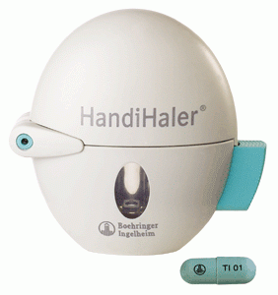
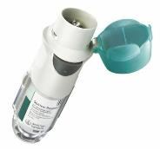
Indikasi
Terapi pemeliharaan pasien dengan PPOK (termasuk bronkitis kronis dan emfisema)
Terapi pemeliharaan sesak nafas
Pencegahan eksaserbasi
Kontraindikasi
Riwayat hipersensitif terhadap atropin atau derivatnya atau komponen lain dalam produk ini
1. Informasi Produk Lokal Spiriva 2015; 2. Informasi Produk Lokal Spiriva Respimat 2016

Slide 33
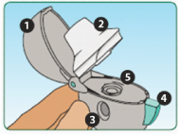
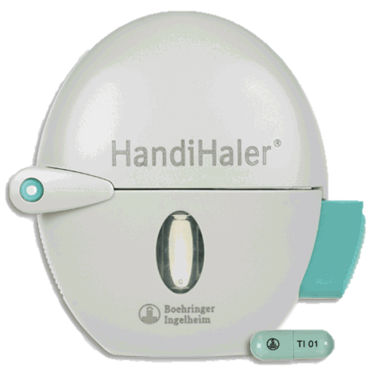
Cara Menggunakan HandiHaler
Mengenal bagian-bagian dari Handihaler
1. Tutup
2. Corong
3. Bagian dasar
4. Tombol hijau
5. Lubang tempat kapsul
4 (empat) langkah menggunakan Handihaler
Buka tutup dan corong Handihaler. Ambil 1 (satu) kapsul SPIRIVA dari blister
Masukkan kapsul SPIRIVA ke dalam lubang tempat kapsul dan tutup kembali corongnya hingga bunyi “klik”.
Tekan tombol hijau sampai rata dan lepaskan kembali.
Buang napas (hembuskan napas) sekuat mungkin. Siapkan mulut pada corong Handihaler dan hirup napas melalui mulut hingga maksimal. Mungkin Anda juga akan merasakan/mendengar adanya butiran halus yang berasal dari kapsul SPIRIVA.
Untuk lebih lengkapnya, harap melihat pada Informasi Produk Lokal SPIRIVA yang terdapat dalam kemasan.
Informasi Produk Lokal Spiriva 2015

Slide 34
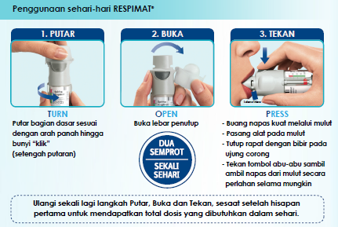
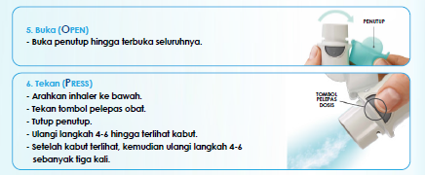
Cara Menggunakan Respimat
1. Informasi Produk Lokal Spiriva Respimat 2016

