Slide 1
GOLD 2017 major revision: Summary of key changes
Respiratory Franchise
ZINC code: GLRESP/COPD/0233
Date of preparation: December 2016

Slide 2
GOLD 2017 includes major revisions in key areas
Key areas of major revision:
Definition of COPD
ABCD assessment tool
Pharmacological management
Focus on inhaler technique
Management of comorbidities
COPD = chronic obstructive pulmonary disease; GOLD = Global Initiative for Chronic Obstructive Lung Disease
GOLD 2017
Notes:
Reference
Global initiative for chronic Obstructive Lung Disease (GOLD 2017). Global strategy for the diagnosis, management, and prevention of chronic obstructive pulmonary disease. Updated 2016. Last accessed 12 December 2016. http://goldcopd.org/gold-reports/

Slide 3
GOLD 2017: Updated COPD definition includes persistent respiratory symptoms
GOLD 2016¹
GOLD 2017²
Chronic Obstructive Pulmonary Disease (COPD), a common preventable and treatable disease, is characterized by persistent airflow limitation that is usually progressive and associated with an enhanced chronic inflammatory response in the airways and the lung to noxious particles or gases
Chronic Obstructive Pulmonary Disease (COPD) is a common, preventable and treatable disease that is characterized by persistent respiratory symptoms and airflow limitation that is due to airway and/or alveolar abnormalities usually caused by significant exposure to noxious particles or gases
COPD = chronic obstructive pulmonary disease; GOLD = Global Initiative for Chronic Obstructive Lung Disease
1. GOLD 2016 2. GOLD 2017
Notes:
References
Global initiative for chronic Obstructive Lung Disease (GOLD 2016). Global strategy for the diagnosis, management, and prevention of chronic obstructive pulmonary disease. Updated 2016. Last accessed 5 February 2016. http://goldcopd.org/gold-reports/
Global initiative for chronic Obstructive Lung Disease (GOLD 2017). Global strategy for the diagnosis, management, and prevention of chronic obstructive pulmonary disease. Updated 2016. Last accessed 12 December 2016. http://goldcopd.org/gold-reports/

Slide 4
GOLD 2017: The changing role of spirometry
Post-bronchodilator spirometry is required for the diagnosis and assessment of COPD
However, assessing the degree of reversibility of airflow limitation (e.g. measuring FEV₁ before and after bronchodilator or corticosteroids) to inform therapeutic decisions is no longer recommended
Spirometry remains key in the diagnosis, prognostication and treatment with non-pharmacological therapies
COPD = chronic obstructive pulmonary disease; FEV₁ = forced expiratory volume in 1 second
GOLD = Global Initiative for Chronic Obstructive Lung Disease
GOLD 2017
Notes:
Reference
Global initiative for chronic Obstructive Lung Disease (GOLD 2017). Global strategy for the diagnosis, management, and prevention of chronic obstructive pulmonary disease. Updated 2016. Last accessed 12 December 2016. http://goldcopd.org/gold-reports/

Slide 5
GOLD 2017: Symptoms and exacerbation risk should be assessed to determine appropriate treatment
Diagnose COPD and determine the severity of airflow limitation (GOLD Grade 1–4) using spirometry
Determine GOLD Group (A–D) and subsequent appropriate pharmacological treatment by assessing symptoms and exacerbation history (including prior hospitalizations)
Spirometrically confirmed diagnosis
Assessment of airflow limitation
Assessment of symptoms/ risk of exacerbations
Exacerbation history
Grade | FEV₁ (% pred.)
1 | ≥80
2 | 50–79
3 | 30–49
4 | <30
>2 or ≥1 leading to hospitalization
C
D
Post-bronchodilator FEV₁/FVC <0.7
0 or 1 (not leading to hospital admission)
A
B
mMRC 0–1
CAT <10
CCQ <1
mMRC 2+
CAT 10+
CCQ 1+
CAT = COPD Assessment Test; CCQ = Clinical COPD Questionnaire; COPD = chronic obstructive pulmonary disease FEV₁ = forced expiratory volume in 1 second; GOLD = Global Initiative for Chronic Obstructive Lung Disease mMRC = modified Medical Research Council
GOLD 2017
Notes:
Reference
Global initiative for chronic Obstructive Lung Disease (GOLD 2017). Global strategy for the diagnosis, management, and prevention of chronic obstructive pulmonary disease. Updated 2016. Last accessed 12 December 2016. http://goldcopd.org/gold-reports/

Slide 6
GOLD 2017: Patient examples using the refined ABCD assessment tool
 | Patient A | Patient B
FEV₁ (% predicted) | <30% | <30%
CAT score | 18 | 18
Exacerbations in the past 12 months | 0 | 3
GOLD 2016 classification | D | D
GOLD 2017 classification¹ | Group B | Group D
Removal of FEV₁ from the risk assessment may result in more patients being classified as GOLD B than when using previous GOLD criteria
More than 50% of patients previously classified as GOLD D (based on airflow limitation alone) may now be classified as GOLD B²
CAT = COPD Assessment Test; FEV₁ = forced expiratory volume in 1 second GOLD = Global Initiative for Chronic Obstructive Lung Disease
1. GOLD 2017 2. Agusti A, et al. Eur Respir J 2013
Notes:
References
Global initiative for chronic Obstructive Lung Disease (GOLD 2017). Global strategy for the diagnosis, management, and prevention of chronic obstructive pulmonary disease. Updated 2016. Last accessed 12 December 2016. http://goldcopd.org/gold-reports/
Agusti A, Hurd S, Jones P, et al. FAQs about the GOLD 2011 assessment proposal of COPD: a comparative analysis of four different cohorts. Eur Respir J 2013;42:1391–401.

Slide 7
The goals of COPD treatment remain unchanged in GOLD 2017
Relieve symptoms
Improve exercise tolerance
Improve health status
Reduce symptoms
Prevent disease progression
Prevent and treat exacerbations
Reduce mortality
Reduce risk
COPD = chronic obstructive pulmonary disease; GOLD = Global Initiative for Chronic Obstructive Lung Disease
GOLD 2017
Notes:
Reference
Global initiative for chronic Obstructive Lung Disease (GOLD 2017). Global strategy for the diagnosis, management, and prevention of chronic obstructive pulmonary disease. Updated 2016. Last accessed 12 December 2016. http://goldcopd.org/gold-reports/

Slide 8
GOLD 2017: therapeutic recommendations by GOLD Group
Group C
Group D
Consider roflumilast if FEV₁ <50% pred. and patient has chronic bronchitis
LAMA + LABA
LABA + ICS
Consider macrolide
Further
exacerbation(s)
Further
exacerbation(s)
LAMA + LABA + ICS
Persistent
symptoms/further
exacerbations
Further
exacerbation(s)
LAMA
LAMA
LAMA + LABA
LABA + ICS
Group A
Group B
Continue, stop or
try alternative class
of bronchodilator
LAMA + LABA
Evaluate
effect
Persistent
symptoms
A long-acting bronchodilator
(LABA or LAMA)
A bronchodilator
FEV₁ = forced expiratory volume in 1 second; GOLD = Global Initiative for Chronic Obstructive Lung Disease ICS = inhaled corticosteroid; LABA = long-acting β₂-agonist; LAMA = long-acting muscarinic antagonist
GOLD 2017
Notes:
Reference
Global initiative for chronic Obstructive Lung Disease (GOLD 2017). Global strategy for the diagnosis, management, and prevention of chronic obstructive pulmonary disease. Updated 2016. Last accessed 12 December 2016. http://goldcopd.org/gold-reports/

Slide 9
GOLD 2017: Group A patients should be offered either a short- or long-acting bronchodilator
A bronchodilator
Evaluate effect
Continue, stop or try alternative class of bronchodilator
Bronchodilator treatment should be continued if symptom benefit is seen
GOLD = Global initiative for chronic Obstructive Lung Disease
GOLD 2017
Notes:
Reference
Global initiative for chronic Obstructive Lung Disease (GOLD 2017). Global strategy for the diagnosis, management, and prevention of chronic obstructive pulmonary disease. Updated 2016. Last accessed 12 December 2016. http://goldcopd.org/gold-reports/

Slide 10
GOLD 2017: Group B patients with persistent symptoms should be stepped up to a LABA/LAMA
LABA or LAMA
Persistent symptoms
LABA + LAMA
Bronchodilator selection (LABA vs LAMA) in patients with less severe symptoms should depend on the patient’s perception of symptom relief
Patients with persistent symptoms may be stepped up to LABA/LAMA
Patients with severe breathlessness may be started on dual bronchodilation
More than 50% of GOLD B patients have CAT scores >20 (high symptom burden),² and therefore should receive LABA/LAMA as initial therapy, or be stepped up from monotherapy
CAT = COPD Assessment Test; GOLD = Global initiative for chronic Obstructive Lung Disease LABA = long-acting β₂-agonist; LAMA = long-acting muscarinic antagonist
1. GOLD 2017; 2. Adelphi Respiratory Disease Specific Programme 2016
Notes:
Reference
Global initiative for chronic Obstructive Lung Disease (GOLD 2017). Global strategy for the diagnosis, management, and prevention of chronic obstructive pulmonary disease. Updated 2016. Last accessed 12 December 2016. http://goldcopd.org/gold-reports/
Adelphi Respiratory Disease Specific Programme. 2016. [COPD patient data file], Bollington, UK. Unpublished raw data.

Slide 11
GOLD 2017: ICS is no longer the preferred choice for patients in GOLD Group C
LAMA
Preferred choice for persistent exacerbations
Alternative
LABA + LAMA
LABA + ICS
Patients with persistent exacerbations may benefit from addition of LABA or a combination of LABA/ICS¹
LAMA/LABA is the preferred choice due to pneumonia risk associated with ICS¹
There is also no evidence to suggest superiority of LABA/ICS over LABA/LAMA²
Triple therapy is not recommended¹
GOLD = Global initiative for chronic Obstructive Lung Disease; ICS = inhaled corticosteroid LABA = long-acting β₂-agonist; LAMA = long-acting muscarinic antagonist
1. GOLD 2017 2.Wedzicha JA, et al. N Engl J Med 2016
Notes:
References
Global initiative for chronic Obstructive Lung Disease (GOLD 2017). Global strategy for the diagnosis, management, and prevention of chronic obstructive pulmonary disease. Updated 2016. Last accessed 12 December 2016. http://goldcopd.org/gold-reports/
Wedzicha JA, Banerji D, Chapman KR, et al. Indacaterol-glycopyrronium versus salmeterol-fluticasone for COPD. N Engl J Med 2016;374:2222–34.

Slide 12
GOLD 2017: Dual bronchodilation is the preferred initial therapy for patients in Group D
LAMA superior to LABA if single substance selected
Option for initial therapy in patients with possible ACOS
Recommended initial therapy
LAMA
LAMA + LABA
LABA + ICS
Further exacerbation(s)/ persistent symptoms
Further exacerbation(s)
LABA + LAMA + ICS
Further exacerbation(s)
Consider roflumilast if FEV₁ <50% predicted and patient has chronic bronchitis
Consider macrolide
ACOS = asthma-COPD overlap syndrome; FEV₁ = forced expiratory volume in 1 second GOLD = Global initiative for chronic Obstructive Lung Disease ICS = inhaled corticosteroid LABA = long-acting β₂-agonist; LAMA = long-acting muscarinic antagonist
GOLD 2017
Notes:
References
Global initiative for chronic Obstructive Lung Disease (GOLD 2017). Global strategy for the diagnosis, management, and prevention of chronic obstructive pulmonary disease. Updated 2016. Last accessed 12 December 2016. http://goldcopd.org/gold-reports/

Slide 13
GOLD 2017: Dual bronchodilation is the preferred initial therapy for patients in Group D
GOLD recommends LABA/LAMA as primary-choice treatment for Group D patients¹
LABA/LAMA has demonstrated superiority versus bronchodilator monotherapy and LABA/ICS in exacerbation prevention^{2,3}
LABA/ICS may be first choice in patients with a history of and/or features suggestive of asthma-COPD overlap¹
Treatment should be escalated to triple therapy in patients who experience further exacerbations despite treatment with LABA/LAMA or LABA/ICS¹
There is currently no evidence to support the efficacy of triple vs LABA/LAMA
If further exacerbations develop despite treatment with triple therapy, the addition of a macrolide or roflumilast may be considered¹
GOLD also suggest the withdrawal of ICS if exacerbations persist on triple therapy
FEV₁ = forced expiratory volume in 1 second GOLD = Global initiative for chronic Obstructive Lung Disease; ICS = inhaled corticosteroid LABA = long-acting β₂-agonist; LAMA = long-acting muscarinic antagonist
1. GOLD 2017
2. Wedzicha JA, et al. Lancet Respir Med 2013 3. Wedzicha JA, et al. N Engl J Med 2016
Notes:
References
Global initiative for chronic Obstructive Lung Disease (GOLD 2017). Global strategy for the diagnosis, management, and prevention of chronic obstructive pulmonary disease. Updated 2016. Last accessed 12 December 2016. http://goldcopd.org/gold-reports/
Wedzicha JA, Decramer M, Ficker JH, et al. Analysis of chronic obstructive pulmonary disease exacerbations with the dual bronchodilator QVA149 compared with glycopyrronium and tiotropium (SPARK): a randomised, double-blind, parallel-group study. Lancet Respir Med 2013;1:199–209.
Wedzicha JA, Banerji D, Chapman KR, et al. Indacaterol-glycopyrronium versus salmeterol-fluticasone for COPD. N Engl J Med 2016;374:2222–34.

Slide 14
GOLD 2017 emphasizes the importance of proper inhaler technique
Inhaler technique should be assessed regularly
Determinants of poor inhaler technique in asthma and COPD patients include:
Older age
Use of multiple devices
Lack of previous education on inhaler technique
Providing patients with quality education regarding proper inhaler technique is important
COPD = chronic obstructive pulmonary disease; GOLD = Global initiative for chronic Obstructive Lung Disease
GOLD 2017
Notes:
Reference
Global initiative for chronic Obstructive Lung Disease (GOLD 2017). Global strategy for the diagnosis, management, and prevention of chronic obstructive pulmonary disease. Updated 2016. Last accessed 12 December 2016. http://goldcopd.org/gold-reports/

Slide 15
GOLD 2017: Identifying and treating comorbidities is important in patients with COPD
COPD often coexists with other diseases that may have a significant impact on health status and prognosis
Cardiovascular disease is a major comorbidity in COPD
Probably the most frequent and most important comorbid disease
Other common comorbidities include skeletal muscle dysfunction, metabolic syndrome, osteoporosis, depression, anxiety and lung cancer
Comorbidities should be actively sought and treated appropriately
COPD = chronic obstructive pulmonary disease; GOLD = Global initiative for chronic Obstructive Lung Disease
GOLD 2017
Notes:
Reference
Global initiative for chronic Obstructive Lung Disease (GOLD 2017). Global strategy for the diagnosis, management, and prevention of chronic obstructive pulmonary disease. Updated 2016. Last accessed 12 December 2016. http://goldcopd.org/gold-reports/

Slide 16
Summary: GOLD 2017 includes major revisions in key areas
Definition of COPD
Refined to place more emphasis on symptoms and comorbidities
ABCD assessment tool
Refined to assess both symptom level and risk of future exacerbations following the revised role of spirometry in COPD
Pharmacological management
Pharmacological algorithms added
Dual bronchodilation recommended as a first-line therapy for a majority of symptomatic patients
ICS therapy only recommended in a minority of patients as an alternative to preferred LABA/LAMA treatment
Focus on inhaler technique
Emphasizes the importance of patient education
Management of comorbidities
Emphasizes the importance of identifying and treating comorbidities
COPD = chronic obstructive pulmonary disease; GOLD = Global Initiative for Chronic Obstructive Lung Disease
LABA = long-acting β₂-agonist; LAMA = long-acting muscarinic antagonist
GOLD 2017
Notes:
Reference
Global initiative for chronic Obstructive Lung Disease (GOLD 2017). Global strategy for the diagnosis, management, and prevention of chronic obstructive pulmonary disease. Updated 2016. Last accessed 12 December 2016. http://goldcopd.org/gold-reports/

Slide 17
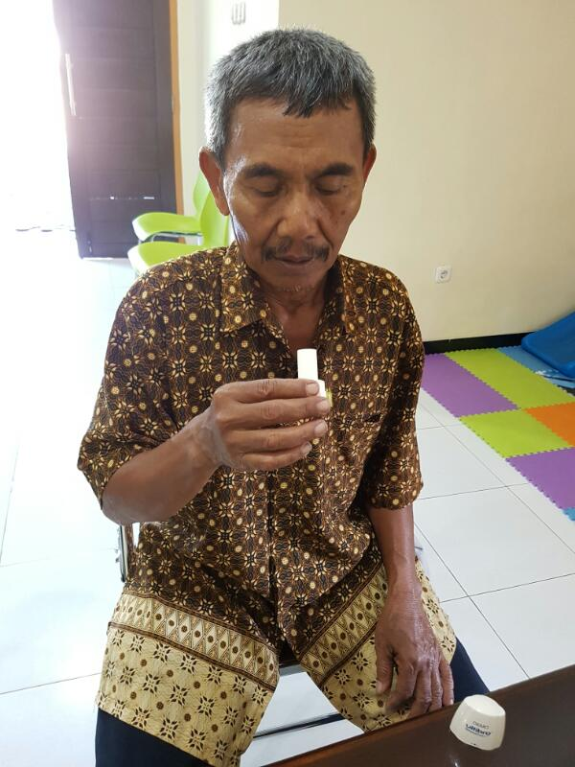
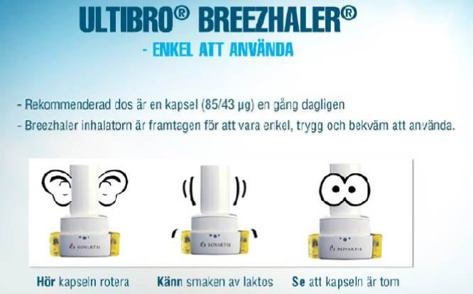
TERIMA KASIH

