Slide 1
EGFR Mutation in Lung Adenocarcinoma (ADC)
Ana Rima

Slide 2
Lung Cancer: Incidence and Mortality
Advanced Non-Small-Cell Lung Cancer: Optimizing the Care of Veterans
clinicaloptions.com/oncology
New cases in 2013: 228,190
40% with stage IV disease at presentation (~ 90,000)
~ 160,000 deaths in 2012, comparable to prostate, pancreas, breast, and colon cancer combined
5-yr relative survival rate: 3.7% for patients with distant-stage disease
Estimated Cancer Deaths by Site, 2012
180,000
160,000
140,000
Prostate
120,000
Pancreas
100,000
80,000
Lung cancer
Breast
60,000
40,000
20,000
Colon
0
Other Cancers
Lung Cancer
NCI. Non-small-cell lung cancer treatment (PDQ®). ACS. Cancer facts & figures: 2012. CDC. Lung cancer rates by race and ethnicity. Howlader N, et al. SEER cancer statistics review.
Notes:
NCI. Non-small-cell lung cancer treatment (PDQ®). http://www.cancer.gov/cancertopics/pdq/treatment/non-small-cell-lung/healthprofessional/page1. Accessed March 15, 2013.
ACS. Cancer facts & figures: 2012. CDC. Lung cancer rates by race and ethnicity. Available at http://www.cancer.org/acs/groups/content/@epidemiologysurveilance/documents/document/acspc-031941.pdf. Accessed March 15, 2013.
Howlader N, et al. SEER cancer statistics review. Available at: http://seer.cancer.gov/csr/1975_2009_pops09. Accessed March 15, 2013.

Slide 3
Pembagian pasien kanker paru berdasarkan stadium di bangsal paru RSDM
Th 2014 terdiagnosis 118 px;
;Th 2015 terdiagnosis 211 px
Hesti, RSDM 2016

Slide 4
Jenis Ca Paru RSDM 2015 (n=211)

Slide 5
EGFR TKI (Erlotinib Gefitinib,, afatinib, Osimertinib)
PFS > lama, ES <
Angiogenesis ALK
Ab monoklonal menghambat VEGF
(bevacizumab)
Targeted therapy
rearrangements ALK
(crizotinib)
Ab monoklonal menghambat EGFR
(cetuximab)

Slide 6
Mengatur fungsi sel :
Proliferasi, diferensiasi, sinyal anti apoptosis dan neurite
TYROSINE KINASE
Enzim katalisis fosforilase residu tirosin
Aktivasi TK tidak teregulasi
Mutasi
Over ekspresi
TYROSINE KINASE INHIBITOR
KANKER
Blokir ikatan ATP
Blokir reseptor TK ekstraseluler
Molekul kecil
Antibodi monoklonal

Slide 7
Epidermal Growth Factor Receptor (EGFR)
Tyrosine Kinase inhibitor (Erlotinib)

Slide 8
multidisciplinary team
EGFR MUTATION TESTING

Slide 9
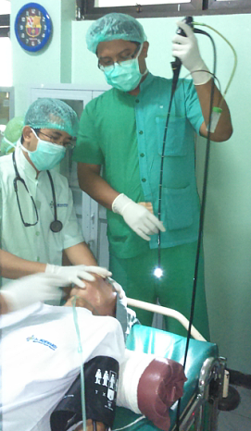
EGFR mutation testing is a multi-step process and involves several key stakeholders
Surgeon/ pulmonologist/ radiologist
pulmonologist
Molecular pathologist/ molecular biologist
Pathologist
EGFR mutation test request &
treatment decision
Histological diagnosis & review of sample to determine suitability for EGFR mutation testing
Tissue sample handling & EGFR mutation test
Tissue sample acquisition
Communication and collaboration across multidisciplinary teams is essential

Slide 10
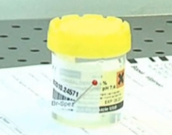
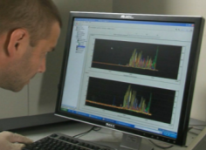
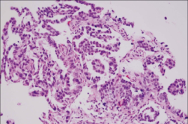
Treatment decisions should be made within 7–10 working days of testing request
Start
Patient
Treating pulmonologist
Therapeutic decision
7–10 days
Specimen collection
Turn Around Time (TAT)
Results
Tumour sample
Molecular diagnosis
Histological diagnosis

Slide 11
Quality and Quantity of Samples
Quality
Quantity
200–400 cells are required¹ (unlike histological techniques [e.g. IHC] which require fewer cells)
Depending on the type of test, samples with a minimum of 150 cells can be processed, although reliable results are usually obtained from samples with 300–1,000 cells²
Samples must contain undamaged tumour cells to allow DNA extraction
1. Pirker, et al. J Thorac Oncol 2010 2. Garrido, et al. Clin Transl Oncol 2012
Lindeman et al., 2013. Arch Pathol Lab Med

Slide 12
Mutation Frequency of EGFR in Adenocarcinoma
Identifying patients with EGFR mutation positive disease is essential to guide treatment decisions
EGFR Mut+ NSCLC
EGFR WT NSCLC
Caucasian
≈10%
≈90%
Asian
≈30%
≈70%
WT = wild-type
Approximately 30% of Asians have EGFR mutation positive disease

Slide 13
EGFR Mutations in NSCLC
N = 569 | Exon 18 | Exon 19 | Exon 20 | Exon 21
Frequency | 3.2 % | 48.2 % | 3.7 % | 42.7 %
Response Rate | 56 % (G719X) | 81% | 0 % | 71%
Yamamoto H, et al. Lung Cancer. 2009;63(3):315-321.

Slide 16
Mutasi EGFR pada Adenocarcinoma
RSDM th 2015
Dikirim ke Lab 132, sebanyak 5 sampel tidak bisa dianalisis krn jumlah sel kurang.(n=127)
Hesti, RSDM 2016

Slide 17
Adeno Ca Mutasi EGFR (+) n= 127
Hesti, RSDM 2016

Slide 18
BEST PRACTICE
CLINICAL EFFICACY ERLOTINIB

Slide 19
First-line Treatment With EGFR TKIs vs Chemotherapy in EGFR-Mutated Patients
Study | Treatment | N | Median PFS, Mos | Median OS, Mos
Maemondo^{[1]} | Gefitinib vs carboplatin/ paclitaxel | 230 | 10.8 vs 5.4 (P < .001) | 30.5 vs 23.6 (P = .31)
Mitsudomi^{[2,3]} | Gefitinib vs cisplatin/ docetaxel | 177 | 9.2 vs 6.3 (P < .0001) | 36 vs 39 (HR: 1.19)
OPTIMAL^{[4,5]} | Erlotinib vs carboplatin/ gemcitabine | 165 | 13.1 vs 4.6 (P < .0001) | HR: 1.065 (P = .65)
EURTAC^{[6]} | Erlotinib vs platinum-based chemotherapy | 174 | 9.7 vs 5.2 (P < .0001) | 19.3 vs 19.5 (P = .87)
LUX-Lung 3^{[7]} | Afatanib vs CDDP/pemetrexed | 345 | 11.1 vs 6.9 (P = .001) | Not reported
1. Maemondo M, et al. N Engl J Med. 2010;362:2380-2388. 2. Mitsudomi T, et al. Lancet Oncol. 2010;11:121-128. 3. Mitsudomi T, et a. ASCO 2012. Abstract 7521. 4. Zhou C, et al. Lancet Oncol. 2011;12:735-742. 5. Zhang C, et al. ASCO 2012. Abstract 7520. 6. Rosell R, et al. Lancet Oncol. 2012;13:239-246. 7. Sequist LV, et al. J Clin Oncol. 2013. [epub ahead of print].
Notes:
EGFR, epidermal growth-factor receptor; OS, overall survival; PFS, progression-free survival; TKI, tyrosine kinase inhibitor
19

Slide 20
Erlotinib Show Significant PFS Compare with others TKI
Benefit PFS >1 Year
Probabilitas PFS
Erlotinib^{6–8}
Gefitinib^{1–5}
Afatinib^{9,11}
Kemoterapi^{1–11}
Referensi: . 1.Zhou, C., Wu, Y. & Chen, G. (2011). Erlotinib versus chemotherapy as first-line treatment for patients with advanced EGFR mutation-positive non-small-cell lung cancer (OPTIMAL, CTONG-0802): a multicentre, open-label, randomised, phase 3 study. Lancet Oncol 12: 735-742. doi: 10.1016/S1470-2045(11)70184-X 2. Rosell, R., Carcereny, E. & Gervais, R. (2012). Erlotinib versus standard chemotherapy as first-line treatment for European patients with advanced EGFR mutation-positive non-small-cell lung cancer (EURTAC): a multicentre, open-label, randomised phase 3 trial. Lancet Oncol 13: 239-246. doi: 10.1016/S1470-2045(11)70393-X; 3. Chen, X., Liu, Y. & Roe, O. (2013). Gefitinib or Erlotinib as Maintenance Therapy in Patients with Advanced Stage Non-Small Cell Lung Cancer: A Systematic Review. PLoS ONE 8(3): e59314. doi:10.1371/journal.pone.0059314; 4. Gefitinib Summary of Product. (2010). Retrieved from http://www.medicines.org.uk/emc/medicine/22104/SPC/ (on April 25, 2016); 4. Han, J., Park, K. & Kim, S. (2012). First-SIGNAL: First-Line Single-Agent Iressa Versus Gemcitabine and Cisplatin Trial in Never-Smokers With Adenocarcinoma of the Lung. Journal of Clinical Oncology 30:1122-1128. doi: 10.1200/JCO.2011.36.8456; 5. Mitsudomi, T. Morita, S. & Yatabe, Y. (2010). Gefi tinib versus cisplatin plus docetaxel in patients with non-small-cell lung cancer harbouring mutations of the epidermal growth factor receptor (WJTOG3405): an open label, randomised phase 3 trial. Lancet Oncol 11-121-128. doi: 10.1016/S1470-2045(09)70364-X; 6. Maemondo, M., Inoue, A. & Kobayashi, K. (2010). Gefitinib or Chemotherapy for Non–Small-Cell Lung Cancer with Mutated EGFR. Nejm 362:2380-2388. retrieved from nejm.org (On 23rd of May 2016); 7. Sequist, L., Yang, J. & Yamamoto, N. (2013). 8. Phase III Study of Afatinib or Cisplatin Plus Pemetrexed in Patients With Metastatic Lung Adenocarcinoma With EGFR Mutations. JCO 31: 332703334. doi: 8.1200/JCO.2012.44.2806. Wu, Y., Zhou, C. & Hu, C. (2014). Afatinib versus cisplatin plus gemcitabine for first-line treatment of Asian patients with advanced non-small-cell lung cancer harbouring EGFR mutations: an open-label, randomised phase 3 trial. Lancet Oncol 15:213-222. doi: 10.1016/S1470-2045(13)70604-1. 9.Wu, et al (Lux lung 3) Lancet Oncol 2014; 10.Yang, et al (Lux lung 6). Lancet Oncol 2015; 11. Park, et al Afatinib versus gefitinib as first-line treatment of patients with EGFR mutation-positive non-small-cell lung cancer (LUX-Lung 7): a phase 2B, open-label, randomised controlled trial. Lancet omcol 2016

Slide 21
Erlotinib PFS (Optimal Study)
Tarceva (n=82)
Chemotherapy (n=72)
ORR = 83%
HR=0,16 (0,10–0,26)
Log-rank p<0,0001
84%
Mengurangi Risiko Pemburukan

Slide 22
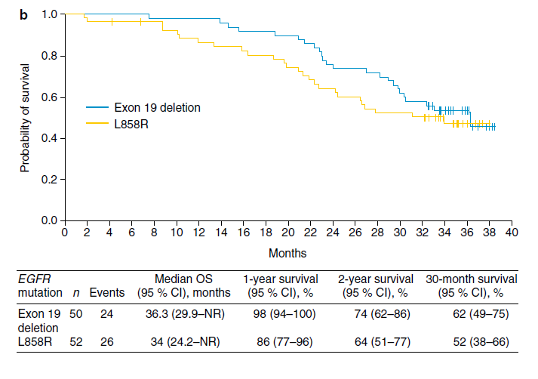
Erlotinib OS (JO22903 Study)
Yamamoto, et al., “Int J Clin Oncol“, 2017

Slide 23
Px laki2, 53 th, smoker, Adeno Ca paru kiri, T4N3M1 st 4
16 september 2016
18 oktober 2016

Slide 24
Msct, Bronkoskopi, sitologi cairan pleura
24 Okt 16
1 Nop 2016
FNAB Lnn supra clavicula dan sikatan bronkus:
Adeno Carcinoma
28 Nop 16
EGFR : Del exon 19

Slide 25
30 Jan 2017 (2 bl terapi)
Tarceva 150 mg 1 Des 16

Slide 26
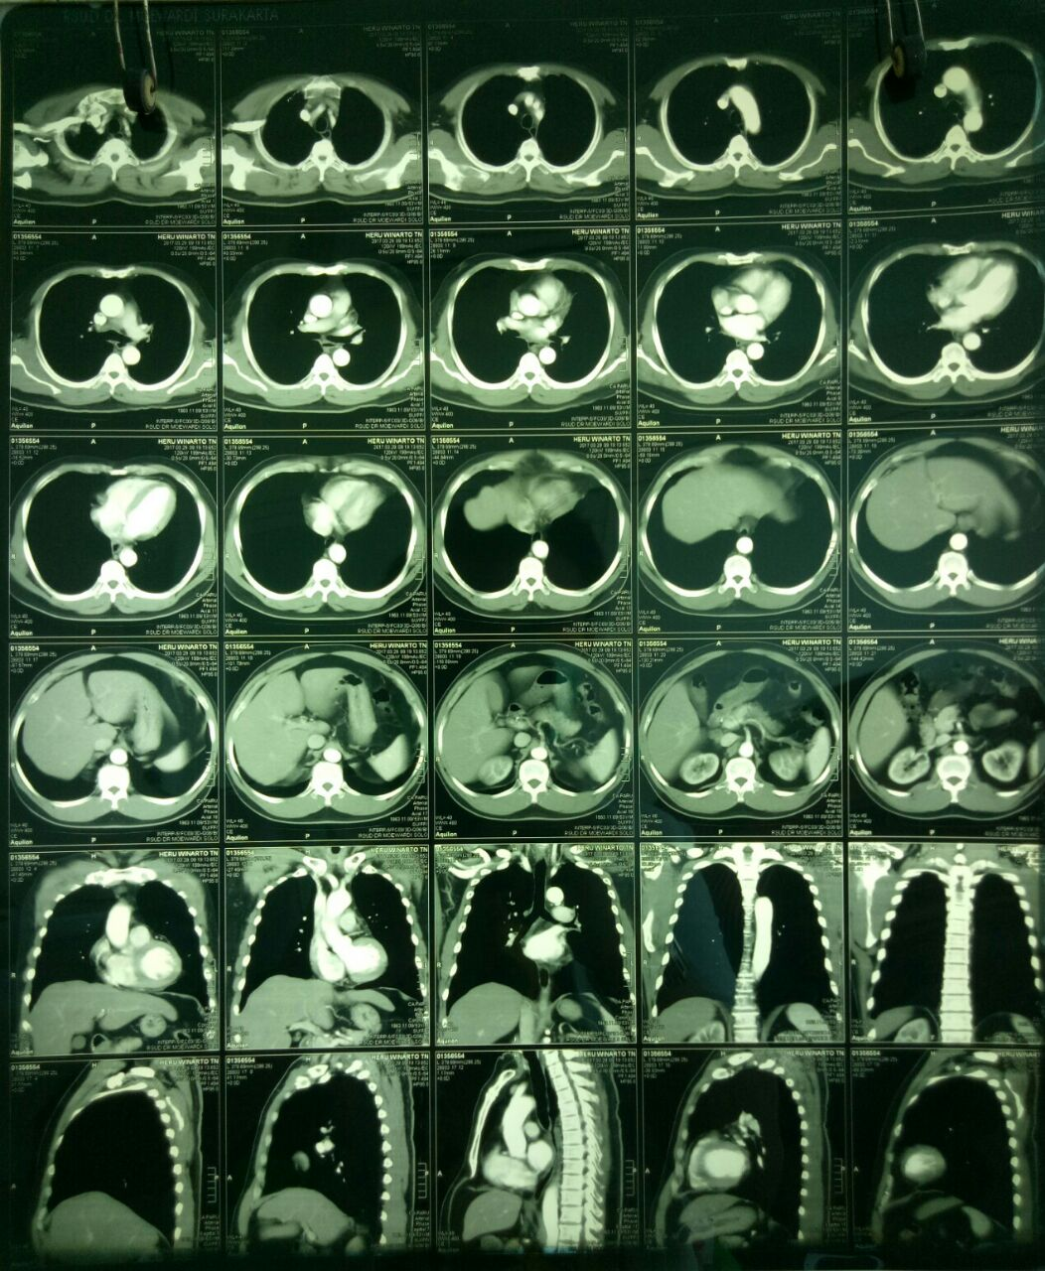
Msct scan setelah tx Tarceva 4 bln
24 Okt 16 (sebelum tx)
29 Maret 17

Slide 27
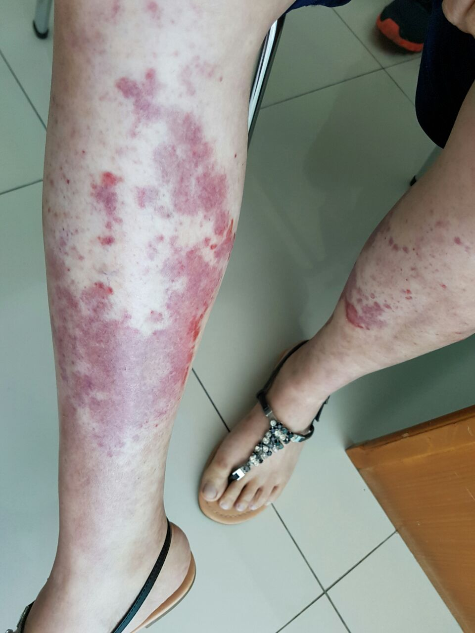
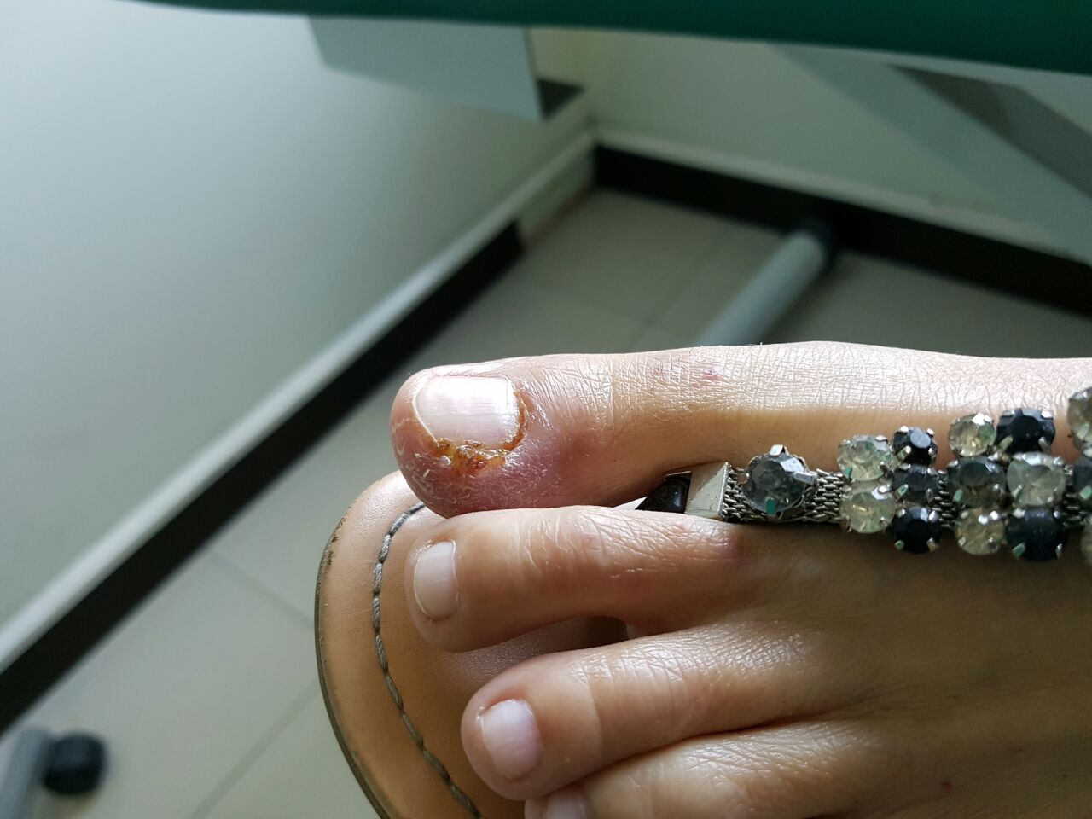
Efek samping

Slide 28
Take Home Message
NSCLC stage IV, quality of life is the first priority.
Adenocarcinoma ( non Squamous ) should be test for EGFR mutation.
TKI for Non Squamous Cell Adenocarcinoma with EGFR Mut+ ,first line treatment : Erlotinib (Tarceva)

Slide 29
Thank You

